Slide 1
I-branding in an emerging market: An exploratory study for e-commerce enterprises in China
6th International Consumer Brand Relationship Conference
19 - 21 May, 2019, Cancun, Mexico
Xinyi Wang, François Colbert
Carmelle and Rémi Marcoux Chair in Arts Management
Department of Marketing
HEC Montreal, Montreal, Canada

Slide 2
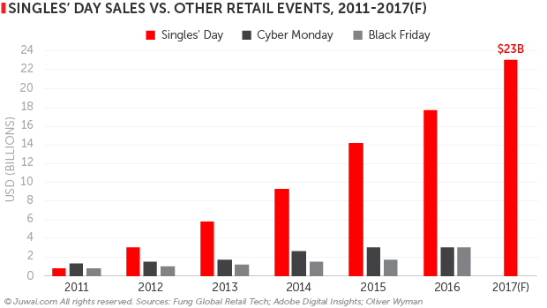
Introduction
Background
I-branding as a main branding tool especially embraced by small-and-medium-sized enterprises.
Multiple online platforms are comprehensively used for i-branding.
Research objective
Examine the i-branding framework in the powerful Chinese e-commerce market, providing more insights to the researchers and SME managers.

Slide 3
Literature background
Branding remains a key means of making a firm stand out in the intensely competitive online environment (Brynjolfsson & Smith, 2000).
I-branding is branding via the Internet.
Interchangeable terms: Internet branding, online branding, e-branding (Barreda, Bilgihan, Nusair, & Okumus, 2016; Hanna & Rowley, 2015).
Simmons (2007) proposes a formative i-branding framework illustrating the four pillars working together to drive successful i-branding:
Understanding customers
Marketing communications
Interactivity
Content
Manage i-branding to create customer-based brand equity (Simmons et al. 2010)

Slide 4
Research questions and conceptual framework
I-branding in China: platform integration
How do Chinese e-commerce enterprises integrate multiple online platforms for i-branding?
How does the platform integration positively and negatively influence the customer-based brand equity?
How does the platform integration influence the i-branding framework?
Managing i-branding
Understanding customers
Interactivity
Content
Marketing communication
Customer-based
brand equity
Brand image
Brand loyalty
Platform integration

Slide 5
Methodology
Qualitative method: Case study of online Hanfu SMEs
Hanfu SMEs as the context
Product characteristics
Small-and medium sized
Author’s expertise
Case familiarity
Information integration
Enterprises characteristics
Practical function
Symbolic meaning
Online channel dependence
Interviewer qualification
Research design
Data source triangulation
Content analysis of websites and apps (n=271)
Bilateral in-depth interviews (n=20)
Observation at physical stores or studios
Secondary data analysis
Data analysis
Websites: checklist and key informants
Interview: inductive coding to build data structure

Slide 6
Findings
The mechanism of platform integration for i-branding
Taobao/Tmall, Weibo, Wechat, QQ, Lofter…
Understanding customers
Marketing communications
Internal chatting group
Comments/reposts
Customer data
Information and pictures
online customer service
search and template design
Interactivity
Content

Slide 7
Findings
Negative influence
Easy access to customer data collection
Highly-improved interactivity
Better-designed and implemented loyalty programs
Effectiveness of marketing communication
Content unification
Vague brand image
Positive influence
The weight of attention to the 4 pillars for i-branding
Understanding customers
Marketing communication
Interactivity
Content

Slide 8
Managerial implications and discussion
Using Taobao vs building independent websites
Legitimacy vs distinctiveness
Level of innovation
Limitations and future research
Multiple contexts for generalizing the findings
Author’s passion: double-edged sword
Q & A

