Slide 1
Consumer Engagement with Chatbots for Consumer-Brand Relationship
2
+
2
+
Sunny Tsai, Yu Liu, & Ching-Hua Chuan

Slide 2
2
+
CHATBOTS
Chatbots will handle 85 percent of customer-service interactions in the next 5 years (Press, 2017)
Chatbots boost perceived website interactivity and improve consumer satisfaction (Heo & Lee, 2018; Sundar et al., 2016)
Experiential vs. utilitarian motives impact chatbot effectiveness (Sivaramakrishnan et al., 2007)
How about chatbots for CBR?
How about chatbot design and communication strategies?

Slide 3
Social presence
2
+
The ability of communicators to project themselves socially and emotionally, as ‘real’ people (i.e., their full personality) in mediated communications (Garrison et al., 2000).
Drives interpersonal effects in computer-mediated communication
Computers as social actors (CASA)
In HCI: “Being with an intelligent being” (Kim & Sundar, 2012)
Rourke el al.’s (1999) communicative strategies:
Affective: emoticons, humor, self-disclosure
Interactive: recognizing interaction partners
Cohesive: salutations, vocatives

Slide 4
anthropomorphism
2
+
Anthropomorphism of brands
Computers as social actors (CASA)
Human-like attributes (human name, gender, gendered voice, humor, personality)
Website interface with anthropomorphic cues were perceived as “personal, sociable, and likeable”

Slide 5
dialogue
2
+
2
+
Chatbots for cbr
Parasocial interaction (PSI)
Perceived interpersonal involvement in one-on-one interactive chats
Message contingency: back-and-forth, synchronous, interconnected conversation thread (Sundar and Kim, 2005)

Slide 6
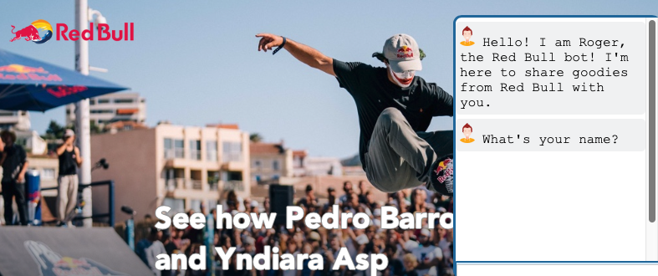
methods
2
+
A 2 (high vs. low social presence) by 2 (anthropomorphic vs. non-anthropomorphic bot) between-subject design
An AI-powered chatbot for Red Bull was programmed using JavaScript and Dialogflow
Main study: 155 respondents recruited via Mturk
Outcome variables: user engagement, interaction satisfaction, and organization-public relationship (Hon & Grunig, 1999)

Slide 7
Results
2
+
Social presence significantly affected PSI and dialogue.
Anthropomorphic cues did NOT affect PSI and dialogue.
No interaction effects. The post-hoc analyses revealed when the chatbot had an anthropomorphic profile, high social presence communication boosted PSI, but not perceived dialogue.
Anthropomorphism moderated the indirect effects of social presence on outcomes via PSI and dialogue. Only with anthropomorphic bots, social presence and dialogue indirectly influenced outcomes through PSI.

