Slide 1
Which Corporate Social Responsibility Activity has the Greatest Impact on Consumers and Investors? An Event Study Approach
Samuel Stäbler Assistant Professor of Marketing Tilburg University
International Consumer Brand Relationship Conference

Slide 2
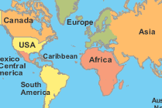
COMPANIES CAN BE INVOLVED IN A WIDE RANGE OF VERY DIFFERENT CSR ACTIVITIES
Short-term activity
or Long-term activity
Reactive activity
or Proactive activity
Home country activity
or Foreign country activity
Environment-related activity or Employee-related activity or
Society-related activity
Research Question: Which CSR activity has the greatest impact on consumers and investors?

Slide 3
EXEMPLARY RESEARCH ON THE CONSEQUENCES OF CSR ACTIVITIES
Author | Outcome variables |  | Focal moderation | Empirical design
 | Consumer-related (e.g., attitude) | Finance-related (e.g., stock return) | Types of CSR
Brown & Dacin 1997 | ✔ | X | X | Experimental
Kennedy, Ferrell, & LeClair 2001 | ✔ | X | X | Experimental
Sen & Bhattacharya 2001 | ✔ | X | X | Experimental
Madrigal & Boush 2008 | ✔ | X | X | Experimental
Olsen, Slotegraaf, & Chandukala 2014 | ✔ | X | X | Observational
Hildebrand, Demotta, Sen, & Valenzuela 2017 | ✔ | X | ✔ | Experimental
Wright, Ferris, Hiller, & Kroll 1995 | X | ✔ | X | Observational
Muller & Kräussl 2011 | X | ✔ | X | Observational
Groening & Kanuri 2013 | X | ✔ | ✔ | Observational
Flammer 2013 | X | ✔ | X | Observational
This study | ✔ | ✔ | ✔ | Observational

Slide 4
CONCEPTUAL FRAMEWORK
CSR characteristics
CSR type I: Time horizon
CSR type II: Target groups
CSR type III: Action type
CSR type IV: Region
Media presence
Performance measures
Consumer Brand Perception
Impression
Quality
Value
Controls variables
Prior brand reputation
Product type
Operating margins
Financial leverage
Market value of equity
Reputation
Satisfaction
Recommend
CSR activities
Shareholder Perception
Stock Return

Slide 5
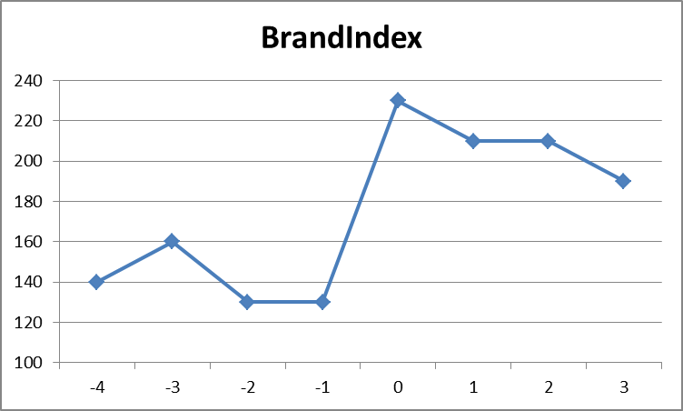
DATA AND METHODOLOGY
Overview of the data
Event study methodology
CSR activities identified through media analysis
Time Frame | 01.2008 – 03.2015
Brands analyzed | 500
Newspapers analyzed | 8
Country | Germany
Brand Perception or Stock Return
CSR Activity
Number of CSR events in sample
Total CSR events | 298
Confounding events | 115
Industries | 12
Final events in dataset | 183
Final brands in dataset | 77
Brand Perception (weekly)
Estimation window: 20 weeks
Event window: 1 week
Constant-mean-return model (Stationarity: Dickey Fuller test statistic = 14.823)
Brand perception data received from YouGov
- Weekly data based on 600 respondents per brand
- Ranges from 100 (negative) to 300 (positive)
- Data from pos/neg responses to 6 questions
- Overall brand perception combines 6 variables (e.g., impression, quality perception, etc.)
Stock Price Data (daily)
Estimation window: 200 days
Event window: max 3 days
Market-model

Slide 6
MAIN IMPACT OF CSR ACTIVITIES ON BRAN PERCEPTION AND STOCK RETURN
Positive impact on consumer perception
Positive impact on stock return
 | DV: Abnormal brand perception returns in percentage
 | w
(weeks) |  | ${AAR}_{w}^{BI}$ (SE)
 | -1 | -.18 |  |  | (.10)
 | 0 | .21 |  | ** | (.10)
 | 1 | .00 |  |  | (.09)
 | Notes: ** p < .05, *** p < .01 (one-sided); OLS(t-test); Standard errors in parentheses in percentage; N(events) = 183.
DV: Abnormal stock price returns in percentage
d (days) | ${AAR}_{d}^{SM}$ | CAARSM[-3,3] (SE)
-3 | .31 | .31 |  | (.37)
-2 | .00 | .31 |  | (.37)
-1 | .06 | .37 |  | (.37)
0 | .50 | .87 | ** | (.38)
1 | .29 | 1.16 | *** | (.38)
2 | -.15 | 1.00 | *** | (.38)
3 | -.29 | .71 |  | (.38)
Notes: ** p < .05, *** p < .01 (one-sided); OLS(t-test); standard errors in parentheses in percentage; N(events) = 36.

Slide 7
DRIVERS OF THE POSITIVE IMPACT ON BRAND PERCEPTION METRICS AND STOCK RETURN
DV 1: Abnormal brand perception returns in event week 0 DV 2: Cumulative abnormal average stock returns day -3 to day 1 |  |  |  |  |  |  | Model I (Brand Perception) |  |  |  |  |  | Model II (Stock Return)
 |  |  | Scale | Expected sign |  |  | Estimated Coefficient |  |  |  |  | (SE) | Estimated Coefficient |  | (SE)
Intercept |  |  |  |  |  | -.028 |  | *** |  | (.006) |  |  | -.059 |  | (.084)
CSR characteristics
CSR type I: |  | Short-term activity (base) |  |  |  |  | - |  |  | -
(Time horizon) |  | Long-term activity | [dummy] |  | + |  | .005 | ** |  | (.002) |  |  | -.029 |  | (.020)
CSR type II: |  | Employees (base) |  |  |  |  | - |  |  | -
(Target group) |  | Environmental | [dummy] |  | + / - |  | .008 | * |  | (.005) |  |  | -.014 |  | (.048)
 |  | Consumers | [dummy] |  | + / - |  | .006 |  |  | (.006) |  |  | -.023 |  | (.054)
 |  | Society | [dummy] |  | + / - |  | .009 | * |  | (.005) |  |  | -.057 |  | (.048)
CSR type III: |  | Reactive activity (base) |  |  |  |  | - |  |  | -
(Action type) |  | Proactive activity | [dummy] |  | + |  | .008 | ** |  | (.004) |  |  | .037 |  | (.037)
CSR type IV: |  | No specific region mentioned (base) |  |  |  |  | - |  |  | -
(Region) |  | Home country | [dummy] |  | + |  | .007 | ** |  | (.003) |  |  | -.014 |  | (.023)
 |  | Foreign industrialized country | [dummy] |  | + / - |  | .002 |  |  | (.005) |  |  | -.006 |  | (.048)
 |  | Foreign developing country | [dummy] |  | + |  | .012 | *** |  | (.004) |  |  | -.062 |  | (.056)
Media presence |  |  | [metric] |  | + |  | .004 | *** |  | (.001) |  |  | .005 |  | (.007)
Abnormal Consumer Brand Perception Returns [metric] + |  |  |  |  |  |  | - |  |  | - |  |  | .223 |  | (.566)
Controls: brand characteristics
Prior brand reputation |  |  | [metric] |  | - | -.1x10⁻³* (.7x10⁻⁴) |  |  |  |  |  |  | .002** (.001)
Product type dummies and |  | Services (base)
 |  | Durables | [dummy] |  |  |  | .003 |  |  | (.003) |  |  | .048 |  | (.034)
 |  | Retailer | [dummy] |  |  |  | .008 | ** |  | (.004) |  |  | .060 |  | (.048)
 |  | Non-durables | [dummy] |  |  |  | .007 | ** |  | (.003) |  |  | .103*** (.029)
Finance-related controls included: MvE, financial leverage, Operating Margins
Model I: N (events):183; N (brands): 77 Adj. R² =.121; Model II: N (events): 36; N (brands): 16 Adj. R² =.347
Notes: * p < .1, ** p < .05, *** p < .01 (two-sided t-test); OLS (t-test); Standard errors in parentheses; Note, most of the analyzed brands are not traded on stock markets. Thus, further finance-related control variables are not included in model I.

Slide 8
DISCUSSION: IMPLICATIONS AND LIMITATIONS
Companies should understand that by implementing CSR they can not only enhance consumer brand perception but also financial measures.
Companies should bring their CSR activities to the news.
CSR activities should have a long-term character
Companies should highly concentrate on activities concerning the environment
Companies should communicate where their CSR activities take place: CSR activities that take place in the home country or foreign developing country have the strongest positive impacts.
Study is limited to consumers in developed countries (here, Germany)
Study is limited to a small number of brands that are listed on the stock market

Slide 9
THANK YOU VERY MUCH FOR YOUR ATTENTION
Contact:
Dr. Samuel Stäbler Assistant Professor of Marketing School of Economics and Management Tilburg
s.staebler@tilburgunviersity.edu

