Slide 1
Luxury Brand Celebrity Endorsements: Three Pairs of Personality Congruence and Consumer Engagement
Sanga Song, Indiana University East
Claire Whang, Cal Poly Pomona

Slide 2
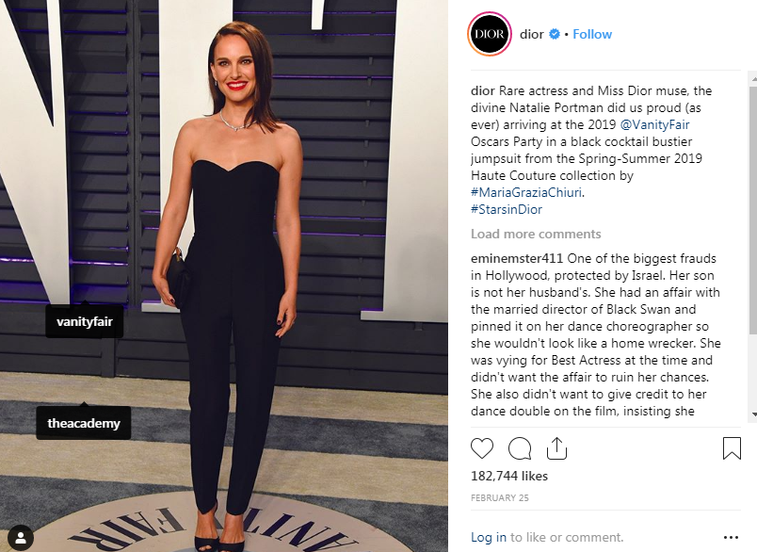
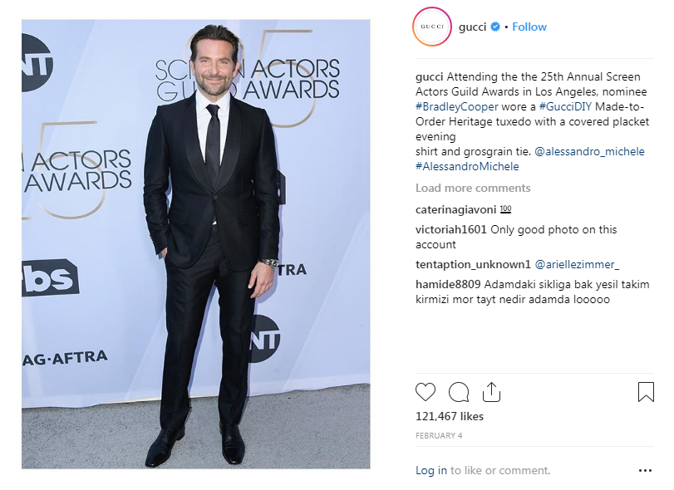
Introduction
Luxury brands increasingly use celebrity endorsements in both traditional & digital media (Park and Yang, 2010).
A more relevant and congruent celebrity and brand pair produces more positive marketing outcomes (Fleck et al., 2012).

Slide 3
Introduction
Social media allows consumers to express their identity (Escalas and Bettman, 2017).
How celebrity endorsements on social media influence consumer engagement based on three pairs of personality congruence (celebrity-brand, brand-self, & celebrity-self)

Slide 4
Literature Review
Match-up Hypothesis (Kamins, 1990)
Self-congruity theory (Sirgy, 1986)
Meaning transfer model (McCracken,1989)

Slide 5
Methodology
A series of pretests to choose a focal brand/celebrities
378 female millennials (18-35 years old) via MTurk
Each entity’s personality (i.e., celebrity, brand and self) was measured by Malhotra’s scale (Malhotra, 1981)
Personality Congruences were calculated by the distance squared model (e.g., BP-CP congruence: $\sum_{i=1}^{n}{\left(BP_{ij}−CP_{ij}\right)}$²)

Slide 6
Findings
Notes
1. BP-CP: the congruence between brand and celebrity, BP-SP: the congruence between brand and self, CP-SP: the congruence between celebrity and self,
AA: ad attitudes, BA: brand attitudes, and CE: consumer engagement intentions
2. The dotted lines indicate insignificant paths.
Figure 1. Hypothesis testing results

Slide 7
Discussion & Conclusion
The key is brand-self congruence, not brand-celebrity
A new model incorporating three pairs of personality congruence
Insights for luxury brands to make the best use of celebrity endorsements on social media

