Slide 1
When Erasmus students love the
countries where they studied:
Exploring the antecedents and
outcomes of Country Brand Love
Suzanne Amaro, Cristina Barroco & Joaquim Antunes

Slide 2
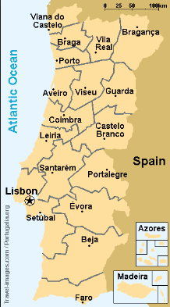
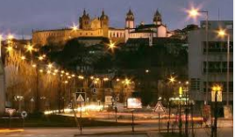

Slide 3
The Erasmus Programme
European Union student exchange programme launched in 1987.
Objectives
Improve personal development
Improve involvement as considerate and active citizens in society
Improve employability in the European labor market and beyond
Develop a sense of European citizenship and identity
Acquire foreign languages competences
Understand other cultures
In 2014, the European Commission created the Erasmus + programme for the period of 2014-2020.
INTRODUCTION
LITERATURE REVIEW
METHODOLOGY
RESULTS
CONCLUSIONS
LIMITATIONS
FUTURE RESEARCH

Slide 4
Over the past 30 years, this programme has enriched the lives of more than 9 million direct participants.
Positive Impacts
Professional careers and academic development
(Engel, 2010)
Individual skills enhancement and employability
(European Comission, 2016a)
European identity and loyalty
(Oborune, 2013)
INTRODUCTION
LITERATURE REVIEW
METHODOLOGY
RESULTS
CONCLUSIONS
LIMITATIONS
FUTURE RESEARCH

Slide 5
Benefits for the countries that receive foreign students
Foreign students may contribute to scientific, technological and economic competiveness and promote socio-cultural progression
(Bodycott, 2009)
Pathway to promote skilled migration (Muche & Wachter, 2005).
Crucial to achieve a knowledge society and build an international quality profile
(Muche & Wachter, 2005).
INTRODUCTION
LITERATURE REVIEW
METHODOLOGY
RESULTS
CONCLUSIONS
LIMITATIONS
FUTURE RESEARCH

Slide 6
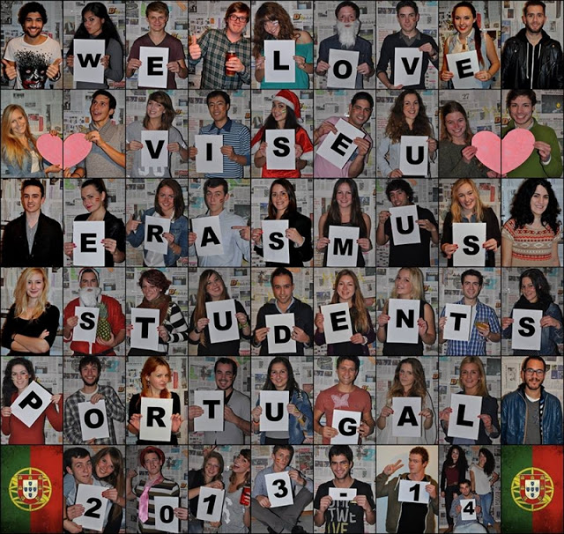
Limited studies focusing on how foreign students, in particular the Erasmus students, can be future “ambassadors” of the host country.
Main Aims of the Study
- Can Brand Love be applied to countries?
- What influences Country Brand Love?
- What are the outcomes of Country Brand Love?
INTRODUCTION
LITERATURE REVIEW
METHODOLOGY
RESULTS
CONCLUSIONS
LIMITATIONS
FUTURE RESEARCH

Slide 7
Literature Review
Erasmus students behaviors
Actively visit other cities
(Pawlowska & Roget,2009; Roget, López, & Pawlowska, 2013; Gardiner, King, & Wilkins, 2013)
Receive visits from family and friends
(Pawlowska & Roget,2009)
Intend to return
(Gardiner, King, & Wilkins, 2013; Pawlowska & Roget,2009)
Recommend the country
(Pawlowska & Roget,2009)
INTRODUCTION
LITERATURE REVIEW
METHODOLOGY
RESULTS
CONCLUSIONS
LIMITATIONS
FUTURE RESEARCH

Slide 8
WOM
H1
Transcendent customer experience - experiences with products that are “characterized by feelings such as self-transformation or awakening, separation from the mundane, and connectedness to larger phenomena outside the self”
e-WOM
Erasmus Experience
H2
H6
Brand
Love
H3
WOM
intensity
H7
H8
Brand Image
H4
Recommendation
H5
“includes passion for the brand, attachment to the brand, positive evaluation of the brand, positive emotions in response to the brand, and declarations of love for the brand” (Carroll and Ahuvia 2006, p. 81)
Revisit
Intentions
How are the countries perceived by Erasmus students?

Slide 9
Methodology
Construct | Indicators
Brand Image | _______ is safe and secure _______ offers exciting and interesting places to visit _______ has beautiful scenery and natural attractions _______ has a pleasant climate As a tourism destination, ______l offers good value for money
Erasmus Experience | I felt like I was having the ideal Erasmus experience I truly enjoyed this experience The experience was beyond words I learned new things as a result of this experience The experience was emotionally intense
Brand Love | ______ makes me feel good; I have neutral feelings about __________ (R); ____________ makes me happy; I love __________
Selected constructs
INTRODUCTION
LITERATURE REVIEW
METHODOLOGY
RESULTS
CONCLUSIONS
LIMITATIONS
FUTURE RESEARCH

Slide 10
Methodology
Online Questionnaire | May –August 2018
Data Analysis
Partial Least Squares Equation Modelling (PLS-SEM) was used to test the proposed hypotheses.
INTRODUCTION
LITERATURE REVIEW
METHODOLOGY
RESULTS
CONCLUSIONS
LIMITATIONS
FUTURE RESEARCH

Slide 11
Results
5,511 valid responses
30%
70%
95 countries
16.7%
13.6%
7.2%
10.1%
14.3%
14.1%
Respondents Nationality
Where they did Erasmus
INTRODUCTION
LITERATURE REVIEW
METHODOLOGY
RESULTS
CONCLUSIONS
LIMITATIONS
FUTURE RESEARCH

Slide 12
Results
Criterion for Assessing Reflective Constructs
Internal Consistency Reliability – Cronbach’s alpha and Composite Reliability
CA –> 0.81 – 0.92 and CR-> 0.88-0.94
Indicator Reliability
Indicator Loadings higher than 0.73
Convergent Validity
AVE all above 0.5 (0.65 – 0.82)
Discriminant Validity
Fornell-Larcker, Cross Loadings and HTMT
INTRODUCTION
LITERATURE REVIEW
METHODOLOGY
RESULTS
CONCLUSIONS
LIMITATIONS
FUTURE RESEARCH

Slide 13
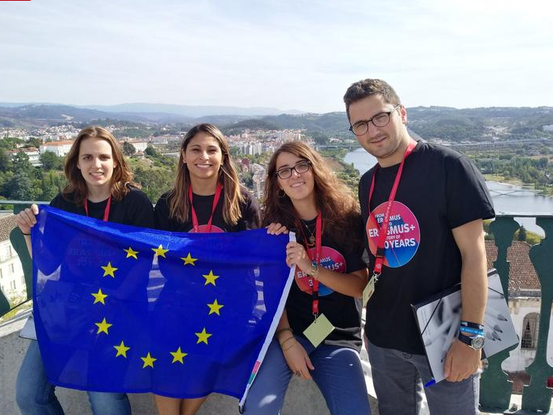
WOM
3.88
0.71***
Erasmus
Experience
e-WOM
4.09
2.61
0.24***
0.46***
Country Brand
Love
WOM intensity
0.58***
3.5
0.43***
0.70***
90% posted a picture at least once a month
0.34***
4.05
Recommendation
Country Brand Image
4.2
4.17
0.55***
Revisit Intentions
4.43
Beautiful scenery and natural attractions
Exciting and interesting places to visit
Safe and Secure

Slide 14
Conclusions
Concepts of Brand Love and Brand Image applied to countries
Erasmus Students Love the Countries where they study
Positive Outcomes: WOM, e-WOM, WOM intensity, recommendation, revisit intentions
INTRODUCTION
LITERATURE REVIEW
METHODOLOGY
RESULTS
CONCLUSIONS
LIMITATIONS
FUTURE RESEARCH

Slide 15
Conclusions
There should be national policy initiatives to attract Erasmus students to the countries and create great Erasmus experiences
Facilitate trips to the most interesting and beautiful places the country has to offer
Destination Management Organizations (DMOs) of certain regions of each country could collaborate with universities to promote their regions to Erasmus students
INTRODUCTION
LITERATURE REVIEW
METHODOLOGY
RESULTS
CONCLUSIONS
LIMITATIONS
FUTURE RESEARCH

Slide 16
Limitations and Future Research
Countries are not equally represented
Compare countries
Examine more factors that influence Country Brand Love
Apply the model to tourists
INTRODUCTION
LITERATURE REVIEW
METHODOLOGY
RESULTS
CONCLUSIONS
LIMITATIONS
FUTURE RESEARCH

Slide 17
Conclusions
This study contributes to the scarce literature regarding the concept of brand love applied to places.
It also evidences the important role that Erasmus students have, raising awareness for the need to provide favorable experiences to Erasmus students, so that they will create a positive image of the country and recommend it to others.

Slide 18
Thank You from Portugal!

