Slide 1
Non Profit Organizations’ Brand Personality: The Must Have Meanings
Abas Mirzraei, Cynthia M. Webster & Helen Siuki
Macquarie Business School

Slide 2
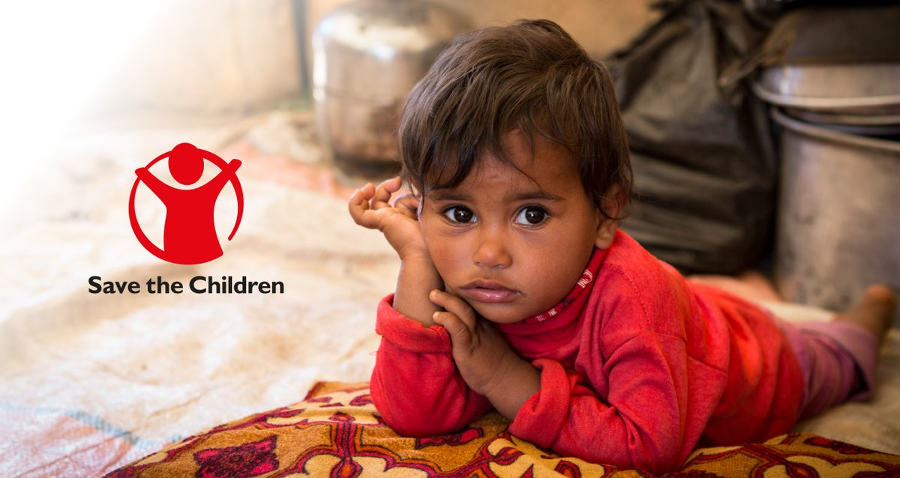
Non-profit Organizations (NPOs)
1.57 million organizations in US social sector (National Center for Charitable Statistics, 2016)
charities, cooperatives, and other voluntary associations are formed to further cultural, educational, religious, professional, or public service objectives.
NPOs compete for limited resources
NPOs need to differentiate themselves by developing strategies
to capture community attention and engagement to increase donations, volunteering and advocacy (McKinley-Floyd & Shrestha, 2008)

Slide 3
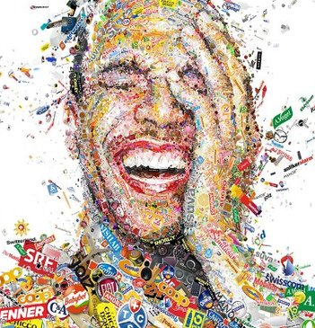
Brand Personality
plays important role in influencing consumer brand trust (Fournier, 1998), affect and loyalty (Sung and Kim, 2010).
involves assigning human personality traits and characteristics to a brandto influence consumer behavior (Aaker, 1998)
Human-like Characteristics
Tangible Features
Consumer–Brand Congruity
Self-brand Connection
Brands Like Me
Consumer–Brand Relationship
Brand Attachment
Brand Aversion
Abstract Personality/Traits

Slide 4
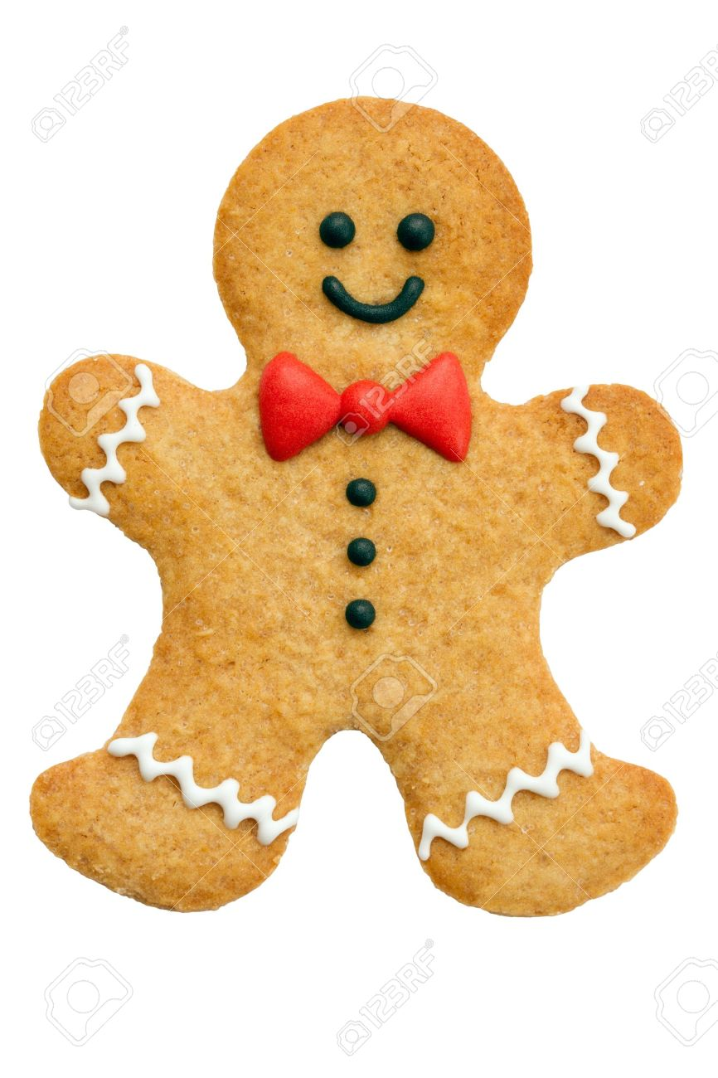
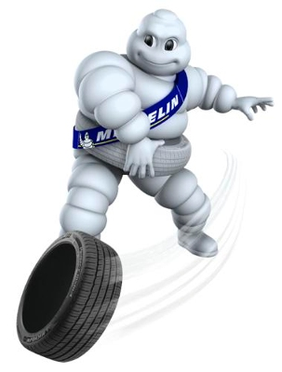
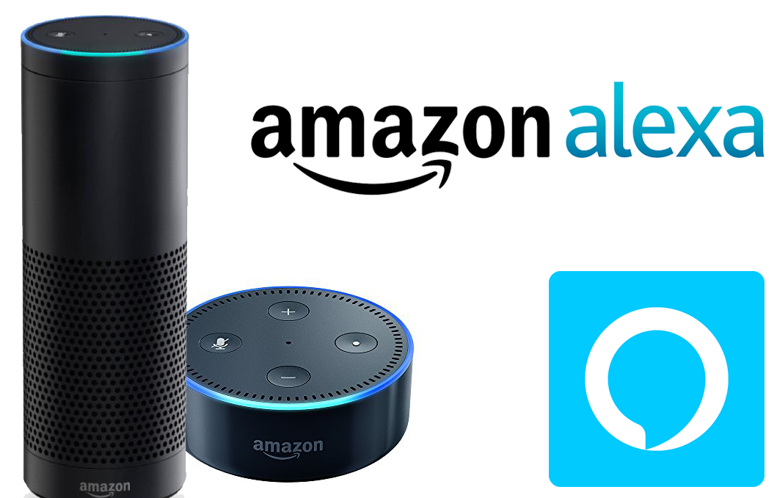
Human-like Characteristics
Consistent with the notion of agent knowledge, consumers are more likely to perceive a brand as having human-like features when the brand is depicted in a way that activates a “human” schema, creating some degree of perceived similarity to humans.
Notes:
When
consumers imagine that the brand has come to life (Aggarwal &
McGill, 2012; Kim & Kramer, 2015) or has human personality
characteristics (Chandler & Schwarz, 2010), they are also more
prone to anthropomorphize.
brand's features resembling a human face or
by representing it as an avatar

Slide 5
Main NPO Brand Personality Measurement
Authors | Scale
Bennett and Gabriel (2003) | Compassion Reputation Dynamism Popularity Political Orientation Idealism Focus on beneficiaries
Venable et al (2005) | Integrity Ruggedness Sophistication Nurturance
Sargeant et al (2008) | Benevolence Progression Conservatism Emotional Engagement Tradition Service Voice
Michel and Rieunier (2012) | Usefulness Efficiency Affect Dynamism
Michaelidou et al (2015) | Usefulness Efficiency Affect Dynamism Reliability Ethicality

Slide 6
RESEARCH METHOD & PRELIM RESULTS NPO Brands across 4 Sectors
Sector
Charity | Acumen Charity: Water Direct Relief United Way
Children | Barnardos Pencils of Promise Room to Read Save the Children
Community-led | Ashoka Do Something Global Giving Kiva
Nature | Green Peace Nature Conservancy Ocean Conservancy Oceana Sierra Club
Content analysis based on 250 posts on NPOs Facebook page (using Leximancer)

Slide 7
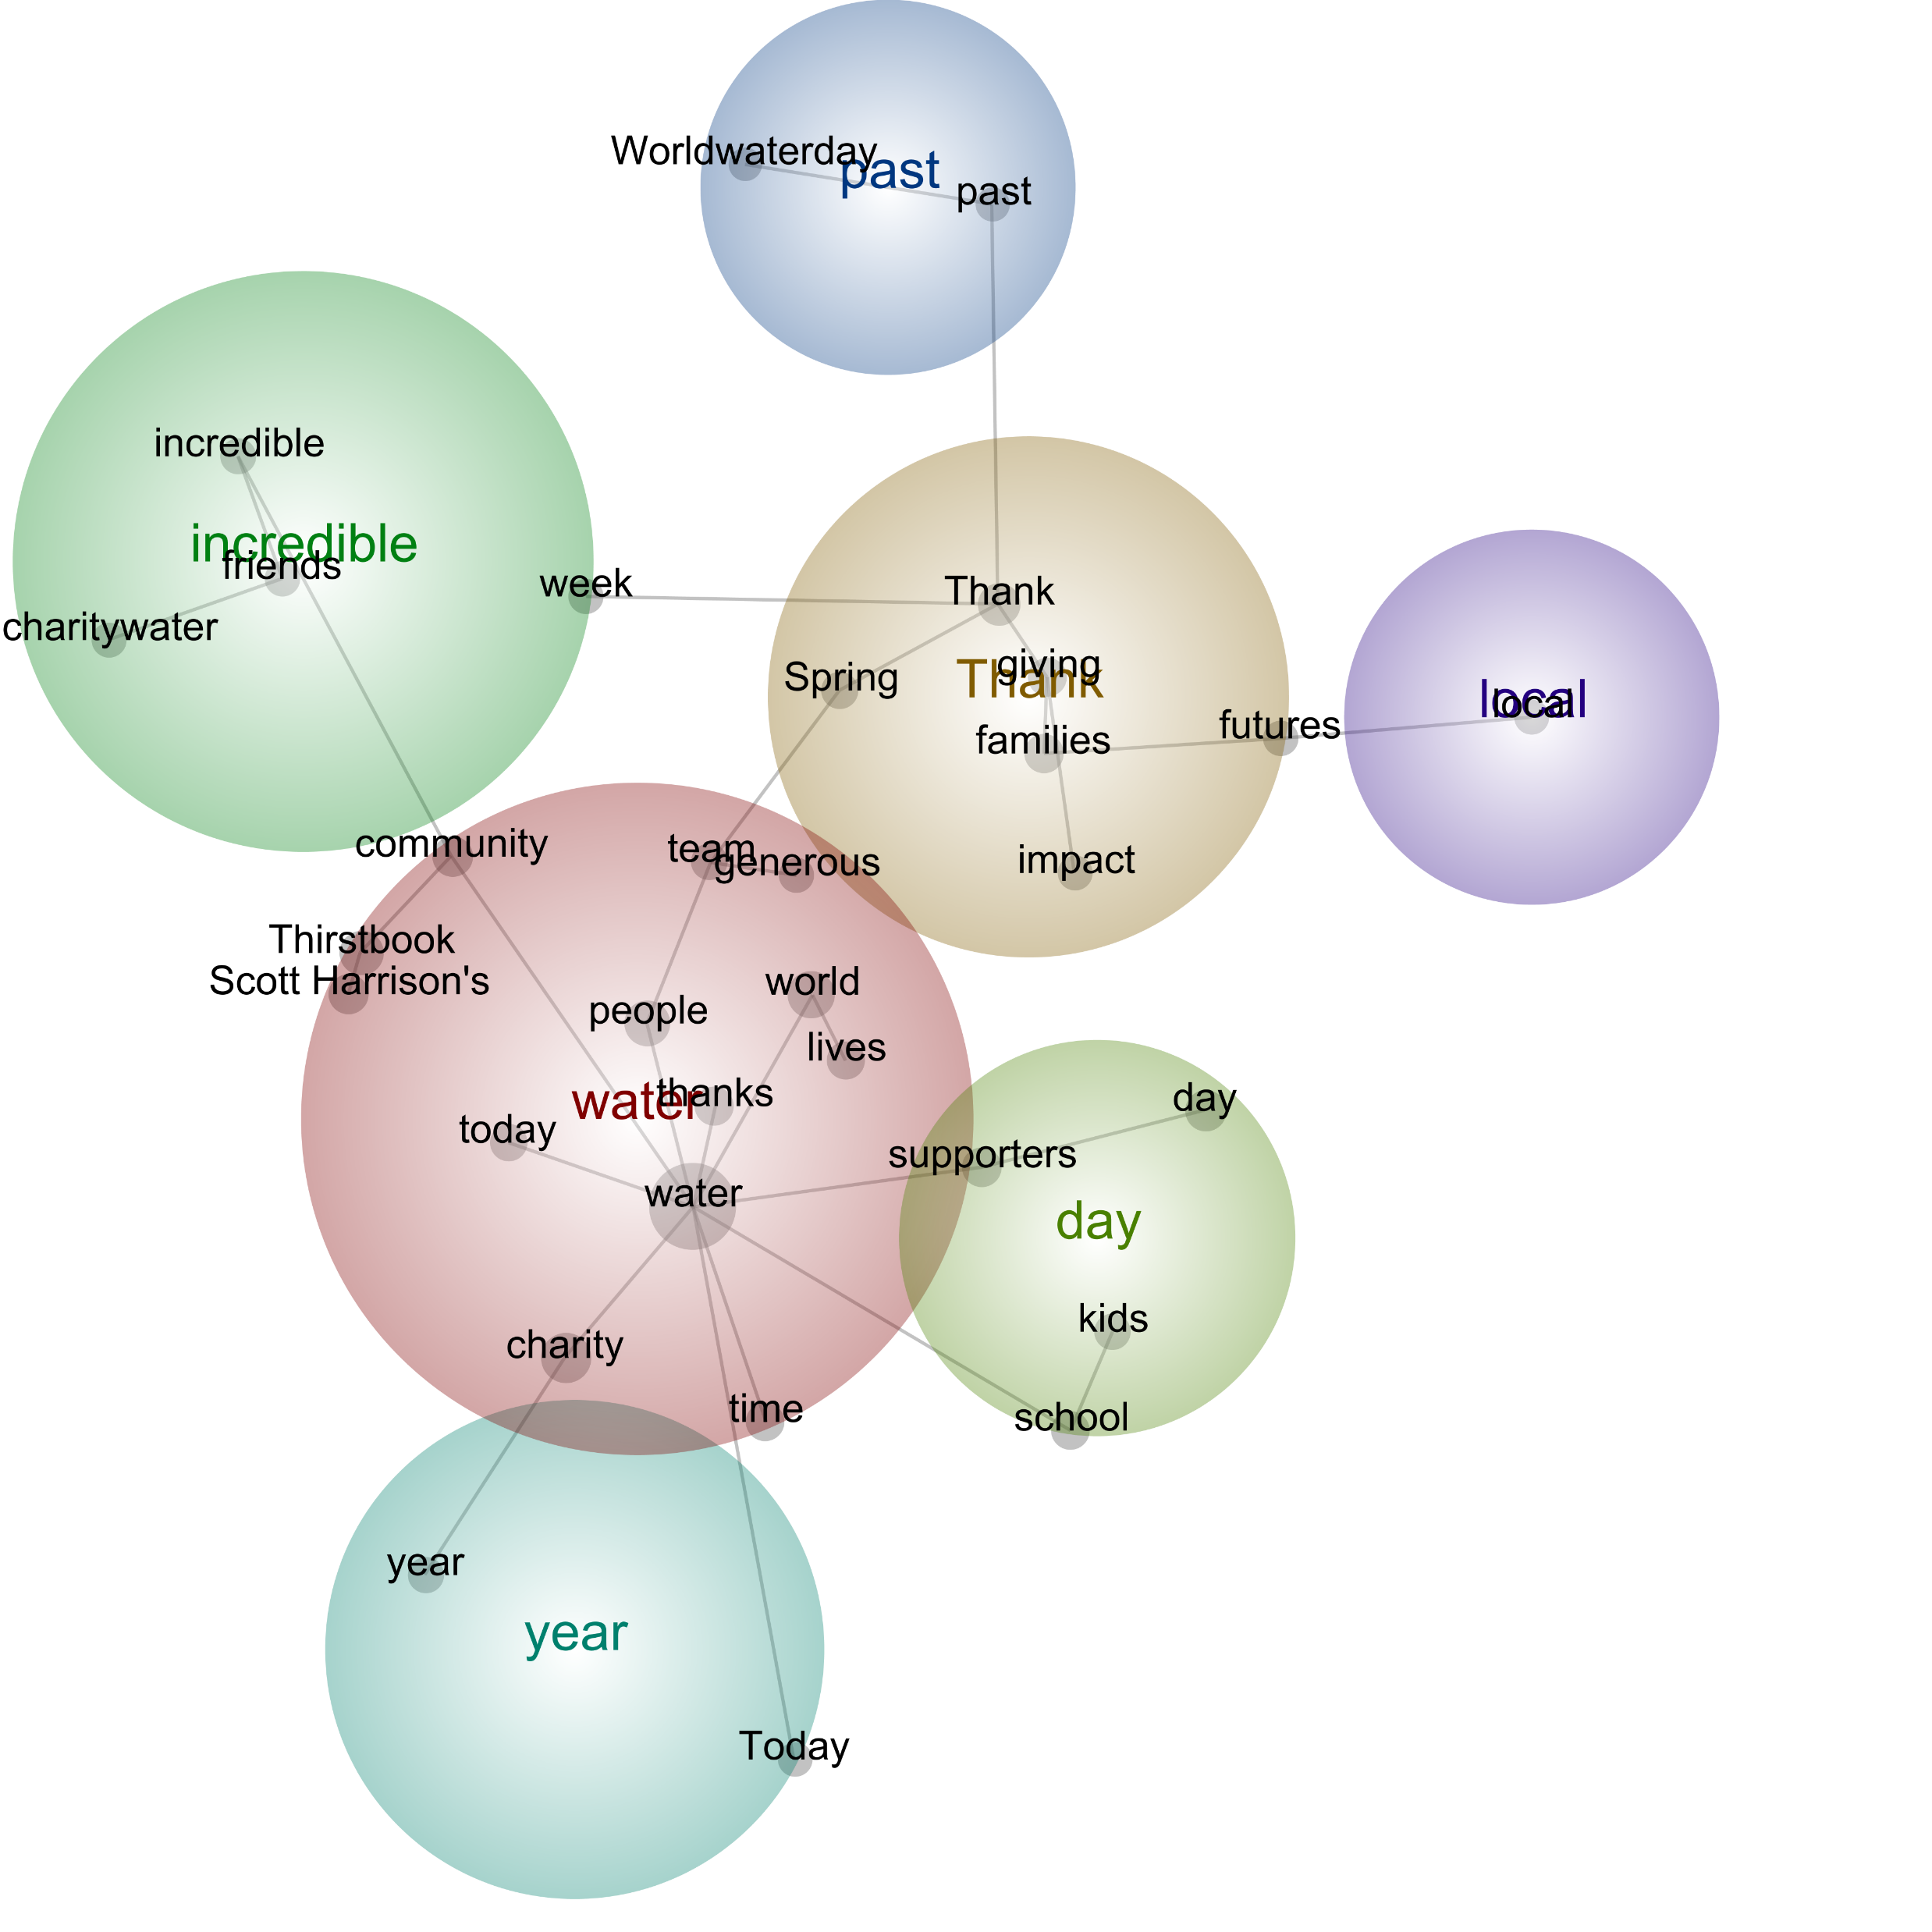
Charity Water

Slide 8
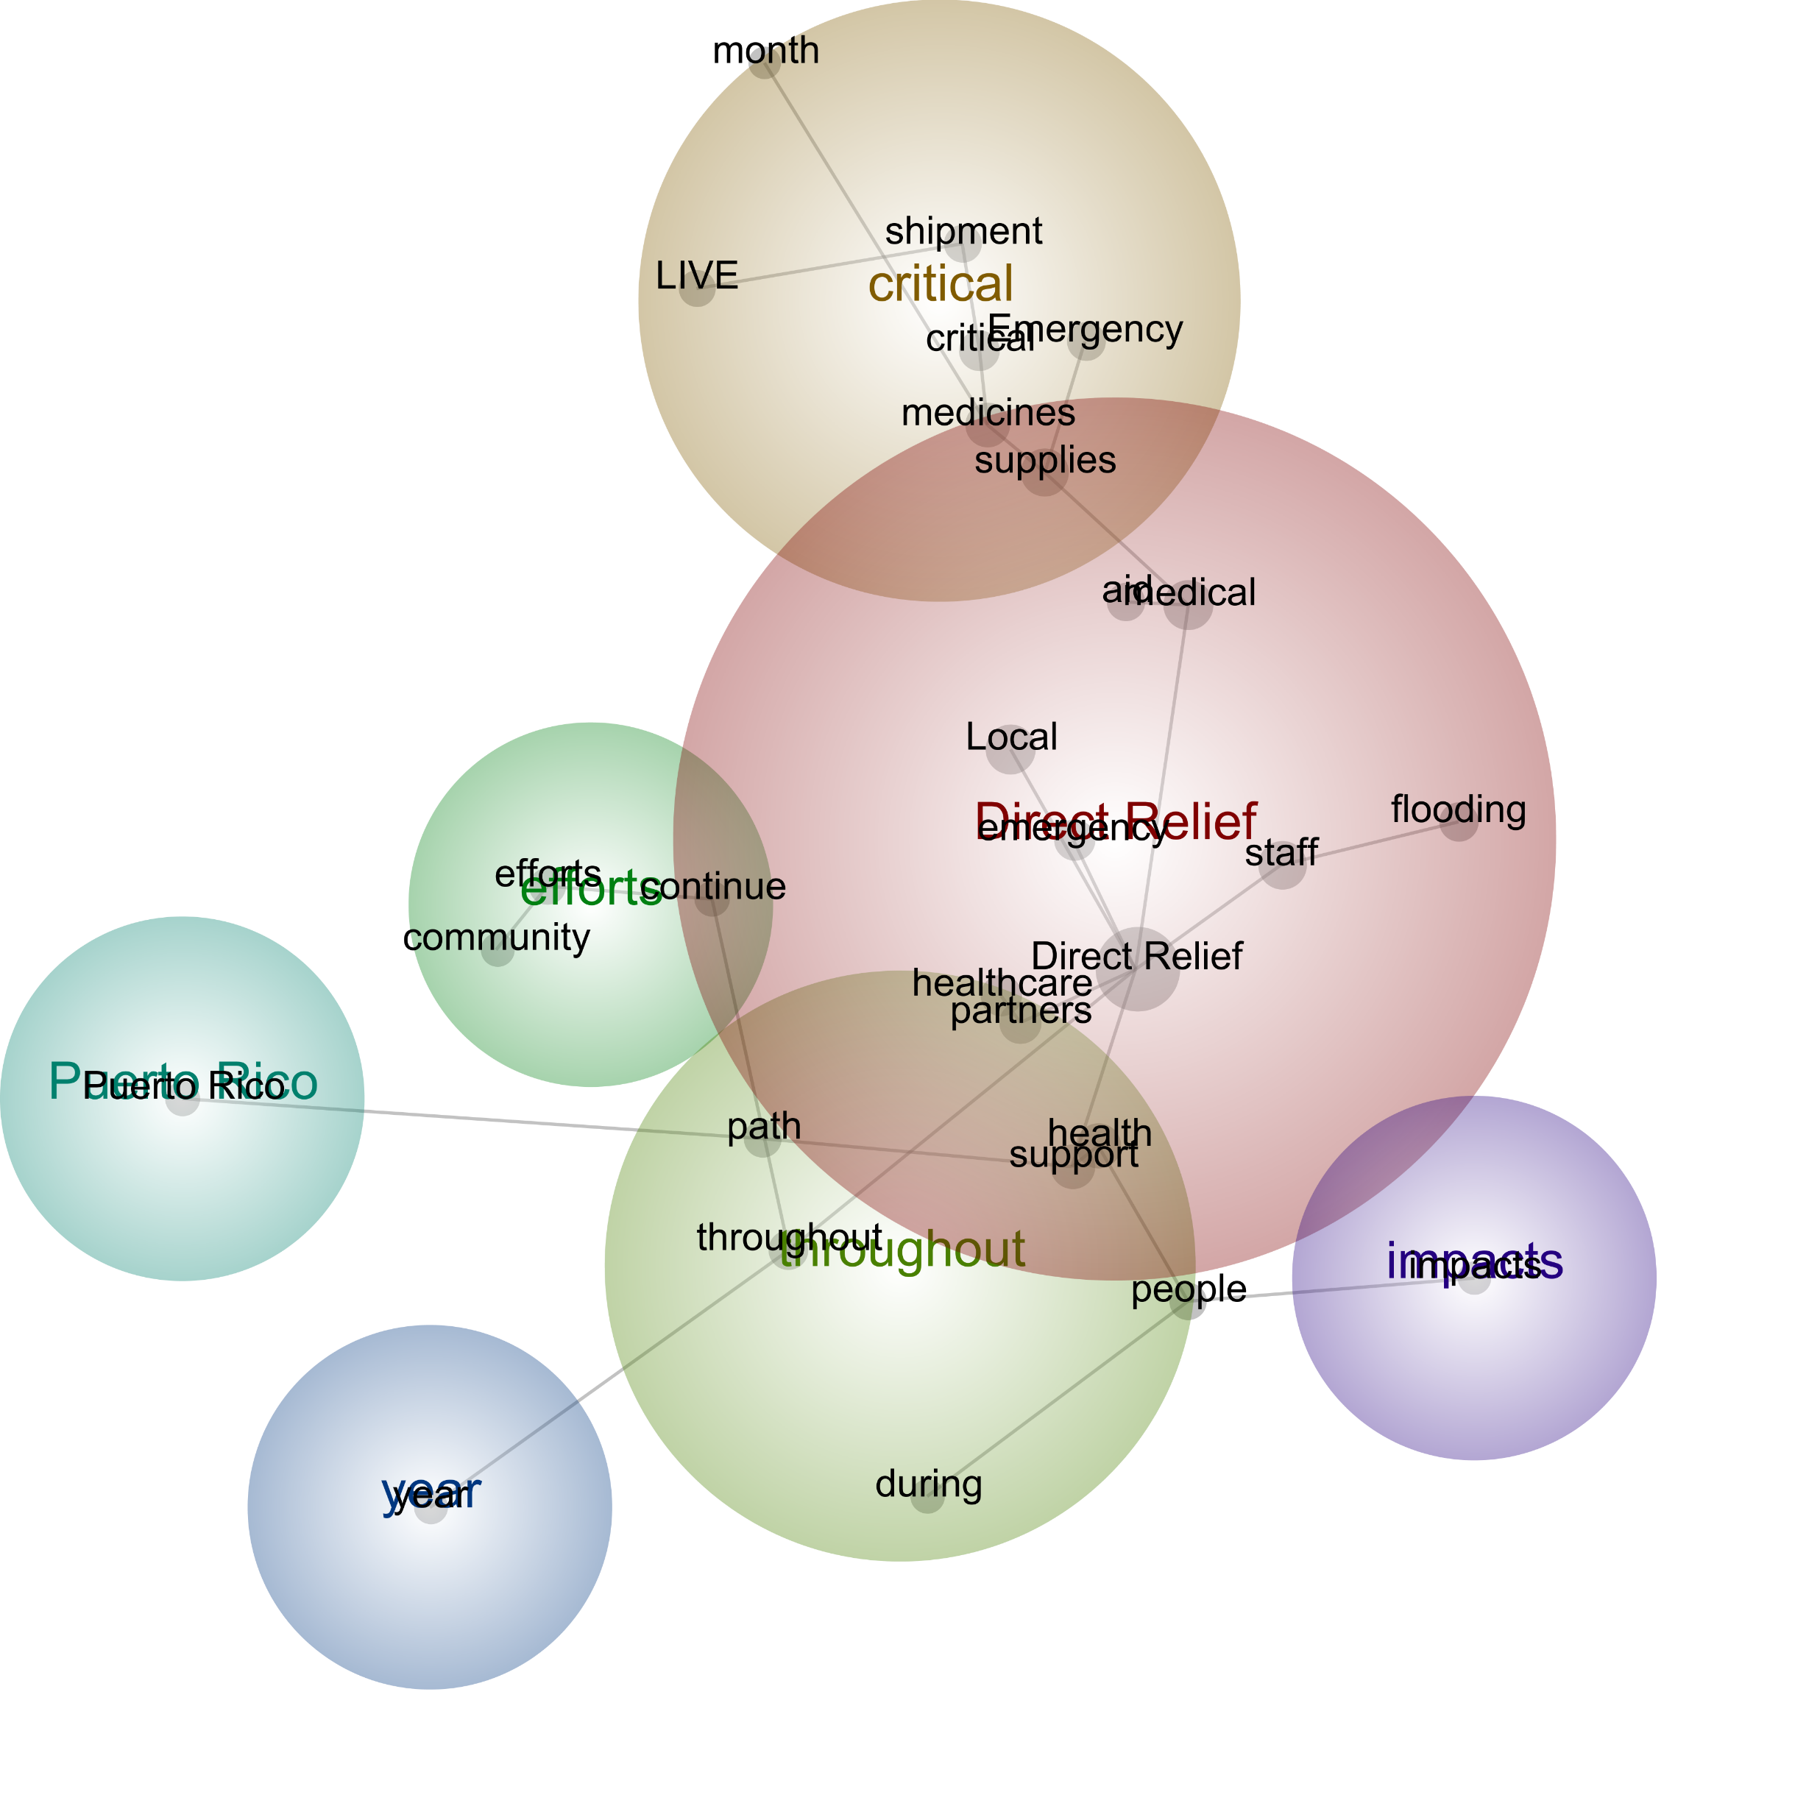
Direct Relief

Slide 9
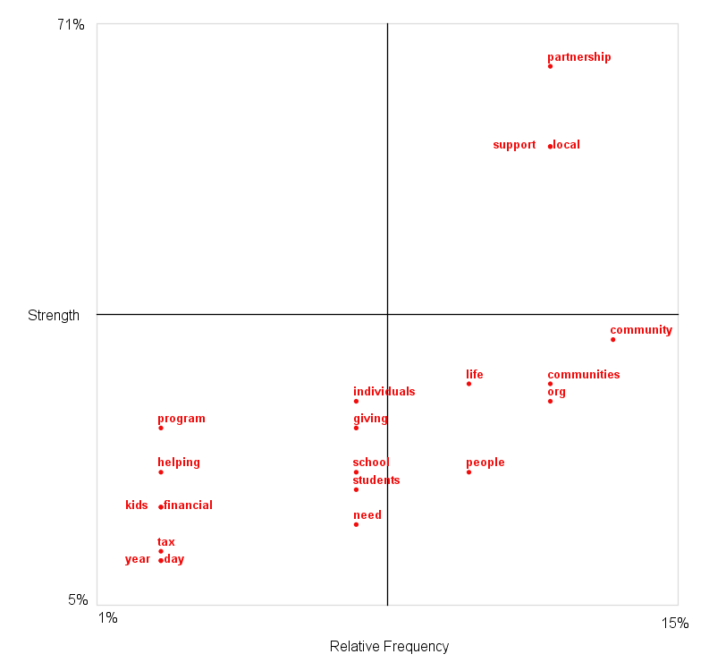
United Way

Slide 10
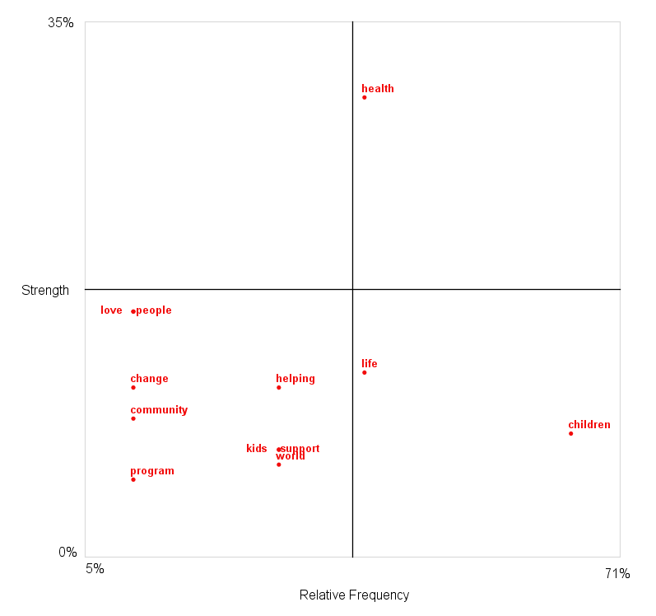
Save The Children

Slide 11
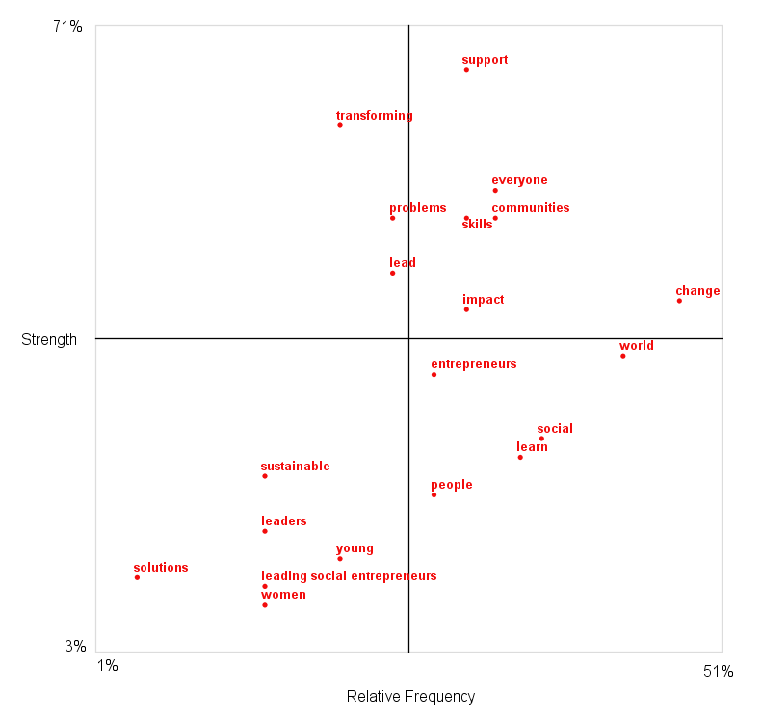
Ashoka

Slide 12
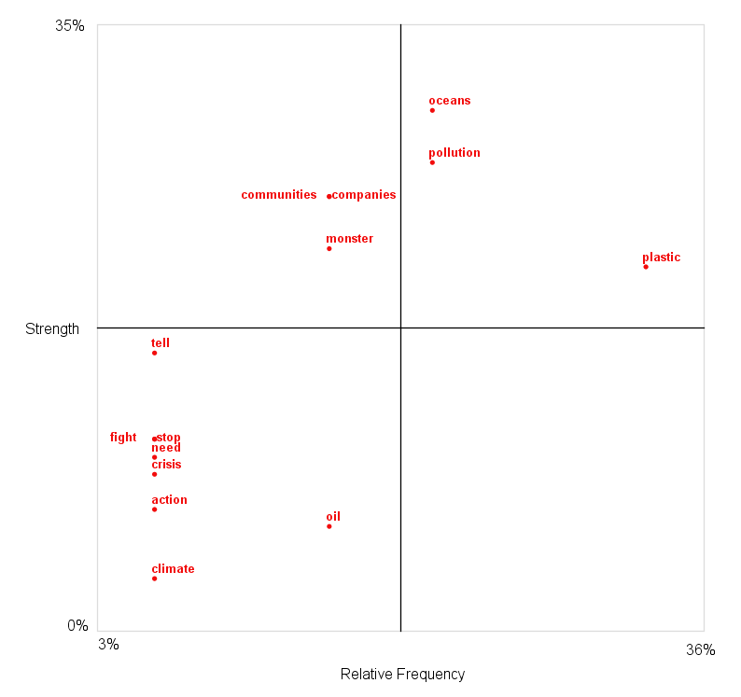
GreenPeace

Slide 13
Key Themes Across NPO Sectors
Sector | Purpose | Meaning | Fight
Charity | Action, Aid, Care, Challenge, Change, Impact, Education, Make a Difference, Emergency, Fund, Help, Inspire, Learn, Opportunity, Philanthropy, Power, Provide, Safe, Supply, Support, | Committed, Innovation, Diverse, Dream, Excited, Generous, Honor, Important, Moral, Passionate, Incredible, Rugged, | Crisis, Destroyed, Devastating, Dirty, Disasters, Health, Wildfires,
Children | Act (Urgently), Care, Change, Educate, Empower, Give Hope, Help, Impact, Inspire, Lifesaving, Protect Provide, Support, Transform | Difference, Emotional, Importance, Innovation, Social, | Abuse, Conflict, Crime, Crisis, Disasters, Exploitation, Harm, Refugee, Suffering, War,
Community-lead | Care, Challenge, Change, Changemakers, Collaboration, Empower, Help, Hope, Impact, Inspire, Opportunity, Provide, Support, Transform, | Activist, Amazing, Charitable, Collective, Committed, Creative, Dedicated, Different, Exciting, Green, Honor, Innovation, Leading, Passionate, Powerful, Safe, Social, Sustainable, Together, Wise | Climate, Crisis, Homeless, Shelter
Nature | Action, Challenge, Change, Defend, Difference, Discover, Emergency, Fight, Help, Impact, Inspire, Justice, Opportunity, Power, Protect, Provide, Stop | Adventure, Clean, Committing, Environmental, Innovation, Mesmerizing, Renewable, Sustainable, Urgent | Climate, Deforestation, Deforestation, Extinction, Habitat, Habitat, Octopus, Plastic, Pollution, Shark, Species, Turtles, Whale, Wildlife

Slide 14
Main Dimensions of NPO Purpose
COMMUNITY | CHANGE | SUPPORT | EMPOWER | FIGHT
Community Collaboration Together | Change Make a Difference Lafe Saving Impact Give Hope Transform | Support Aid Care Provide Supply Fund Help | Empower Opportunity Hope Power Challenge Educate | Fight Stop Protect Act

Slide 15
Next Steps
Assessing the heterogeneity of concepts across different sectors,
Examining the extent to which there is a significant difference across categories in terms of the type of concepts and brand personalities.

