Slide 1
The Moral Relationships of Brands
Max Blackston
6th International Consumer Brand Relationship Conference
Cancun, May 2019

Slide 2
Moral Foundations
Theory
Consumer Brand
Relationships Theory
Brands’ Moral Relationships

Slide 3
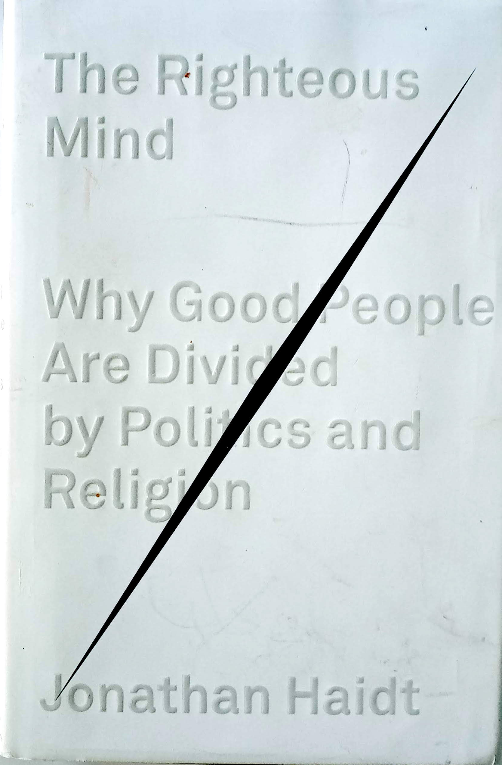
Moral Foundations
Theory
Consumer Brand
Relationships Theory
Brands’ Moral Relationships

Slide 4
Moral Foundations
Theory
Consumer Brand
Relationships Theory
Brands’ Moral Relationships

Slide 5
Moral Foundations
Theory
Consumer Brand
Relationships Theory
Brands’ Moral Relationships

Slide 6
! Trigger Warning !

Slide 7
A Sacred Cow is about to be slaughtered

Slide 8
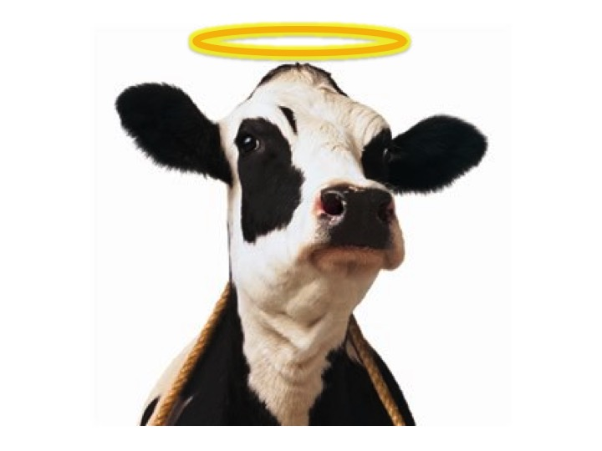
Brand Love Brand Love Brand Love Brand Love

Slide 9
Brand Love
In two recent studies - one in the USA and one in Mexico, together covering 128 brands in 20 different product categories - on average about one in four of the people who never use a brand say they "love it" or "like it a lot."
Liking or loving a brand may be a necessary condition for buying it, but it is not sufficient.

Slide 10
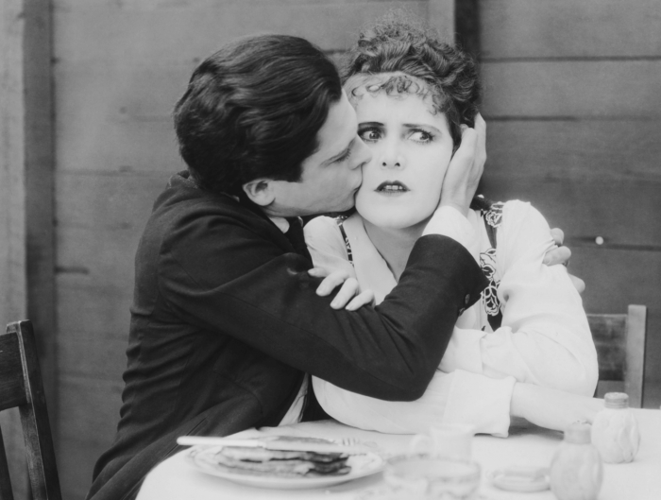
Unrequited Love

Slide 11
Unrequited Love
Brand Love (You love the brand) is Not Enough

Slide 12
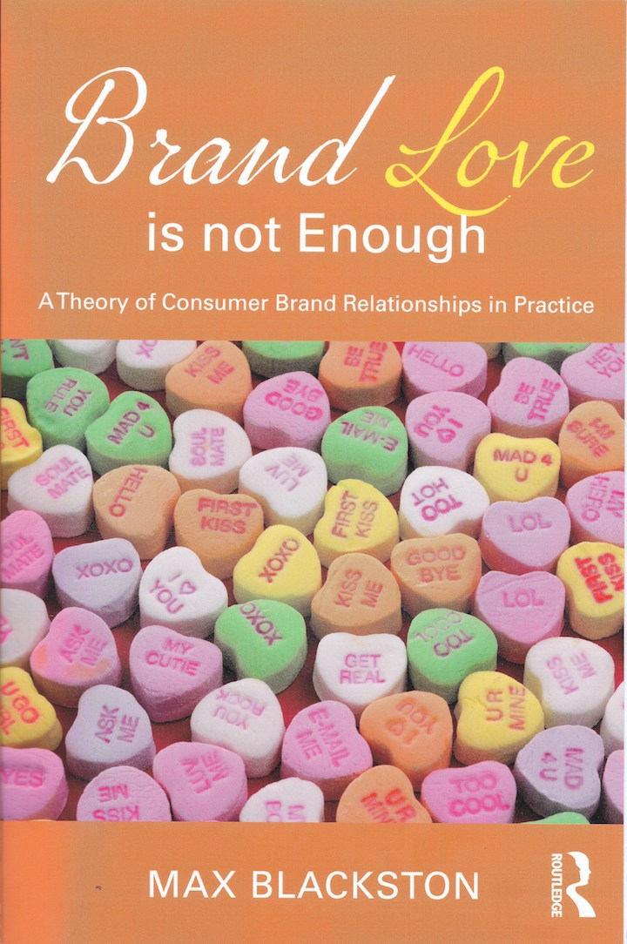

Slide 13
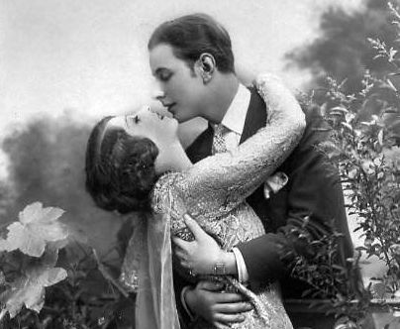
Brand Love (You love the brand) is Not Enough
The Brand must Love You Too

Slide 14
The Brand Must Love You Too
Brands can and do show their love for the consumer
They need to have the right “attitude”
Brands’ attitudes convey an Emotional Response (“I love you too”) to the consumer, e.g:
Brings back good memories
Provides a little treat for me
Cares about me
Has my interests at heart
Helps me to express myself
Makes me feel good about myself

Slide 15
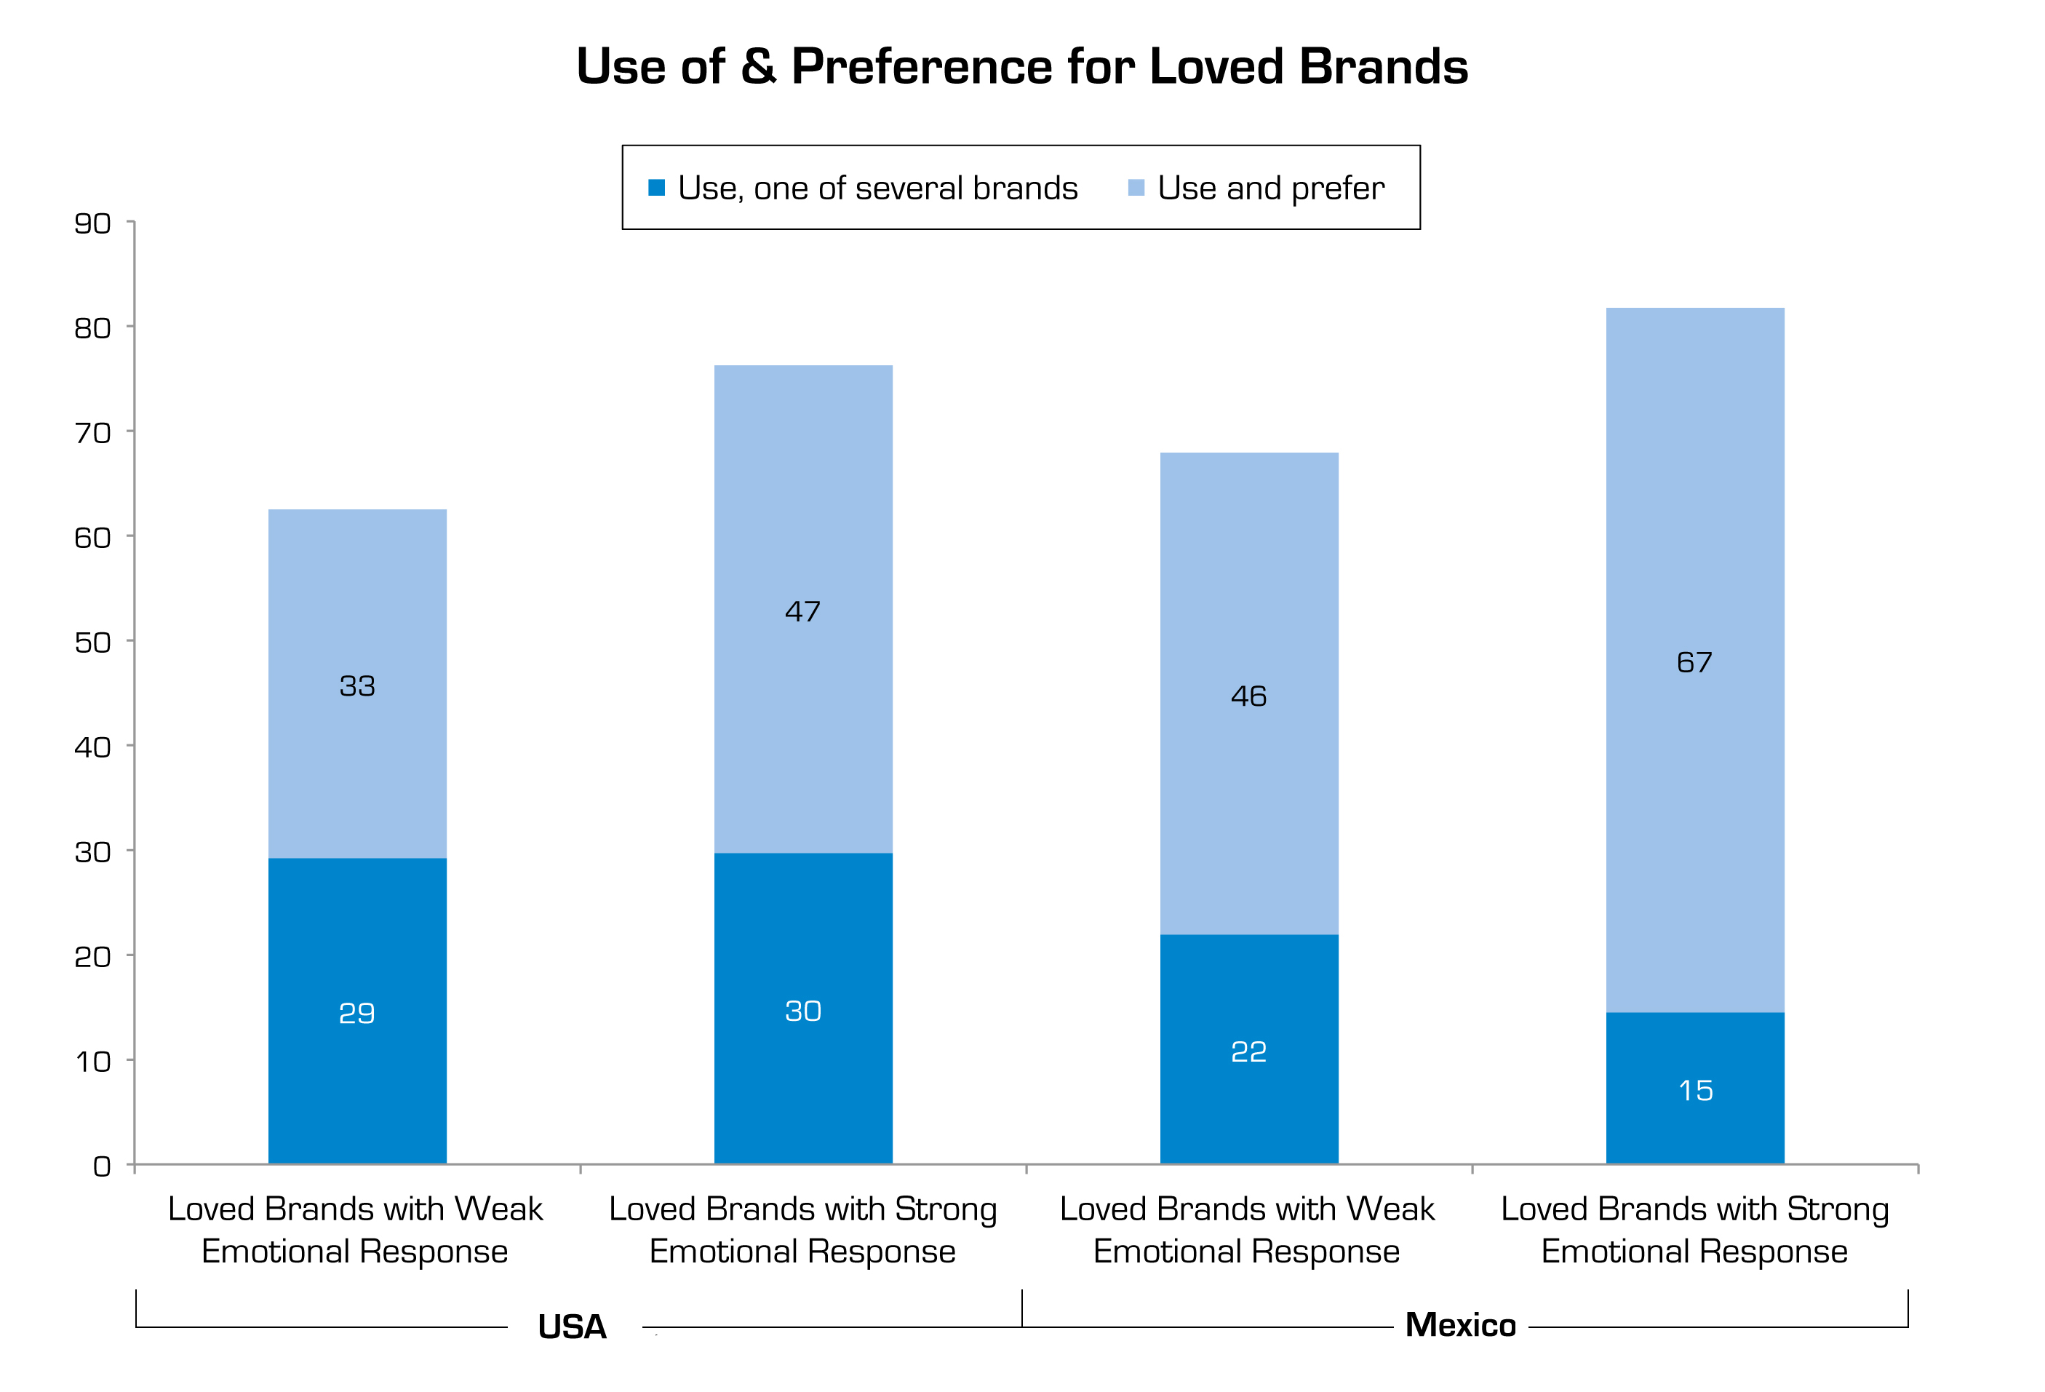

Slide 16
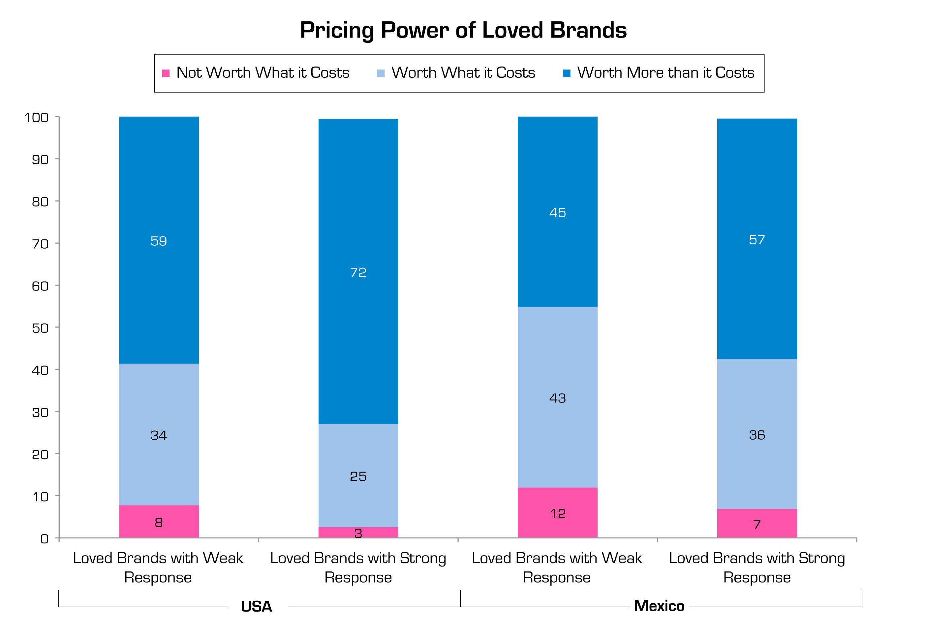

Slide 17
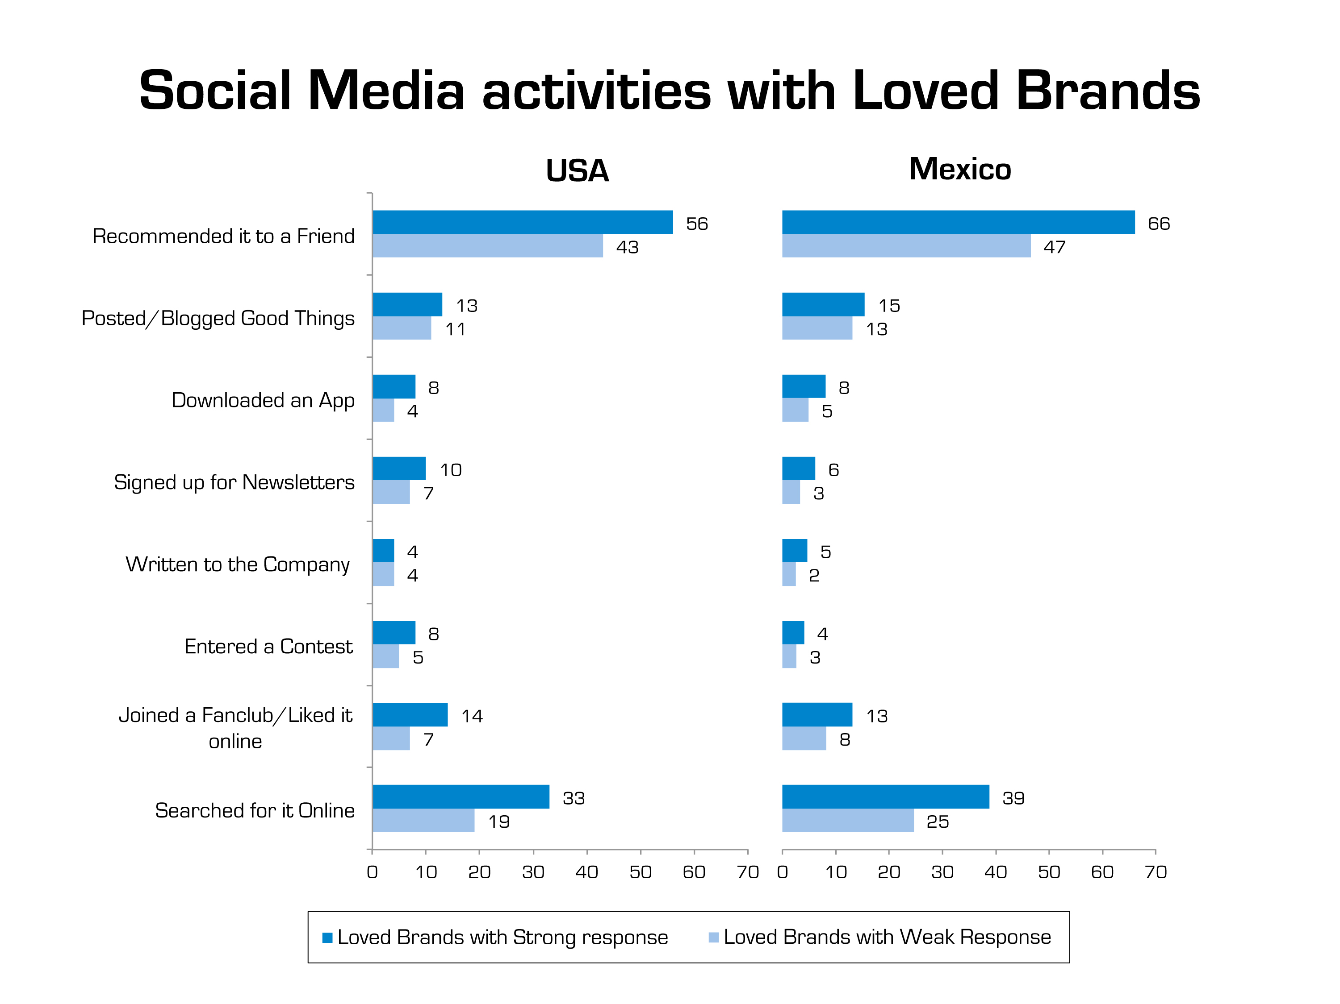

Slide 18
/
Brand’s Attitude = Brand Attitude

Slide 19
/
Brand’s Attitude = Brand Attitude

Slide 20
Brand Attitude [aka A _{brand} or Brand Image]
What the consumer believes about the brand

Slide 21
Brand Attitude [aka A _{brand} or Brand Image]
What the consumer believes about the brand
Brand’s Attitude
what (the consumer believes) the brand believes

Slide 22
The Consumer-Brand Relationship is the outcome of the dialogue between the two
CBR = f{Brand Image, Brand’s Attitude}

Slide 23
Brand’s Attitude and Brand Image are Not Additive
A Brand’s Attitude acts as a control factor and modifier of the meaning of its Brand Image

Slide 24
The Brand Relationship Map

Slide 25
Not all Consumer Brand Relationships are about Love

Slide 26
Brands’ Attitudes
Esteem
Makes me look good to others
Shares my values
Is recommended by people I care about

Slide 27
Brands’ Attitudes
Mentoring
Excites me
Inspires me
Challenges me to think differently

Slide 28
Brands’ Attitudes
Responsive
Cares what I think
Responds to my needs
Appreciates my business
Gives me more

Slide 29
Brands’ Attitudes
“Bad” Attitudes
Is not honest with me
Makes me feel that I am not good enough
Doesn’t care about my opinion
Looks down on me

Slide 30
Moral Foundations
Theory
Consumer Brand
Relationships Theory
Brands’ Moral Relationships

Slide 32
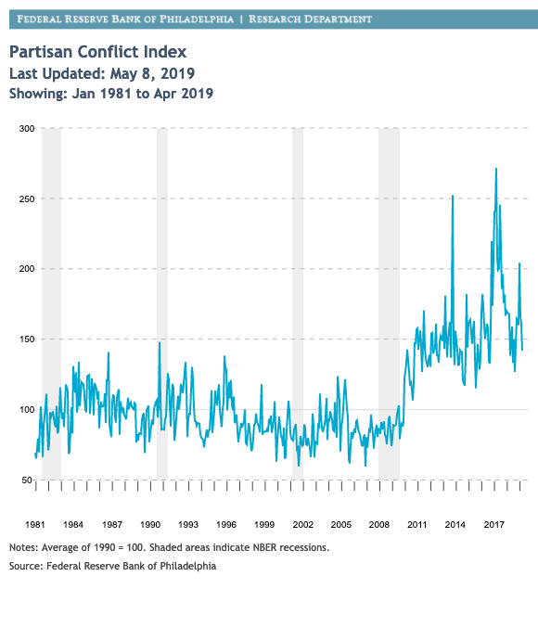
Philadelphia Partisan Conflict Index

Slide 33
Brands are becoming "politicized"
The current state of political polarization is now entering brand marketing.
CEO's like Howard Schultz of Starbucks or Timothy Cooke of Apple have not been timid about airing their views on President Trump or about religion-based discrimination against same-sex couples.
Nike’s continued support of Colin Kaepernick kneeling during the playing of the National Anthem at NFL games
Boycotting of Under Armor products and downgrading of company by Wall St analyst because of CEO’s support for the President

Slide 34
”Politicized” Brands
Does a brand risk its reputation by associating with one side or another of a controversial issue?
Do brands actually have a choice, can they remain neutral?
Must brands now be targeted at “red” and “blue” segments?

Slide 35
In order to get beyond the anecdotal and examine the phenomenon systematically, we need to dig below the specific political issues that some brands have got entangled with, and examine the roots - the underlying values - that give rise to them. We need to understand and measure the Moral Foundations of Brands

Slide 36
Moral Foundations
Factors that underlie people's "moral intuition"
The nearly instantaneous set of perceptions we all have about other people, the beliefs they hold, and the things they do.
These intuitions feel like self-evident truths, making us righteously certain that those who see things differently are wrong.

Slide 37
The 5 Moral Foundations
Care/Harm − Makes us sensitive to signs of suffering and need; makes us despise cruelty.
Fairness/Cheating − Makes us sensitive to indications that another person is likely to be a good/bad partner for collaboration.
Loyalty/Betrayal − Makes us sensitive to signs that another person is/not a team player. Makes us want to trust and reward or alternatively ostracize such people.
Authority/Subversion − Makes us sensitive to signs of rank or status and to signs that others are/not behaving properly, given their position.
Sanctity/Degradation − Makes it possible to associate ideas and behaviors with irrational and extreme values – positive and negative – which are important for binding groups together

Slide 38
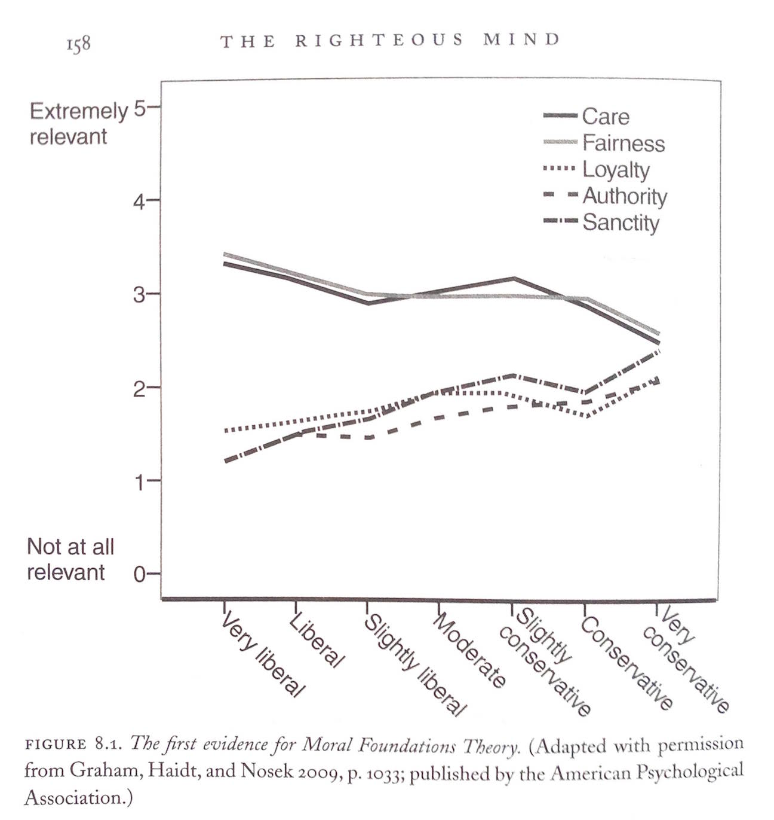
Haidt's research shows that:
Politically liberal people value the first two foundations - Caring and Fairness – far more than the latter three.
Conservatives, in contrast, endorse all five foundations more or less equally.

Slide 39
Brands’ Moral Foundations – Proof of Concept Study
Used an adaptation of Haidt's questionnaire to make questions appropriate to brands
Measured 20 brands in 4 different product categories
Representative Sample of 200 US consumers
Successfully measured 4 of the 5 Foundations

Slide 41
Convergence of Brands’ and Peoples’ Moral Foundations
People who identify themselves as Democrats are more likely than Republicans to share values with brands they identify with: Care and Fairness Foundations
Republicans are more likely than Democrats to share values with brands they identify with: Loyalty and Authority Foundations

Slide 42
Brands’ Moral Foundations
Brands are "political players" – and probably have been for some time.
The question is not whether it is happening, but whether it matters?
Do the moral foundations of brands influence their commercial and financial performance?
Is the current toxic political atmosphere likely to prevent brands from "reaching across the aisle" for a bi-partisan franchise?

Slide 43
From Moral Foundations
Brands’ Moral foundations by themselves can explain why people feel a brand fits more or less with their own moral/political values but – as consumers’ Moral Foundations do not necessarily (yet?) control the brands they buy – they are an inadequate explanation of consumers’ purchasing behavior.
Brands defined just by their Moral Foundations risk polarizing their consumer targets, and becoming locked into “red” and “blue” segments.

Slide 44
From Moral Foundations
To Moral Relationships
Brands’ Moral foundations by themselves can explain why people feel a brand fits more or less with their own moral/political values but – as consumers’ Moral Foundations do not necessarily (yet?) control the brands they buy – they are an inadequate explanation of consumers’ purchasing behavior.
Brands defined just by their Moral Foundations risk polarizing their consumer targets, and becoming locked into “red” and “blue” segments.
Moral Foundations are consumers' perceptions of brands' moral underpinnings - the moral equivalent of brand image. They are just one of the components of Moral Relationships
As with other Consumer Brand Relationships, the other component is the Brand’s Attitude, which can radically alter – positively or negatively – the influence of the Brand’s Moral Foundation

Slide 45
Brand’s Moral Relationships:
The perceived Moral Foundations of the Brand,
as filtered through and modified by one or more
brand’s attitudes

Slide 46
Moral Relationship (1)
Care
Benevolent Authority
Care
Benevolent Authority
Moral Foundation (x)
Authority
Moral Foundation (x)
Authority

Slide 47
Moral Relationship (2)
Inclusiveness
Inclusive Loyalty
Care
Benevolent Authority
Moral Foundation (x)
Authority
Moral Foundation (x)
Loyalty

Slide 48
Moral Relationship (3)
Generous
Generous Fairness
Care
Benevolent Authority
Moral Foundation (x)
Authority
Moral Foundation (x)
Fairness

Slide 49
Moral Relationships – The Bridge
A "good" or appropriate attitude can help reconcile differing values (for example, if respect for authority is seen to be caring and benevolent)
A "bad" attitude can negate or even reverse the effect of good values (for example, if a particular stance comes over as just "virtue signaling" rather than as a genuinely held belief)
The appropriate brand attitude can serve to “soften” a conservative foundation or to “harden” a liberal foundation hence providing a broader base of appeal for the brand
Moral Relationships provide a better explanation of consumers’ brand preferences and purchasing behavior than Moral Foundations alone.

