Slide 1
Fine‐tuning Branding Strategies in the Battle with Consumer Animosity
Sijun Wang
Professor of Marketing
Loyola Marymount University, Los Angeles, CA
Aidin Namin
Assistant Professor of Marketing
Loyola Marymount University, Los Angeles, CA
Tuesday May 21st, 2019

Slide 2
Motivation and Research Question
Cognitive elements
Interpersonal forgiveness and inter-group conflict
Cultural similarity and forgiving the COO
Emotional Evaluation Mechanisms

Slide 3
A Very Brief Glance at the Literature
Consumer Animosity (Leong et al., 2008; Riefler and Diamantopoulos, 2007)
Country Competitiveness (Insch and Miller, 2005)
Cultural Similarity (Taylor, Zou, and Osland, 1998)

Slide 4
Hypotheses
H2
Cultural Similarity
-
+
-
Consumer Animosity
Purchase Likelihood
H1
+
-
Country Competitiveness
H3

Slide 5
Data
National sample (n=276)
Fifty states
Measures of
Country Competitiveness
Animosity
Cultural similarity
Questionnaire available upon request

Slide 6
Model
Logit choice model to predict purchase likelihood
$y=\left\{\begin{aligned}1 β_{0}+β_{1}x_{1}+…+β_{n}x_{n}+ε \\ 0 esle \end{aligned}\right.$
${Likelihood _of_purchase}_{i}=β_{0}+β_{1}{Animosity}_{i}+β_{2}{CtryComp}_{i}+β_{3}{CulSim}_{i}+β_{4}{Reaction}_{i}+β_{5}{GlobalBrand}_{i}+β_{6}{Practice}_{i}+β_{7}{Quality}_{i}+β_{8}{Familiarity}_{i}+β_{9}{Prestige}_{i}+β_{10}{Taste}_{i}+β_{11}{Reliable}_{i}$+$β_{12}{Fashion}_{i}+β_{13}{Importance}_{i}+β_{14}{GlobalPerception}_{i}+β_{15}{Stereo}_{i}+β_{16}{Patriot}_{i}+β_{17}{Pride}_{i}+β_{18}{Overall}_{i}+β_{19}{Visit}_{i}+β_{20}{{Ani}_{i}∗CtryComp}_{i}+β_{21}{{Ani}_{i}∗CulSim}_{i}+β_{22}{{Ani}_{i}∗CulSim}_{i}∗{CtryComp}_{i}+ε$

Slide 7
Major Findings
H2 
(p<0.05)
Cultural Similarity
-
+
-
Consumer Animosity
Purchase Likelihood
H1 (p<0.05)
+
-
Country Competitiveness
H3⊗

Slide 8
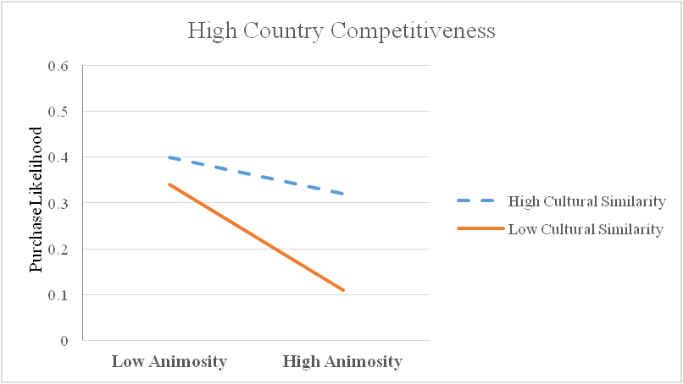
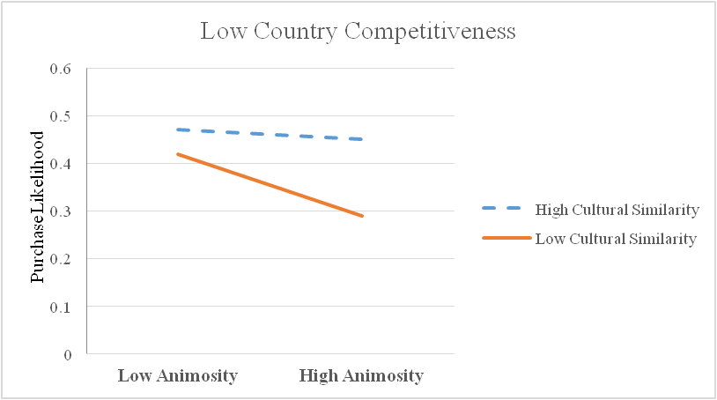
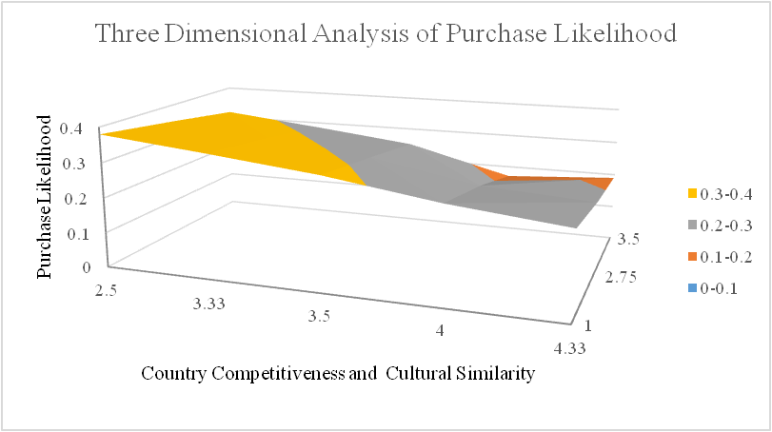

Slide 9
Theoretical Contributions
The first study on intriguing relationships among consumer animosity, cultural similarity, and country competitiveness
Improved animosity model
Emotional mechanisms

Slide 10
Managerial Implications
Selectively soften COO cues
Targeted branding promotion and decision making
Location of the elements of company’s value chain
Sophisticated branding strategies

