Slide 1
A Methodology to Understand Consumer Reactions to Brand Scandals:
The Case of Nike, Kaepernick and Social Justice
Temo Luna-Nevarez
Gerardo Moreira
6iCBR Conference May 21, 2019

Slide 2
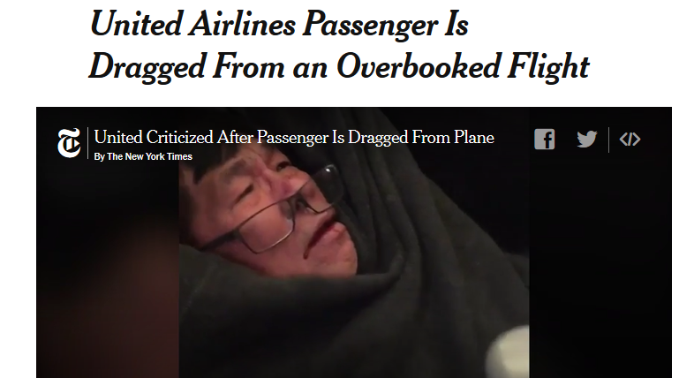
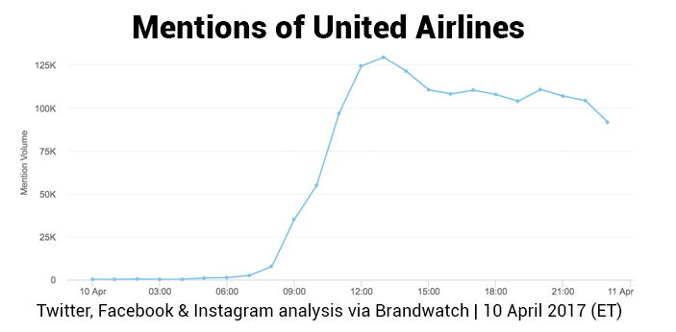
Introduction
Brands have long been affected by scandals of different scopes and impacts.
Brand scandals may affect consumers directly, trigger backlash from them and, eventually, damage the brand reputation.
These events usually cause an immediate response from the public, which leads to thousands of consumer mentions on social media sites, blogs and news sites.
Notes:
In 2015, Chipotle’s business nearly dried up after an E.coli outbreak that spanned 11 states, leading the company to undertake a chain-wide safety retraining in early 2016 that closed all 2,000 of its stores for a day.The event severely damaged consumer confidence and made even the most fervor Chipotle brand loyalist question their claim of fresh, safe ingredients. The knock to consumer confidence lead to a massive drop in Chipotle sales and stock price. Chipotle immediately tried to mitigate risk with public appearances and later launched a full force marketing and PR campaign with the goal of recovering from the massive crisis.

Slide 3
Introduction
The analysis of this user-generated content (UGC) can help firms gain valuable consumer insights, which can be further translated into actionable intelligence.
Taking an exploratory approach, this research proposes a 3-step methodology to understand consumer reactions to brand scandals.
The methodology can be helpful for both practitioners and marketing educators.
We explain the methodology by using a case study: Nike and their “Just Do It” anniversary campaign.

Slide 4
Literature Review
A brand scandal is “an event or series of events that can occasionally or permanently damage a brand’s image” (Gullan, 2016)
Such events can cause a decrease in both consumers’ perceived brand reputation and their level of trust towards the firm (Rhee and Valdez, 2009)
‘Listening’ to consumers’ narratives and their brand perceptions online may represent a way to avoid brand boycotts (Edelman, 2010)
By measuring the volume and sentiment of social conversation, managers can uncover warning signs and assess the impact of a brand scandal (Brown, 2018)
Notes:
No matter how hard you plan and how carefully you control your messaging, scandals sometimes hit. Brand scandals are all different, but one thing is universal: They can seriously tarnish a company’s image and even do irreparable harm to the business in question.
Not all brand scandals are created equal. Some scandals blow over in a week while others linger for years. Some hit hard and all at once, others start small and get worse over time.
But brands are not powerless in the face of a scandal, and there are steps brands can take to avoid, minimize and recover from a scandal. By measuring the volume and sentiment of social conversation about individual crisis-hit brands, we were able to uncover some crucial lessons about the warning signs and impact of scandals.
React quickly
Historically, brands were able to pause before reacting to a scandal, using time to their advantage in an effort to determine if any response at all was required. Today, scandals emerge overnight and consumer responses snowball on social media incredibly quickly. Therefore, a “wait and see” approach is no longer a viable option for most brands. You can stay quiet in the face of a scandal all you want, but your customers won’t.
Instead, brands must be prepared to respond quickly. Our study showed that the brands that reacted quickly, took ownership and offered a sincere and unambiguous apology were able to move on from scandals faster than those that waited.
One example comes from Chipotle. In the fall of 2015, the fast-casual Mexican chain made headlines for exactly the wrong reason: an E. coli outbreak. Because consumer safety was in question, the brand knew it needed to act fast. The chain immediately closed more than 40 locations and issued a statement shortly after, in which they accepted full ownership.
Consumers and stakeholders today have become “empowered” due to their participation in social media activities (Muniz and O’Guinn, 2001)

Slide 5
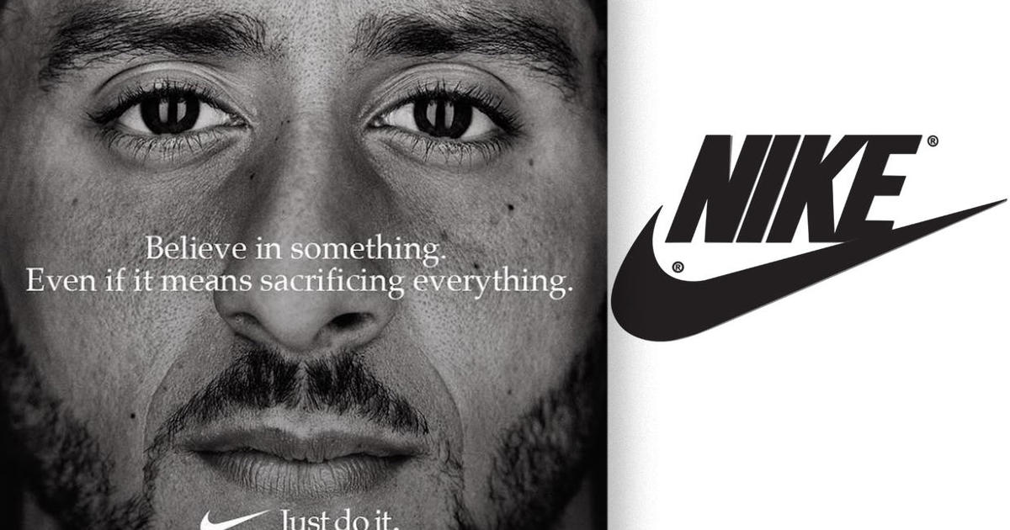
Case Study: Nike
In September 2018, Nike celebrated the 30th anniversary of its “Just Do It” campaign.
The ad pictured Colin Kaepernick.
The campaign triggered both backlash and support from customers and critics.
The release of the ad generated more than 2.7 million mentions of Nike in social media in 1 day.
Notes:
The ad that pictured Colin Kaepernick (a football player who became popular for kneeling during the national anthem in protest of police brutality)

Slide 6
Research Questions
RQ₁: What are the main consumer narratives about Nike’s
scandal?
That is, what are the most relevant themes discussed by
consumers in social media regarding Nike’s campaign?
RQ₂: What is consumers’ sentiment of Nike after the
scandal emerged?
Notes:
when the scandal impacts consumers’ experience with the brand and, especially, if it involves potential harm to users—a defective chin strap on a football helmet or a phone catching fire—greater thought may lead to more consideration of the damage that could occur, and reflection may lead to an increasingly negative view of the brand.”

Slide 7
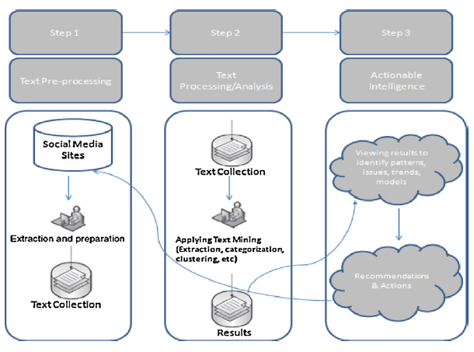
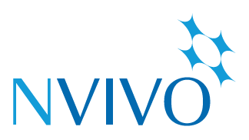
Methodology
Three Steps:
Word Frequency Analysis (Keyword Analysis)
Story Network Analysis (adapted from Boje, 2001)
Sentiment Analysis
Social Media Mining (He et. al, 2013)

Slide 8
Data Collection
An initial search, using 4 real-time social media search tools (Mentionlytics, SocialMention, Mention and Google Alerts), produced 1,680 results (Keywords:“Nike” + “Kaepernick”).
These tools collect information about a topic from thousands of websites, blogs, and social media.
The search covered documents (texts) generated within the first 48 hours after the Nike’s ad was released.
The final sample was 1,020 documents. Duplicated posts and brand-generated content were deleted.
The unit of analysis was a single post on the results page (e.g., a tweet, comment or opinion containing the search keywords).

Slide 9
1. Word Frequency Analysis
Word frequency counts for each word in a document and calculates the percentage of the word occurrences in the text.
Documents were analyzed by word occurrence and frequency using NVivo 12.0 software.
Variations of the same word were grouped and counted as a single keyword (e.g., “brand,” “brands,” “branded,” “branding.”
Words used for sentence construction were deleted.
The remaining words were analyzed and grouped by themes according to the researchers’ assessment.

Slide 10
2. Story Network Analysis
It provides a useful framework for the analysis and construction of meanings and impressions of a topic by modeling types of actors into story network maps (Boje, 2001).
Our Story Network Analysis included the construction of:
Relationship matrix
Story network diagram
A relationship matrix and story network diagram for the main themes discussed by consumers regarding Nike’s campaign were created by the researchers.

Slide 11
3. Sentiment Analysis
Sentiment analysis refers to “the process of automatically detecting if a text segment contains emotional of opinionated content and extracting its polarity or valence.”
It focuses on evaluating attitudes and opinions on a topic of interest using software tools or simple human observation.
NVivo was used to calculate sentiment of Nike’s posts at the sentence-level.
According to NVivo’s algorithm, sentences (or paragraphs) in a document can be classified as very positive, moderately positive, moderately negative or very negative.

Slide 12
Results
More than 1000 words found, but only meaningful words (or keywords) were recorded for further analysis and coding.
Some of these terms included:
Nike, Kaepernick, campaign, company, brands, national, NFL, protest, athletes, support, advertising, consumers, marketing, image, Trump, business, political, burning, activism, controversy, stocks, profits, kneeling, boycott, brutality, racial, police, debate, inspirational, movement, culture, decline, injustice, equality, discrimination, sales, negative, destroying, backlash, fans, diversity, and communities

Slide 13
Results
From Keyword Analysis, we uncovered 6 main themes:
“Nike is just trying to make a profit of social justice…”
“Social protests during the national anthem remain an unresolved NFL issue, still featuring in Trump speeches…”
“Hey @Nike, promoting anti #police propaganda with #Kaepernick seems like an odd marketing strategy. Congrats on your virtue signaling to socialist police-haters, but maybe stick to apparel and not politics...”
Brand Boycott
Nike Products
Marketing Strategy
Racial Protests
Political Views
Social Justice

Slide 14
Results
“F*ck you, @Nike. You made a big mistake.
#Adidas from now.”
Overall, the sentiment among consumers was NEGATIVE, as 63.81% of the documents were very negative or moderately negative.
“Nike stock has opened down over $2 in premarket trading in wake of Colin Kaepernick endorsement deal. That means that the bad decision to sign Kaepernick has already cost Nike $3 billion in market cap. $3 billion!!!”
“Hey Nike, I don’t wear politics or anything related to #ColinKaepernick”

Slide 15
Conclusion
The implications of this content analysis are twofold:
This exploratory research can be effective in identifying consumer narratives and sentiment after a brand scandal, which can allow managers to act quickly and reduce the magnitude of its negative effect.
The proposed three-step methodology can be also a helpful tool for marketing educators (e.g., marketing research, social media marketing, branding, etc.) and demonstrates the importance of user-generated content (UGC) as a valuable source of consumer information.

Slide 16
Limitations and Future Research
Sample size was relatively small and not randomly selected (i.e. convenience sample). The texts were collected by using four real-time online search engines.
Unit of analysis used was a single text extracted from a website or social media page (e.g. post, tweet, comment). Further analysis of other texts such as replies or responses to comments (i.e. second-level comments) could be also analyzed.
This is only an exploratory analysis. A follow-up study using experimental (or quantitative) research would be strongly recommended.

Slide 17
Any Questions???
A Methodology to Understand Consumer Reactions to Brand Scandals:
The Case of Nike, Kaepernick and Social Justice
Temo Luna-Nevarez
Gerardo Moreira

