Slide 1
The Role of Culture and Brands’ Health Messages: Evaluating Hispanic Consumers’ Response to Healthy Eating Appeals
Tessa Garcia-Collart, Nuket Serin and Jayati Sinha

Slide 2
“Matching the cultural characteristics of minority populations with public health interventions may enhance receptivity to, acceptance of, and salience of health information and programs.” - Thomas, Fine & Ibrahim (2004)
“The fight against the obesity epidemic must have a culturally relevant approach.” - World Health Organization (2014)
Notes:
NOTE: Belief systems, religious and cultural values, life experiences, and group identity act as powerful filters through which information is received. It is important to consider these factors in the development of health communication campaigns.
VERBATIM: “Matching the cultural characteristics of minority populations with public health interventions designed to affect individuals within the group may enhance receptivity to, acceptance of, and salience of health information and programs. This approach is consistent with the documented evidence that factors such as belief systems, religious and cultural values, life experiences, and group identity act as powerful filters through which information is received. It is important to consider these factors in the development of health communication campaigns.” - Thomas, Fine & Ibrahim (2004)

Slide 3
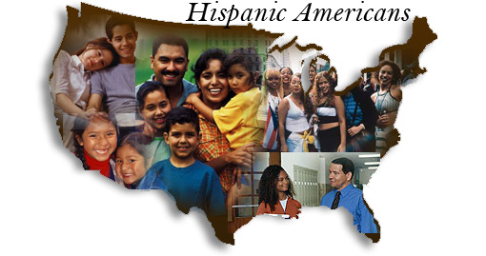
Hispanics in the US:
Facts
In 2018, Hispanics in the US:
18% of US population
Growth expectations by 2050
(US Census Bureau, 2018)
Overweight & Obesity
80% Hispanic versus 68,5% of non-Hispanic White
(CDC, 2017)
Increased propensity for obesity rates within this community
(The State of Obesity, 2014)
Notes:
Third Bullet: Limited access to healthcare programs, higher hunger rates and lower quality food availability increase such propensity
(Transition: To understand the health needs and situation of the Hispanic community, we must understand the current socioeconomic factors)

Slide 4
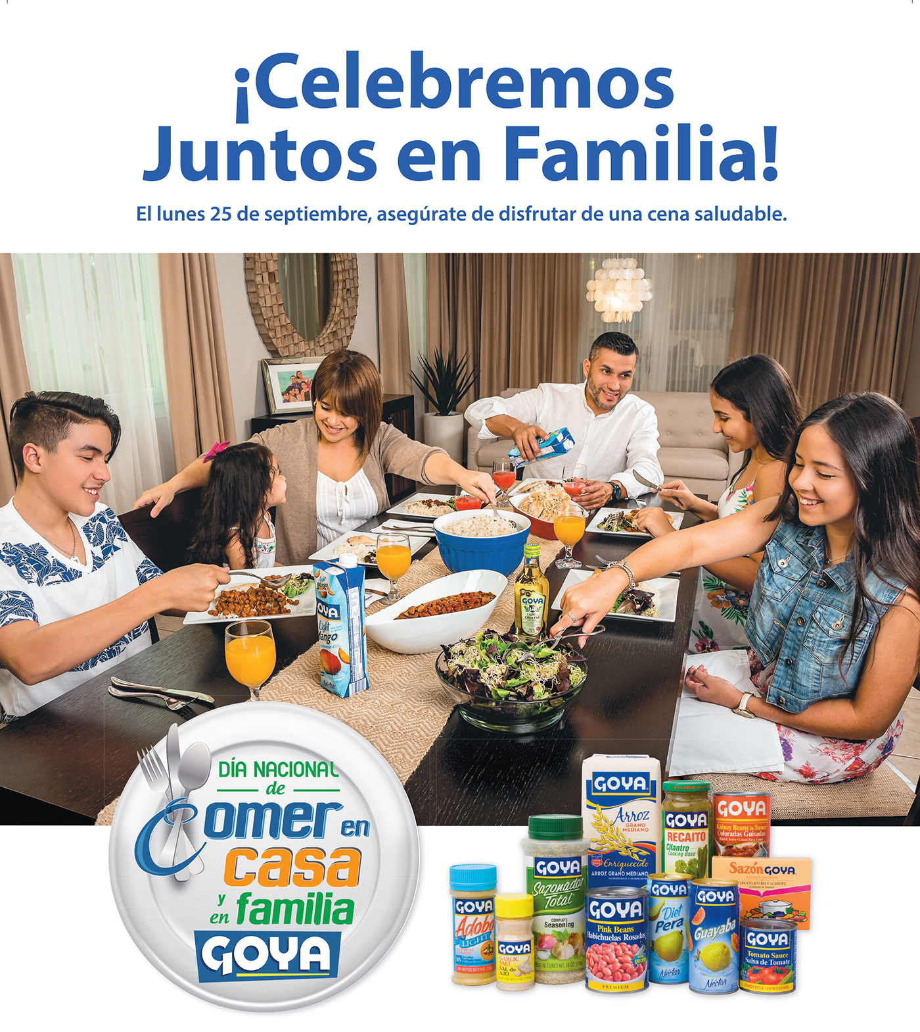
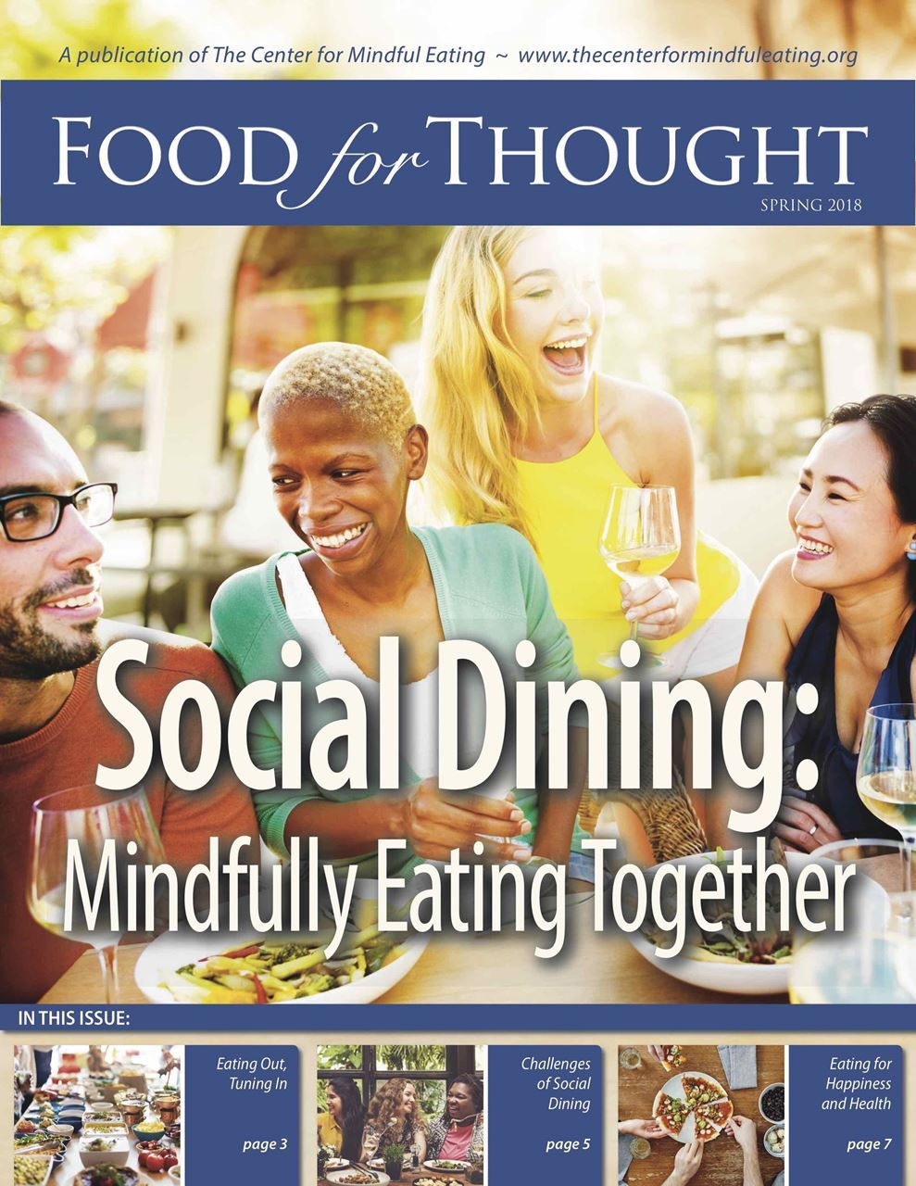
Healthy Eating Appeals
Let's Celebrate Together as a Family!
Make sure to enjoy a healthy dinner on Monday September 25th!
Notes:
Highlight: CULTURALLY relevant approach as advised by World Health Organization (Facts on Obesity) and Thomas, Fine and Ibrahim, 2004.

Slide 5
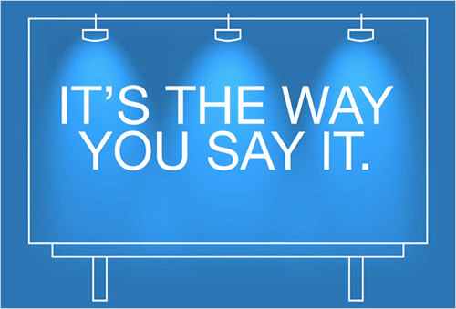
Message Framing & Persuasion
Health communications significantly influence consumer’s attitudes, emotions and behaviors
Andrews, Netemeyer, & Burton, (1998); Goldberg et al., (2006); Naylor, Droms, & Haws, (2009); Schneider et al., (2001)
Effectiveness of health ads depends on message content and consumers’ characteristics
Pechmann & Catlin, (2016)
Message framing (narrative) influences consumers’ perceptions of message persuasion
Smith & Petty, (1996); Aaker & Lee, (2001); Chandran & Menon, (2004)
Notes:
Important: Persuasiveness of appeals directly linked to MESSAGE FRAMING

Slide 6
Hispanics’ Self-Construal
Interdependent self-view
Focus on their community
Connected to others
Value interpersonal relationships
Independent self-view
Focus on self
Detached from others
Value unique attributes
CO-WORKERS
FAMILY
SELF
FRIENDS
FRIENDS
Self-Views Choices & Behavior
Source: Markus & Kitayama, (1991); Lee, Aaker, & Gardner, (2000); Aaker & Williams, (1998); Aaker & Lee, (2001
Notes:
These different self-views guide consumers’ choices, preferences and behavior

Slide 7
Health Appeals = Hispanic Identity
Matching Effect
The effectiveness of identity-congruent appeals depends on the context (Healthy Eating)
Considering:
Hispanics’ self-construal
Hispanics’ relationship with food:
social & individual dimensions
SELF
SOCIAL
EATING
Notes:
(Transition: While many studies have been devoted to understanding the trends, preferences, consumption patterns of Hispanics, limited knowledge exists on which type of health appeals will in fact increase their healthy eating & exercising / fitness choices )

Slide 8
Hispanics & Healthy Eating
Hispanics are more likely to eat socially than alone
(Multicultural Latino Consumer Report, 2013)
High consumption of fast-foods & less available nutritious foods
(Boutelle, et al., 2006)
Parental healthy (unhealthy) choices affect children significantly
Habits persist through adulthood
(Moore, Wilkie, & Desrochers, 2017)
* 3x per week
(Boutelle, et al., 2006)
No Matching Effect:
Hispanic Identity = Self-framed Healthy Eating Appeals
Notes:
Hispanics are more likely to eat socially with friends and family, than they are to be eating alone
15.9% of Hispanic households consume family meals consisting of fast food items, +3x per week, compared to 9.6% of non-Hispanic Whites and to 7.7% of non-Hispanic Blacks
Positive relation between higher rates of fast-food consumption with less available nutritious foods (i.e. fruits and vegetables) in Hispanic households.
Parent’s healthy (unhealthy) choices affect their children significantly, persisting through adulthood
TRANSITION: While Hispanics regard family mealtimes as an important aspect of their cultural values, they are generally less nutritious compared to other ethnic groups in the US.

Slide 9
Research Questions
1.
Are Hispanics more persuaded by health messages that are congruent with their self-construal (social versus self)?
2.
Do Hispanics’ cultural perceptions of healthy eating (individual versus social) impact attitudes toward health appeals (self versus social framed)?
3.
Are Hispanics’ healthy eating choices affected by health appeals that are framed individually versus social framed?
Notes:
Research Question: Are Hispanics more persuaded by health messages that are congruent (versus incongruent) with their self-construal?

Slide 10
Hypotheses:
Identity incongruent effect of culture
Self-framed (social-framed) appeals will be more (less) effective in persuading Hispanic consumers to increase healthy food choices.
Hispanics’ cultural perceptions of healthy eating as an individual (versus social) activity, will mediate the proposed effects of ethnicity on message appeal.
Message framing (self versus social) will moderate the effects of culture on ad persuasion, attitude and choices.
H1
H2
H3

Slide 11
Conceptual Model
H2
Message Framing
Cultural Perceptions
of Healthy Eating
H3
Culture
Attitudes / Choices
H1
Notes:
We propose a moderated mediation model

Slide 12
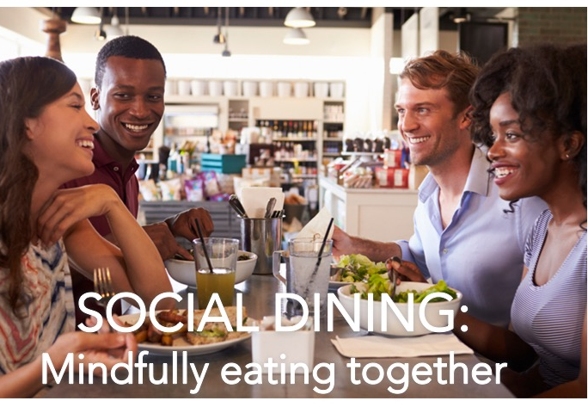
Study 1
Hispanics’ Response to Healthy Eating Appeals
Objective: Demonstrate Hispanics’ are more persuaded by self-framed healthy eating appeals versus social-framed (H1)
Participants
159 undergraduate students (47.2% female; M_{age} = 22.5)
Design
2 (self-construal: independent, interdependent) x 2 (message frame: social, self) between subjects design
Self-Construal Manipulation (Aaker and Lee 2001)
Main DV: Appeal Persuasion (Reichert, Heckler, and Jackson 2001, α = .888)
Covariates
Nutrition Involvement (Chandon & Wansink, 2007; α = .824)
Identification with the Hispanic culture
Generation (COO / Parents’ COO)
Notes:
IMPORTANT: OUR RESEARCH SEEKS TO TEST that Hispanics’ positive response to health appeals congruent with their identity, is context dependent

Slide 13
Study 1
Results
F(1, 158) = 4.68, p = .032
Main Effect Message Framing:
F(1, 158) = 1.69, p = .196)
Main Effect Construal:
F(1, 158) = .026, p = .873
Interdependent Condition
M_{Self} = 4.03, SD = 1.80
M_{Social} = 3.19, SD = 1.24
(t = -2.43, p = .017)
Independent Condition
M_{Self} = 3.55, SD = 1.48
M_{Social} = 3.68, SD = 1.67
( t = .356, p = .723 )

Slide 14
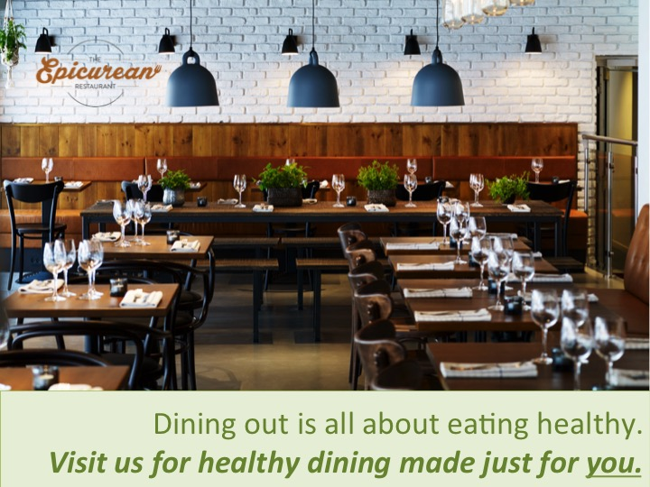
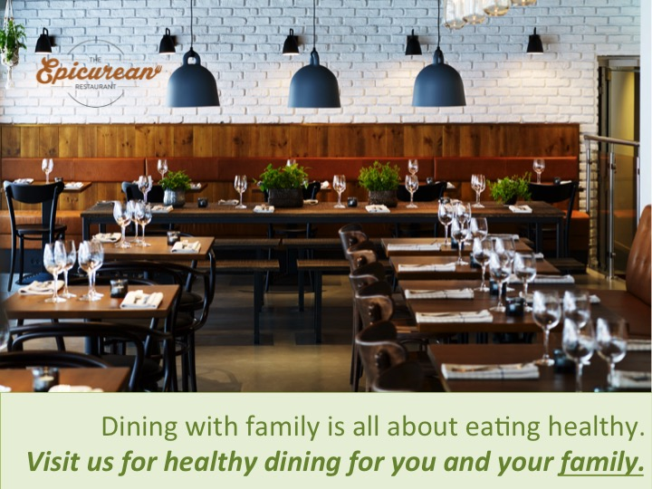
Study 2
Hispanics’ Cultural Perceptions of Healthy Eating
Objective: Replicate previous findings and evaluate cultural perceptions of eating as mediator and message framing as moderator (H2, H3)
Participants
153 undergraduate students (50% Hispanic; 53% Female, M_{age} = 23)
Design
2 (ethnicity: Hispanic, Non-Hispanic) x 2 (message framing: self-framed, social-framed) between subjects design
Main Variables
Ad Attitudes (Sprott & Shimp, 2004; α = .95)
Cultural Perceptions of Healthy Eating (α = .60)
Self-Framed
Social-Framed
Notes:
IMPORTANT: OUR RESEARCH SEEKS TO TEST that Hispanics’ positive response to health appeals congruent with their identity, is context dependent

Slide 15
Study 2
Effect of Culture on Attitudes toward the advertisement
F(1, 149) = 6.75, p = .01
Main Effect Message Framing:
F(1, 149) = .143, p = .71)
Main Effect Construal:
F(1, 149) = .634, p = .43
Non-Hispanics
M_{Self} = 4.26, SD = 1.32
M_{Social} = 4.71, SD = 1.39
(t = -1.43, p = .16)
Hispanics
M_{Self} = 4.95, SD = 1.07
M_{Social} = 4.34, SD = 1.13
( t = 2.37, p = .021)
t = 2.37, p = 0.02
t = -1.43, p = 0.16

Slide 16
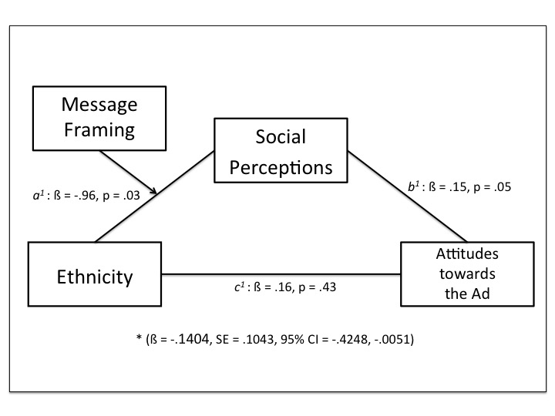
Study 2
Analysis of Conceptual Model: Moderated Mediation
Cultural Perceptions of Healthy Eating
F(1, 149) = 4.72, p = .031
Main Effect Message Framing:
F(1, 149) = .725, p = .40
Main Effect Construal:
F(1, 149) = .208, p = .65
Non-Hispanics
M_{Hispanic} = 4.26, SD = 1.32
M_{Social} = 4.71, SD = 1.39
(t = -1.43, p = .16)
Hispanics
M_{Self} = 4.95, SD = 1.07
M_{Social} = 4.34, SD = 1.13
( t = 2.37, p = .021)
Notes:
Model 7 PROCESS MACRO, Hayes (2018)

Slide 17
Study 3
Actual Eating Choices
Objective: Evaluate actual food choices of interdependent versus independent consumers when presented with either a self or social framed healthy eating appeal.
Participants: 115 undergraduate students (61% Female, M_{age} = 23)
Design: 2 (self-construal: interdependent / independent) x 2 (message framing: self-framed, social-framed) between subjects design
Snack Choice:
Snack choice (0 = healthy and 1 = unhealthy)
Main effect of self-construal (β = .967, t(114) = 2.79, p < .095), MS
Main effect of message framing (β = .091, t(114) = .024, p = .876), NS
Interaction term (β = -1.423, t(114) = 2.93, p < .087), MS
Spotlight analysis (PROCESS Model 1, Hayes 2018)
Interdependent condition: (self = 33%, social = 65%),
Z = -2.25, CI: -2.49, -.17, p = .02
Independent condition: (self = 44%, social = 42%),
Z = .16, CI: -1.05, 1.23, p = .88
Healthy Snack Choice
Unhealthy Snack Choice
Notes:
IMPORTANT: OUR RESEARCH SEEKS TO TEST that Hispanics’ positive response to health appeals congruent with their identity, is context dependent

Slide 18
CONCLUSIONS & MANAGERIAL IMPLICATIONS
Identity incongruent effect: Interdependents (Hispanics) respond more positively to self-framed (versus social-framed) healthy eating appeals
Findings ascertain the strong influence of culture in the marketing / consumer behavior domain
Health marketers can use this information to design marketing strategies that although do not match Hispanics self-construal, better align with their culture

Slide 19
Tessa Garcia-Collart
tgarciac@fiu.edu

