Slide 1
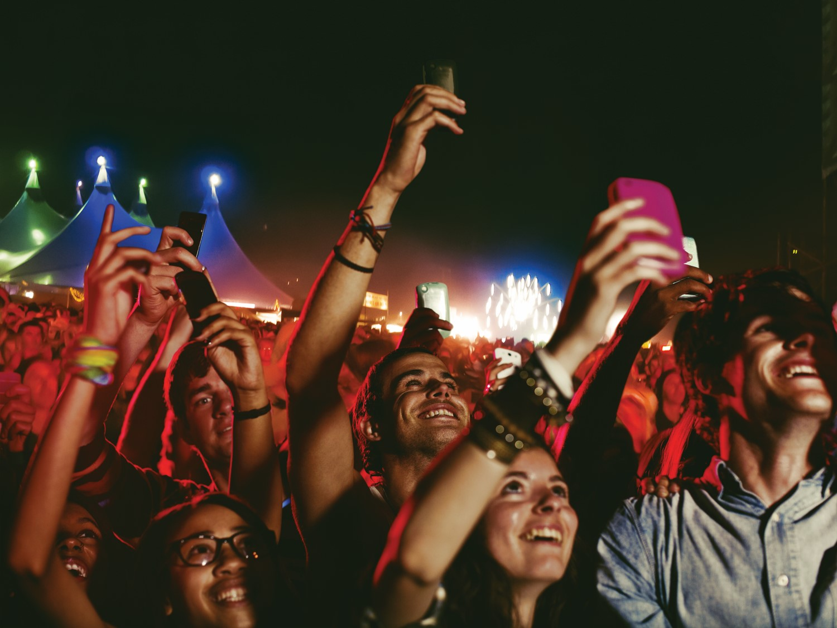
Brand enthusiasm: More than loyalty
IBM Institute for Business Value & Global Consumer Products Industry
Presenters: T. Davis & A. Bigornia
How today’s consumers want to engage with your brand
Global Consumer Brand Relationships Conference, Porto, May 2015

Slide 2
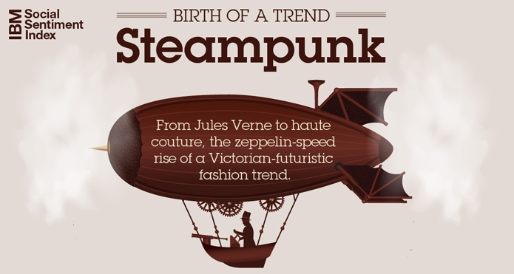
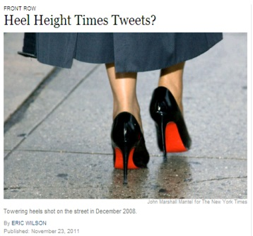
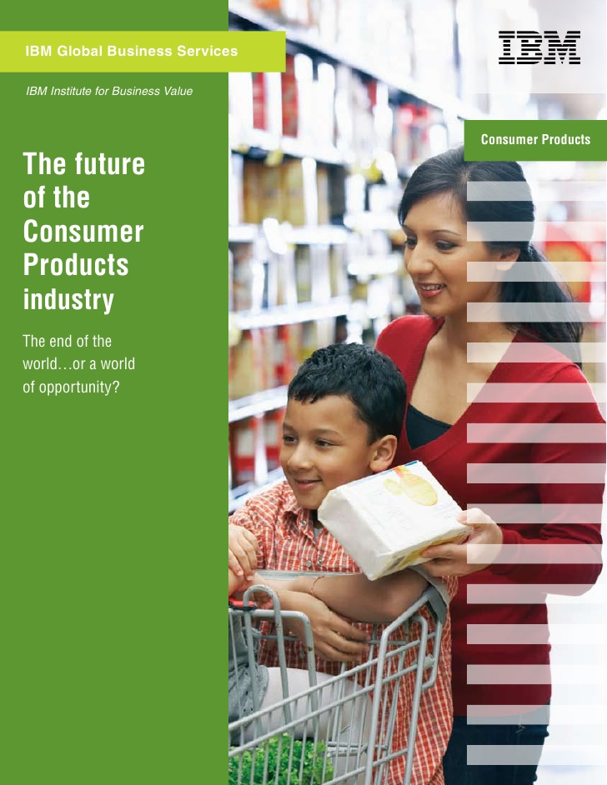
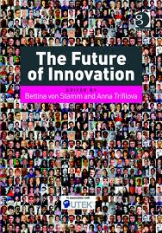
About Trevor
IBM Distinguished Engineer & Research Scientist by background
Worked across Marketing and Operations in FMCG for last 20+ years (Diageo, Heineken, Mars, Kraft, P&G, Unilever, etc.)
Member of IBM Industry Academy
Contact: trevor.davis@uk.ibm.com
2

Slide 3
Our hypothesis: Digital consumerization has fundamentally changed consumer behaviour with respect to brand loyalty
Consumers are adopting technology at unprecedented rates.
Top two influencers of purchases are a friend’s posts and pins on social networks.
Consumer brand loyalty appears to be waning.
6B
Mobile devices world-wide; 1B+ of them smartphones
2.5B
Active Facebook, Twitter, and YouTube accounts
78%
Of consumers are not loyal to a particular brand
Source: Nielsen

Slide 4
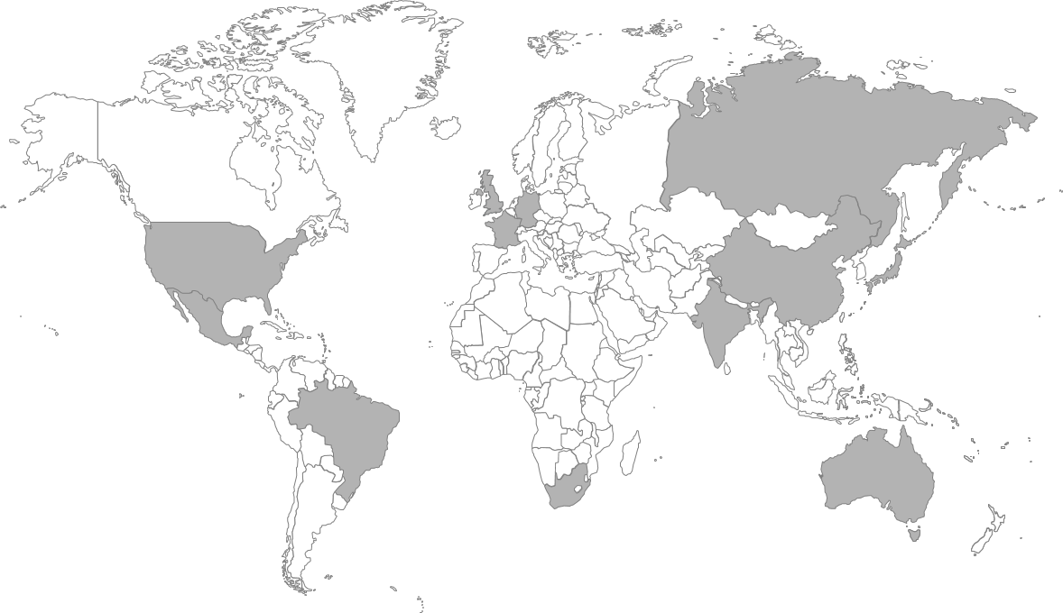
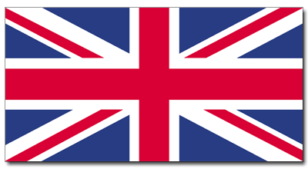
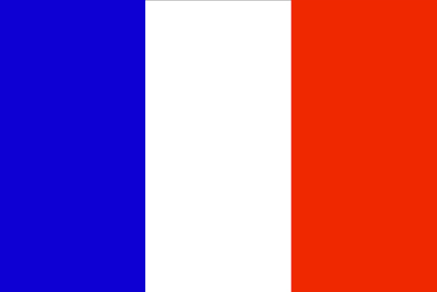
IBM surveyed 18,462 consumers across 12 countries and 6 continents
IBM Institute for Business Value
Primary Research from 12 Countries
Total Surveyed = 18,462
USA
n=1,547
UK
n=1,537
South Africa
n=1,521
Russia
n=1,507
Mexico
n=1,501
France
n=1,523
China
n=1,492
Japan
n=1,624
Brazil
n=1,504
Germany
n=1,513
India
n=1,622
Australia
n=1,571
4
Source: CP IBV Consumer Survey 2014, n=18,462

Slide 5
Respondents were analysed across a range of age groups, income brackets, and product categories
IBM Institute for Business Value
Age Groups
Income Brackets
18-29 | n= 4351 | 24%
30-39 | n= 3535 | 19%
40-49 | n= 3378 | 18%
50-59 | n= 2968 | 16%
60+ | n= 4220 | 23%
Lower | n= 6545 | 41%
Middle | n= 4478 | 28%
High | n= 2427 | 15%
Affluent | n= 2584 | 16%
Product Categories*
Apparel & Footwear | n= 7719 | 42%
Food & Beverage | n= 7726 | 42%
Household Products | n= 7709 | 42%
Personal Care | n= 7711 | 42%
Tobacco | n= 5644 | 31%
Source: CP IBV Consumer Survey 2014, n=18,462
* Respondents were segmented into 2 product categories each

Slide 6
We asked consumers about their attitudes, preferences, and behaviour in order to truly understand their sentiment towards brands
IBM Institute for Business Value
BRAND ATTITUDES
How brand loyal are you?
To what extent do you like to try new brands?
How much do you want to actively engage?
TECH USAGE
Do you consider yourself tech savvy?
How often do you use social media?
Do you like to purchase gadgets as soon as they come out?
PRODUCT DECISION CONSIDERATIONS
What is your willingness to pay for specific brand characteristics or product features?
How important are factors such as health and wellness, and social and environmental responsibility in your purchase decision making?
SHOPPING BEHAVIOUR
Which shopping channels do you use?
How willing are you to share your personal data with brands?
How influenced are you by different types of media?

Slide 7
Brand enthusiasm is a more relevant way to understand consumers in today’s digital landscape
Brand loyalty
Brand enthusiasm
Repeat Transactions
Level of Communication Desired
Willingness to Provide Input
Degree of Comfort with Sharing Personal Data
The extent to which consumers buy the same brand repeatedly
The extent to which consumers want brands to actively recognize, communicate to, and dialogue with them.
How willing and eager consumers are to provide input and feedback about brands.
The level of comfort consumers have with sharing various forms of personal information with brands.
No insight into why consumers repeat purchase or attitude towards brands
Provides not only an understanding of consumer preferences and behaviour, but also overall attitude towards and trust in brands
OLD CONSUMER VIEW
NEW CONSUMER VIEW
Source: IBV Analysis

Slide 8
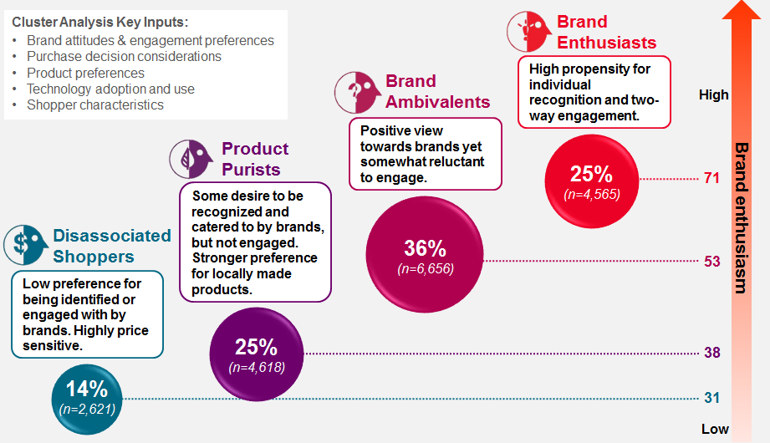
Big Data approach applied to reveal a four distinct consumer clusters across all Categories and Countries
Custom survey instrument for data collection across 5 Categories: Apparel, Food and Beverage, Household Products, Personal Care Products, Tobacco
MaxDiff analysis used to analyse relative importance of product preferences for each Category and by Country
Two-step cluster analysis (CA) used to reduce set of survey inputs into smaller subsets or groups
Hierarchical to "set the landscape" of persons, products or occasions that can be characterized based on their similarities (e.g. product preferences)
k-means iteratively to establish a final solution with a holdout sample to test reliability of the determined a four-cluster solution

Slide 9
We identified four consumer groups, each representing different levels of brand enthusiasm and engagement preferences
Cluster Analysis Key Inputs:
Brand attitudes & engagement preferences
Purchase decision considerations
Product preferences
Technology adoption and use
Shopper characteristics
Brand Enthusiasts
Brand Ambivalents
High propensity for individual recognition and two-way engagement.
High
Positive view towards brands yet somewhat reluctant to engage.
Product Purists
25%
(n=4,565)
71
Some desire to be recognized and catered to by brands, but not engaged. Stronger preference for locally made products.
Brand enthusiasm
Disassociated Shoppers
36%
(n=6,656)
53
Low preference for being identified or engaged with by brands. Highly price sensitive.
25%
(n=4,618)
38
14%
(n=2,621)
31
Low
Source: CP IBV Consumer Survey 2014, n=18,462

Slide 10
However, proceed with caution: Brand Enthusiasts demand constant engagement and are loyal to newness
Brand Loyalty vs. Preference for Trying New Brands, by Cluster
(Size denotes cluster population)
Brand Enthusiasts
Key Takeaways
Consumer brand loyalty is increasingly fickle
Brand loyalty no longer means purchase exclusivity
Disassociated Shoppers and Product Purists demonstrate ‘brand loyal’ behaviour—but aren’t
Brand Ambivalents
I like to try new brands frequently
Product Purists
Disassociated Shoppers
I consider myself to be brand loyal
Source: CP IBV Consumer Survey 2014, n=18,462. Q06_2: Try new brands; Q06_7: Brand loyal

Slide 11
Consumer clusters’ level of brand advocacy is consistent across most product categories
“I often make recommendations or write reviews about the products I use”
(Percentage who agree)
Apparel & Footwear
Food & Beverage
Household Products
Personal Care Products
Tobacco
Brand Enthusiasts
61%
60%
61%
63%
54%
Brand Ambivalents
18%
20%
21%
21%
12%
Product Purists
6%
7%
8%
7%
5%
Disassociated Shoppers
5%
6%
6%
6%
3%
Source: CP IBV Consumer Survey 2014, n=18,462. Q10: How strongly do you agree or disagree with the statements listed below? Q10_2: I often make recommendations or write reviews about the [PRODUCT CATEGORY] products I use.

Slide 12
Brand enthusiasm can help companies strike the right balance between engagement and reach, efficiently and effectively
Reach vs. Engagement by Cluster
(Size denotes cluster population)
Key Takeaways
Engagement and reach are not mutually exclusive
Different consumers crave different levels of 1 to 1 interaction and broad communication
Brand enthusiasm can be used to determine a brand’s investment approach
Brand Enthusiasts
Brand Ambivalents
Product Purists
Reach
Disassociated Shoppers
Degree of Influence from Mass Communication
Willingness for 1:1 Interaction with Brand Owners
Engagement
Source: CP IBV Consumer Survey 2014, n=18,462. Q11: Discovery influence; Q06_8: Recognized as individual; Q06_11: Solicit my input; Q06_12: Engage via social media

Slide 13
Brand owners who are not taking advantage of the data consumers are willing to share are missing out on a key opportunity
Degree of comfort with sharing personal information with brands
Disassociated Shoppers
Product Purists
Brand Ambivalents
Brand Enthusiasts
Which products I’ve purchased before
16%
24%
42%
74%
My email address
16%
21%
40%
74%
How often and when I last purchased a product
14%
19%
37%
73%
Demographic data
15%
19%
35%
69%
Data related to my media usage habits
13%
16%
34%
71%
Data related to my health and wellness
11%
15%
32%
69%
9%
My social media activity
10%
26%
65%
Data related to my lifestyle
10%
12%
25%
62%
9%
My cell phone number
9%
24%
60%
My online history
9%
11%
24%
60%
Location-based data
9%
11%
24%
59%
% of Consumers who are Comfortable
Source: CP IBV Consumer Survey 2014, n=18,462. Q08: Think about a trusted brand that you purchased recently. Indicate the extent to which you are comfortable or uncomfortable with that brand using personal information to customize a message or service to you.

Slide 14
With alternative forms of online purchasing poised to dramatically increase, going direct to consumer is a significant opportunity
Clusters current vs. expected purchasing using various methods GLOBAL
32%
39%
42%
average growth
Buy Online, Ship to Home
52%
46%
Now
1-2 yrs
Now
1-2 yrs
Now
1-2 yrs
Now
1-2 yrs
190%
183%
180%
178%
average growth
Buy Online, Pick up in Store
160%
Now
1-2 yrs
Now
1-2 yrs
Now
1-2 yrs
Now
1-2 yrs
400%
250%
500%
382%
average growth
Auto-replenishment
380%
Now
1-2 yrs
Now
1-2 yrs
Now
1-2 yrs
Now
1-2 yrs
Brand Enthusiasts
Brand Ambivalents
Product Purists
Disassociated Shoppers
Source: CP IBV Consumer Survey 2014, n=18,462. Q14: Which of the following ways do you currently purchase and obtain products? Q15: In the next year or two, how likely do you think you will be to purchase or obtain products online?

Slide 15
Brands need to adjust their strategies to accommodate new consumer attitudes, behaviour, and norms
Re-define your consumer mix for growth
Prepare for tomorrow’s digital world, not today’s
Create a consumer-focused, data-driven organization
Do you know who you Brand Enthusiasts are?
How are you going to capture the Brand Ambivalents?
Do you have impulse, point of sale initiatives underway to cater to Product Purists and Disassociated Shoppers?
Are you starting to engage directly via digital?
Are you preparing to deliver next level digital experiences?
Do you have the right innovation and channel partners?
Is your organization starting down the path of consumer centricity?
Do you have the skills you need to keep up with Brand Enthusiasts?
Are you leveraging consumer data and listening to consumer feedback?

Slide 16
Notes:
IBM Big Data & Analytics © 2013 IBM Corporation
16

