Slide 1
A Two-Way Street: Examining the Impact of Brand Transgressions on Consumers’ Perceptions of Celebrity Endorsers
Veronica L. Thomas
Towson University
&
Kendra Fowler
Youngstown State University

Slide 2
Ball
Celebrity Endorsers
Individuals that “enjoy public recognition and use this recognition on behalf of a consumer good by appearing with it in an advertisement” (McCracken 1989).
Celebrity endorsers are effective at influencing:
Attitudes towards the product (Atkin & Block 1983; Eisend & Langner 2010; Kahle & Homer 1985)
Purchase intentions (Kahle & Homer 1985)
Perceptions of performance and financial risk (Biswas et al. 2006)
Sales (Elberse &Verleun 2012)
Stock prices (Elberse & Verleun 2012)

Slide 3
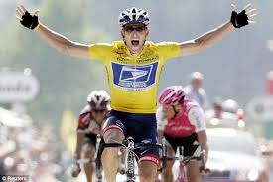
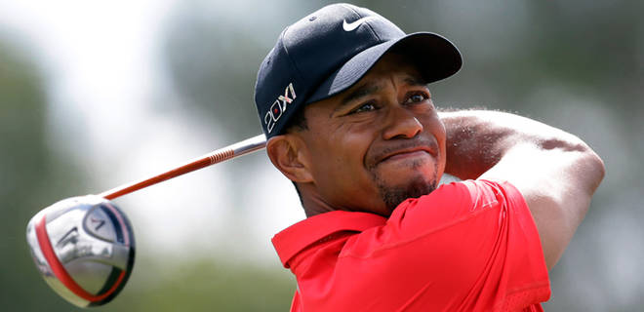
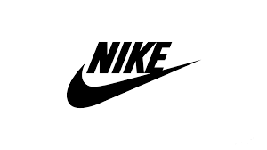
Ball
Celebrities Behaving Badly
Celebrity Transgressions
Negatively impact consumers’ evaluations of the brand (Till & Shimp 1998; Um 2013).
Reduce purchase intentions (Um 2013)
Adverse effect on stock returns (Bartz, Molchanov, & Stork 2013)
Notes:
Marketwatch.com:
Lance Armstrong and Nike
ESTIMATED VALUE OF DEAL: $10 MILLION A YEAR
He also lost lucrative sponsorships with Nike, Anheuser-Busch InBev, Trek Bicycle Corp, FRS and Honey Stinger, among others. (http://fortune.com/2014/09/20/ray-rice-adrian-peterson-tiger-woods-athletes-dropped-endorsements/)
Tiger Woods and Accenture
ESTIMATED VALUE OF DEAL: $10 MILLION A YEAR
Gillette, Accenture, AT&T, Gatorade and Tag Heuer soon ended their endorsements. Nike stuck by him, but as Fortune learned in 2011, it slashed the value of his $20 million-per-year deal in half for two years as a punishment. These days, Woods has a smaller portfolio of deals (still lucrative enough to crack the top ten of our Fortunate 50 list) with Nike, Rolex, Japanese heat-rub Kowa, and Asian wristband-maker All Custom Focus. (http://fortune.com/2014/09/20/ray-rice-adrian-peterson-tiger-woods-athletes-dropped-endorsements/)
http://www.marketwatch.com/story/what-lance-lost-6-endorsement-deals-gone-bad-2012-10-18

Slide 4
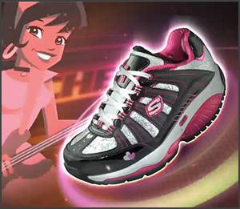
Do the actions of brands impact how consumers view the celebrities that
are paid to endorse them?
“…Instead of encouraging young girls to be healthy, live a balanced life and feel good about their individuality and natural body type, ads like this tell young girls that they need to “shape up” and run away from food to be popular and successful… Skechers is the one who needs to shape up!” - Lynn Grefe, president and CEO of NEDA
"The attempt to commercialize and make popular more than 200 years of human degradation, where blacks were considered three-fifths human by our Constitution is offensive, appalling and insensitive. Removing the chains from our ankles and placing them on our shoes is no progress. ... These slave shoes are odious and we as a people should be called to resent and resist them.“ – Rev. Jesse Jackson

Slide 5
Ball
Transfer of Meaning
Objects and persons that have been endowed with culturally constituted meanings can transfer these meanings to products (McCracken 1986).
Brands carry cultural meaning (Schroeder 2009)
Celebrities can be conceptualized as branded products (Luo et al. 2010)
This suggests that brands (an object) could also transfer meaning to a celebrity (the product).

Slide 6
Ball
Associative Network Model of Memory
Memory is stored in nodes that are connected by links (Anderson 1983)
Celebrities and the brands that they endorse can become linked in a consumer’s memory (Keller 1993; Till & Shimp 1998; Till 1998)
Support for this assertion:
Perceptions of the brand should also be able to impact the image of the celebrity (Seno & Lukas 2007)
Perceptions of a brand can impact perceived attributes of a celebrity such as attractiveness, trustworthiness, expertise, and credibility (Doss 2011)
Analysis of newspaper articles suggests that actions committed by a brand may transfer to the endorser (Halonen-Knight & Hurmerinta 2010)

Slide 7
Ball
Hypothesis #1
H1: A transgression committed by a brand will negatively impact consumers’ attitudes toward the celebrity endorsing the brand.

Slide 8
Ball
Responsibility & Moral Reputation
Attribution theory (Heider 1958) suggests that blame (Bailey and Bonifield 2010; Cleeren et al. 2013) and the often held mindset that others are guilty by association (Cleeren et al. 2013) may be the one part of the underlying mechanism that results in a reduction of consumers’ attitudes toward the endorser.
Moral psychology research suggests that perceptions of responsibility impact individuals make moral judgments unconsciously and automatically (Greene and Haidt 2006).
Perceptions of responsibility have been found to impact moral reputation (Zhou and Whitla 2013)
Further, assessments of moral reputation results in feelings of instant approval or disapproval (Greene and Haidt 2006).
Decreases in perceptions of moral reputation also lead to decreases in attitudes (Zhou and Whitla 2013)

Slide 9
Ball
Hypothesis #2
H2: The impact of a transgression committed by a brand on consumers’ attitudes toward the celebrity endorsing the brand will be sequentially mediated by perceptions of responsibility and moral reputation.
Perceptions of Responsibility
Moral Reputation
Brand Transgression
Attitudes

Slide 10
Ball
Study : Pretests
Pretest 1 (n= 97):
Objective: Determine celebrity endorser
Results: Justin Timberlake was selected
98% indicated familiarity and strong, positive attitudes (M = 5.92, SD = 1.42, Median = 6.25)
Pretest 2 (n= 27):
Objective: Determine transgression
Results: “A company knowingly sells products with defects that result in consumer harm” was selected
Perceived as severe (M = 6.88, SD = .34, Median = 7.00)
Pretest 3 (n= 20):
Objective: Determine brand name
Results: Escapade was selected
Suitable for a cologne (M = 4.50, SD = 1.76, Median = 4.00)
Suitable for a perfume (M = 4.20, SD = 2.01, Median = 4.00)
Overall positive attitudes (M = 4.60, SD = .18, Median = 4.70)

Slide 11
Ball
Study : Design & Methods
Undergraduate business students (n= 127: average age 21, 49% male)
Variables:
Randomly assigned to transgression (coded 1) or no transgression (coded 0) condition.
Measured irresponsibility using items adapted from Radighieri et al. (2014)
Measured moral reputation using Zhou and Whitla (2013) scale
Measured attitudes

Slide 12
Ball
Study : Design & Methods
Procedure
Rated attitudes toward Timberlake
10 minute filler task
Fictitious article announcing endorsement deal
Assignment to transgression condition
Completed survey measures

Slide 13
Ball
Results: H1
One-Way Repeated Measures ANOVA with condition as the between subjects factor revealed a significant interaction between change in attitudes and the transgression condition (F (1, 125) = 7.87, p < .01).

Slide 14
Ball
Results: H2
Data were analyzed using Hayes’ (2013) Process macro in SPSS 21.0 (Model 6).
Perceptions of Irresponsibility
.61**
Poor Moral
Reputation
.79**
-.14
-.27*
-.35
Transgression Condition
-.13
Attitudes toward Celebrity

Slide 15
Ball
Contributions
This research suggests that celebrities should carefully consider the risks they are assuming before endorsing a brand.
Celebrities should search for ways to minimize the negative effect on their own reputation should an endorsed brand face negative press.
This research suggest that the relationship between the brand and the celebrity endorser is a two-way street.
This study is one of the first to not only empirically test for the effect of a brand transgression on attitude toward the endorser, but also to show a sequential pathway by which this relationship transpires.
Thank You! Questions?

