Slide 1
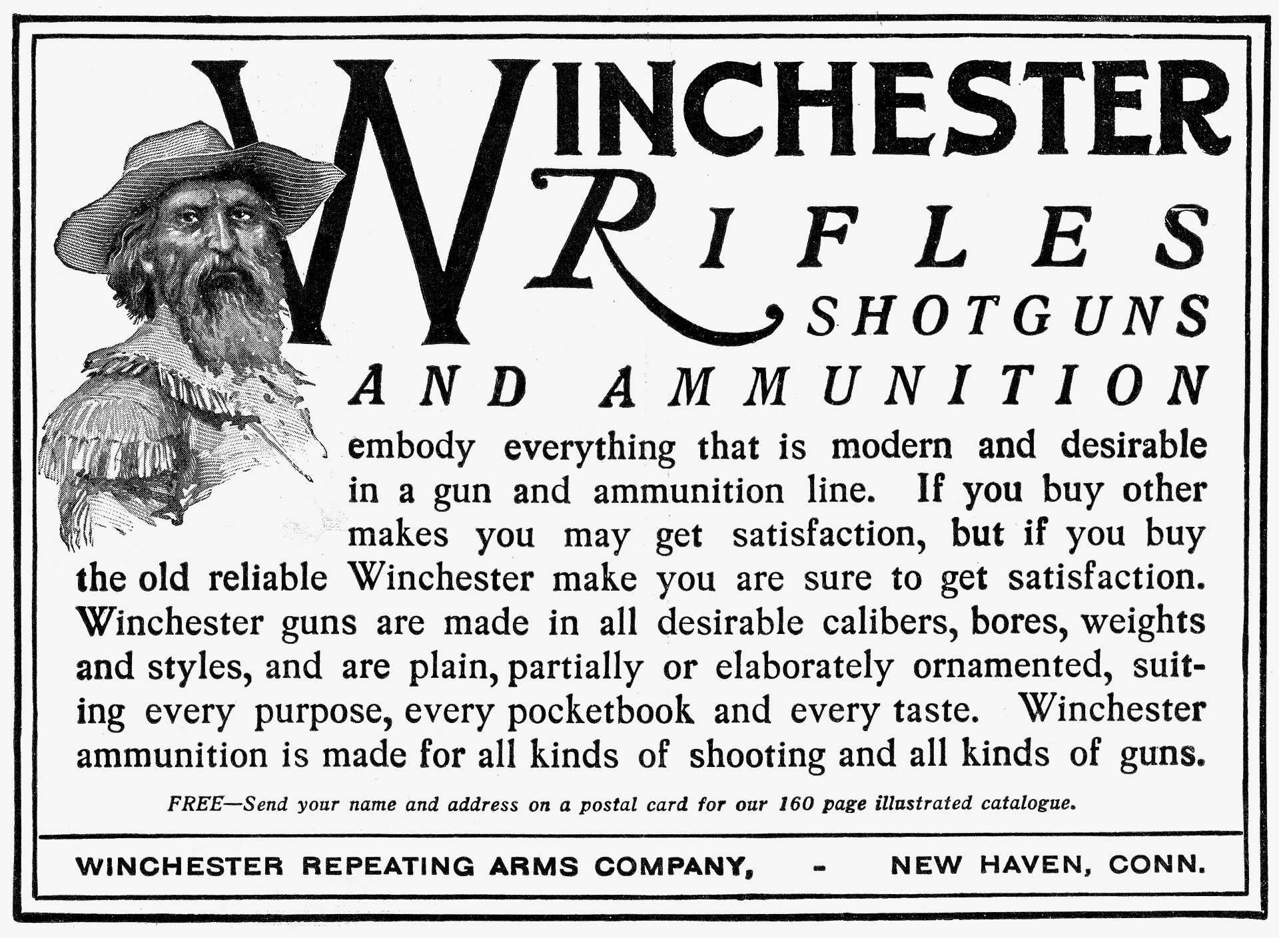
Winchester: The Making of a Heritage Brand & Its Consumer Communities
by
Terrence H. Witkowski
California State University, Long Beach
To be presented at the 2015 Consumer Brand Relationships Conference, Porto, Portugal, May 21-23.

Slide 2
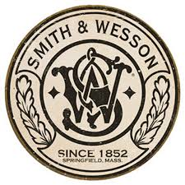
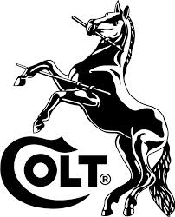
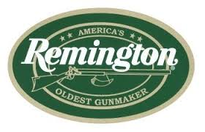
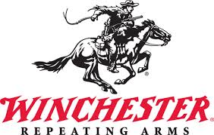
Introduction
Communities of consumers have formed around heritage brands of American firearms – Colt, Remington, Smith & Wesson, & Winchester.

Slide 3
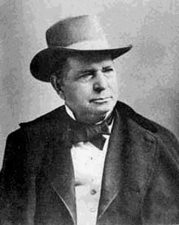
Introduction
This study focuses on the firearms company, product line, & brand named after Oliver F. Winchester in 1866.
Winchester rifles have been associated with great events in U.S. history, especially the settlement of the West & both world wars.
Model 1866 rifle; Oliver F. Winchester (1810-1880)

Slide 4
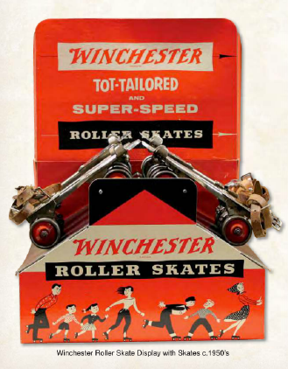
Introduction
Since the 1880s, Winchesters have been referenced in dime novels, motion pictures, television, & other popular culture media.
The brand has aroused acquisitive impulses among collectors & has motivated research & writing on
Winchester firearms & related products as collectible artifacts
the company’s business history.
Winchester’s many branded items included roller skates in the 1950s.

Slide 5
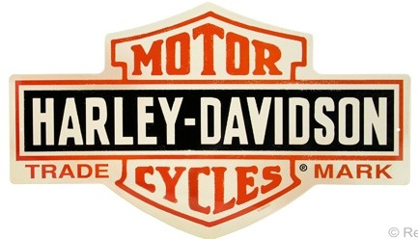
Research Aims
Bring historical perspective to research on consumer brand relationships.
Heritage brands & their consumer communities have had histories well worth studying.
History is embedded in heritage brands & in their customer brand relationships.
The Harley-Davidson bar & shield logo was first used in 1910 & trademarked the following year.

Slide 6
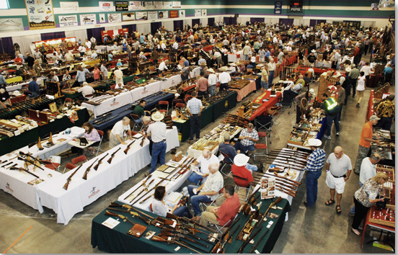
Research Aims
Learn how heritage brands & their communities have affected & have been affected by their social contexts.
Study firearms brand communities as an ingredient in American consumer culture.
A Winchester gun show

Slide 7
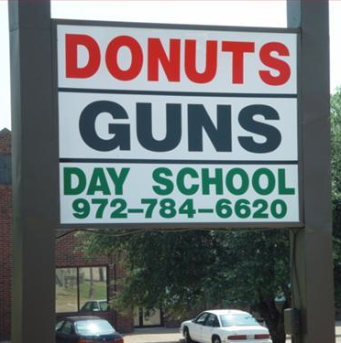
What the Research is Not About
This study does not purport to advance the marketing management interests of Winchester or the firearms industry. The U.S. already has more guns than any other nation (Karp 2007).

Slide 8
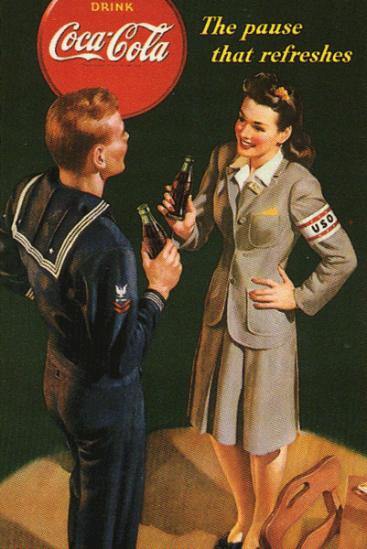
Heritage Brands
Marketed over many years
Connected to historical events
Referenced in the popular culture media over time
World War II Coca Cola ad

Slide 9
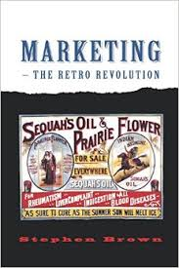
Heritage Brands
Similar but not identical to retro brands & retro marketing (see Brown, Kozinets & Sherry 2003).
History & heritage are different –the former seeks to inquire into the past, whereas the latter celebrates it & uses it to serve present purposes.

Slide 10
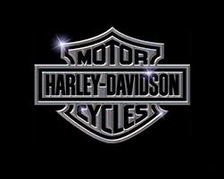
Types of Consumer Communities
Brand communities – shared consumer consciousness & experiences with brand (Muniz & O’Guinn 2001).
Subcultures of consumption – more activity focused & with outsider status (Schouten & McAlexander 1995)
Consumer tribes – more transient & hedonic (Canniford 2011)

Slide 11
Data Sources
Literature on brands & CBR.
Literature catering to Winchester collectors & historians.
Primary visual data gathered from period ads, promotional ephemera, photographs, movies & television
Visual data accessed via Google searches & Internet Movie Firearms Database.
Terrence H. Witkowski – 2015 CBR Conference

Slide 12
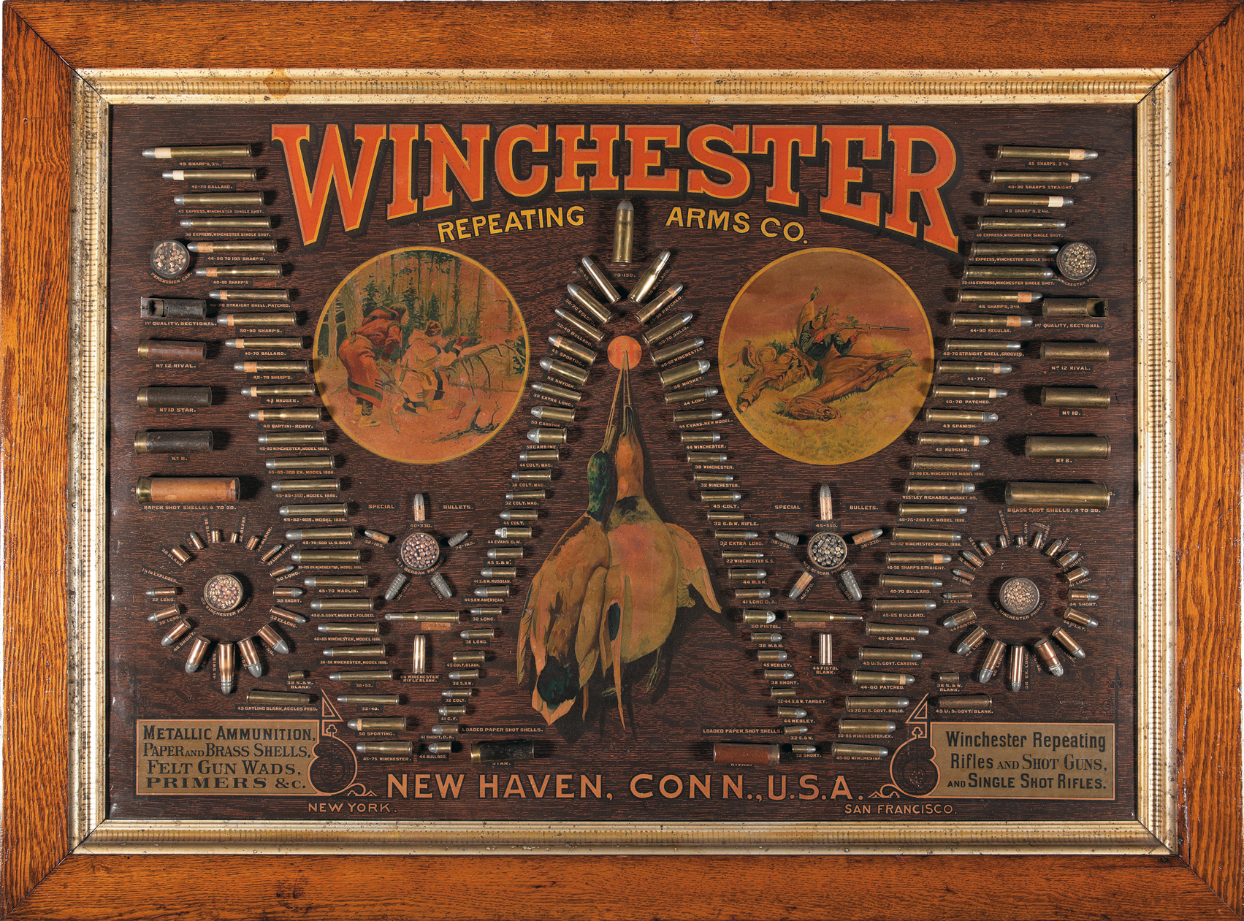
Winchester Brand & Promotional History
Winchester brand promotion began with its sales organization consisting of salesmen, who called on jobbers (wholesalers), & missionaries, who called on dealers & retailers (Williamson 1952).
Promotional cartridge board, ca. 1885. This specimen was sold for $31,652 on September 7, 2012 by Rock Island Auction.

Slide 13
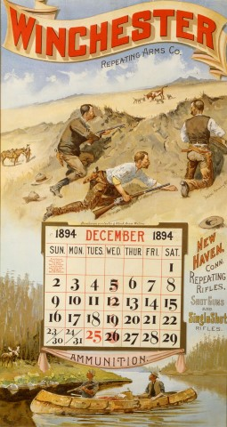
Winchester Calendar, 1894
Winchester calendar showing ranchmen protecting cattle from wolves (top) & being surprised by a moose (below). Chromolithograph on paper with original art by Frederic Remington, ca. 1894. Source: Buffalo Bill Center of the West (2014).

Slide 14
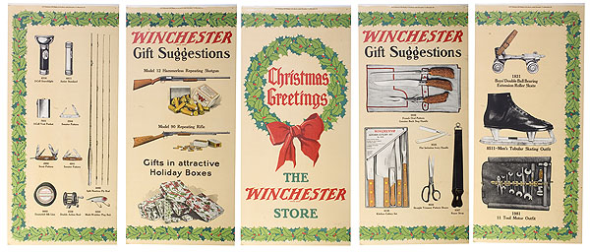
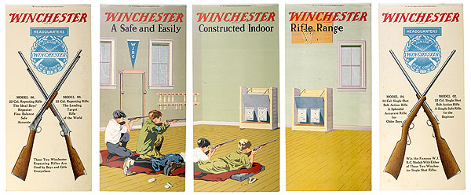
Winchester Five-Panel Window Displays, 1920s
Winchester directed dealers to display the Christmas gifts side for the weeks of December 7-25, 1925.
The Junior Rifle Corps side was to be displayed December 26-January 4, 1926.

Slide 15
Winchester Five-Panel Window Displays
How a display looked in a Winchester store window. Source: Williamson (1952), p. 352.

Slide 16
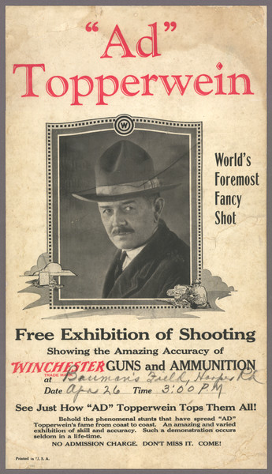
Winchester Brand & Promotional History
Winchester further spread its fame by employing expert marksmen & women to garner publicity for its guns.
Winchester broadsides & print ads date to as early as 1868.

Slide 17
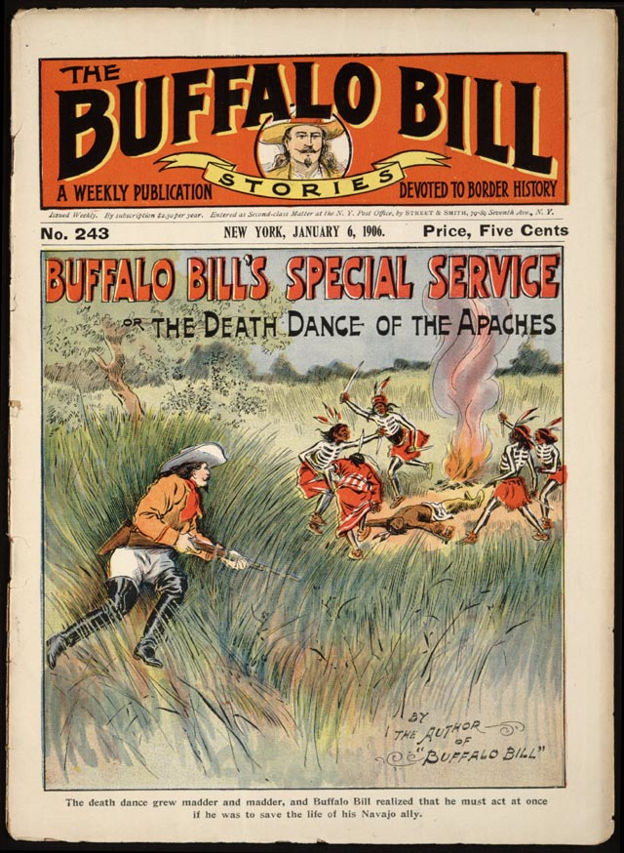
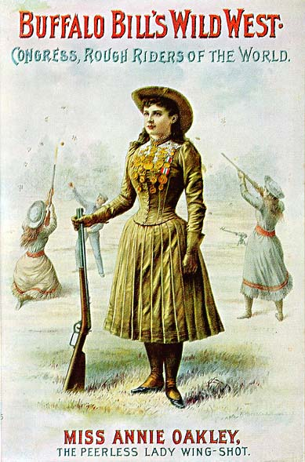
Winchester Cultural References
Celebrities William F. “Buffalo Bill” Cody & Annie Oakley used & promoted Winchesters, ca. 1900.

Slide 18
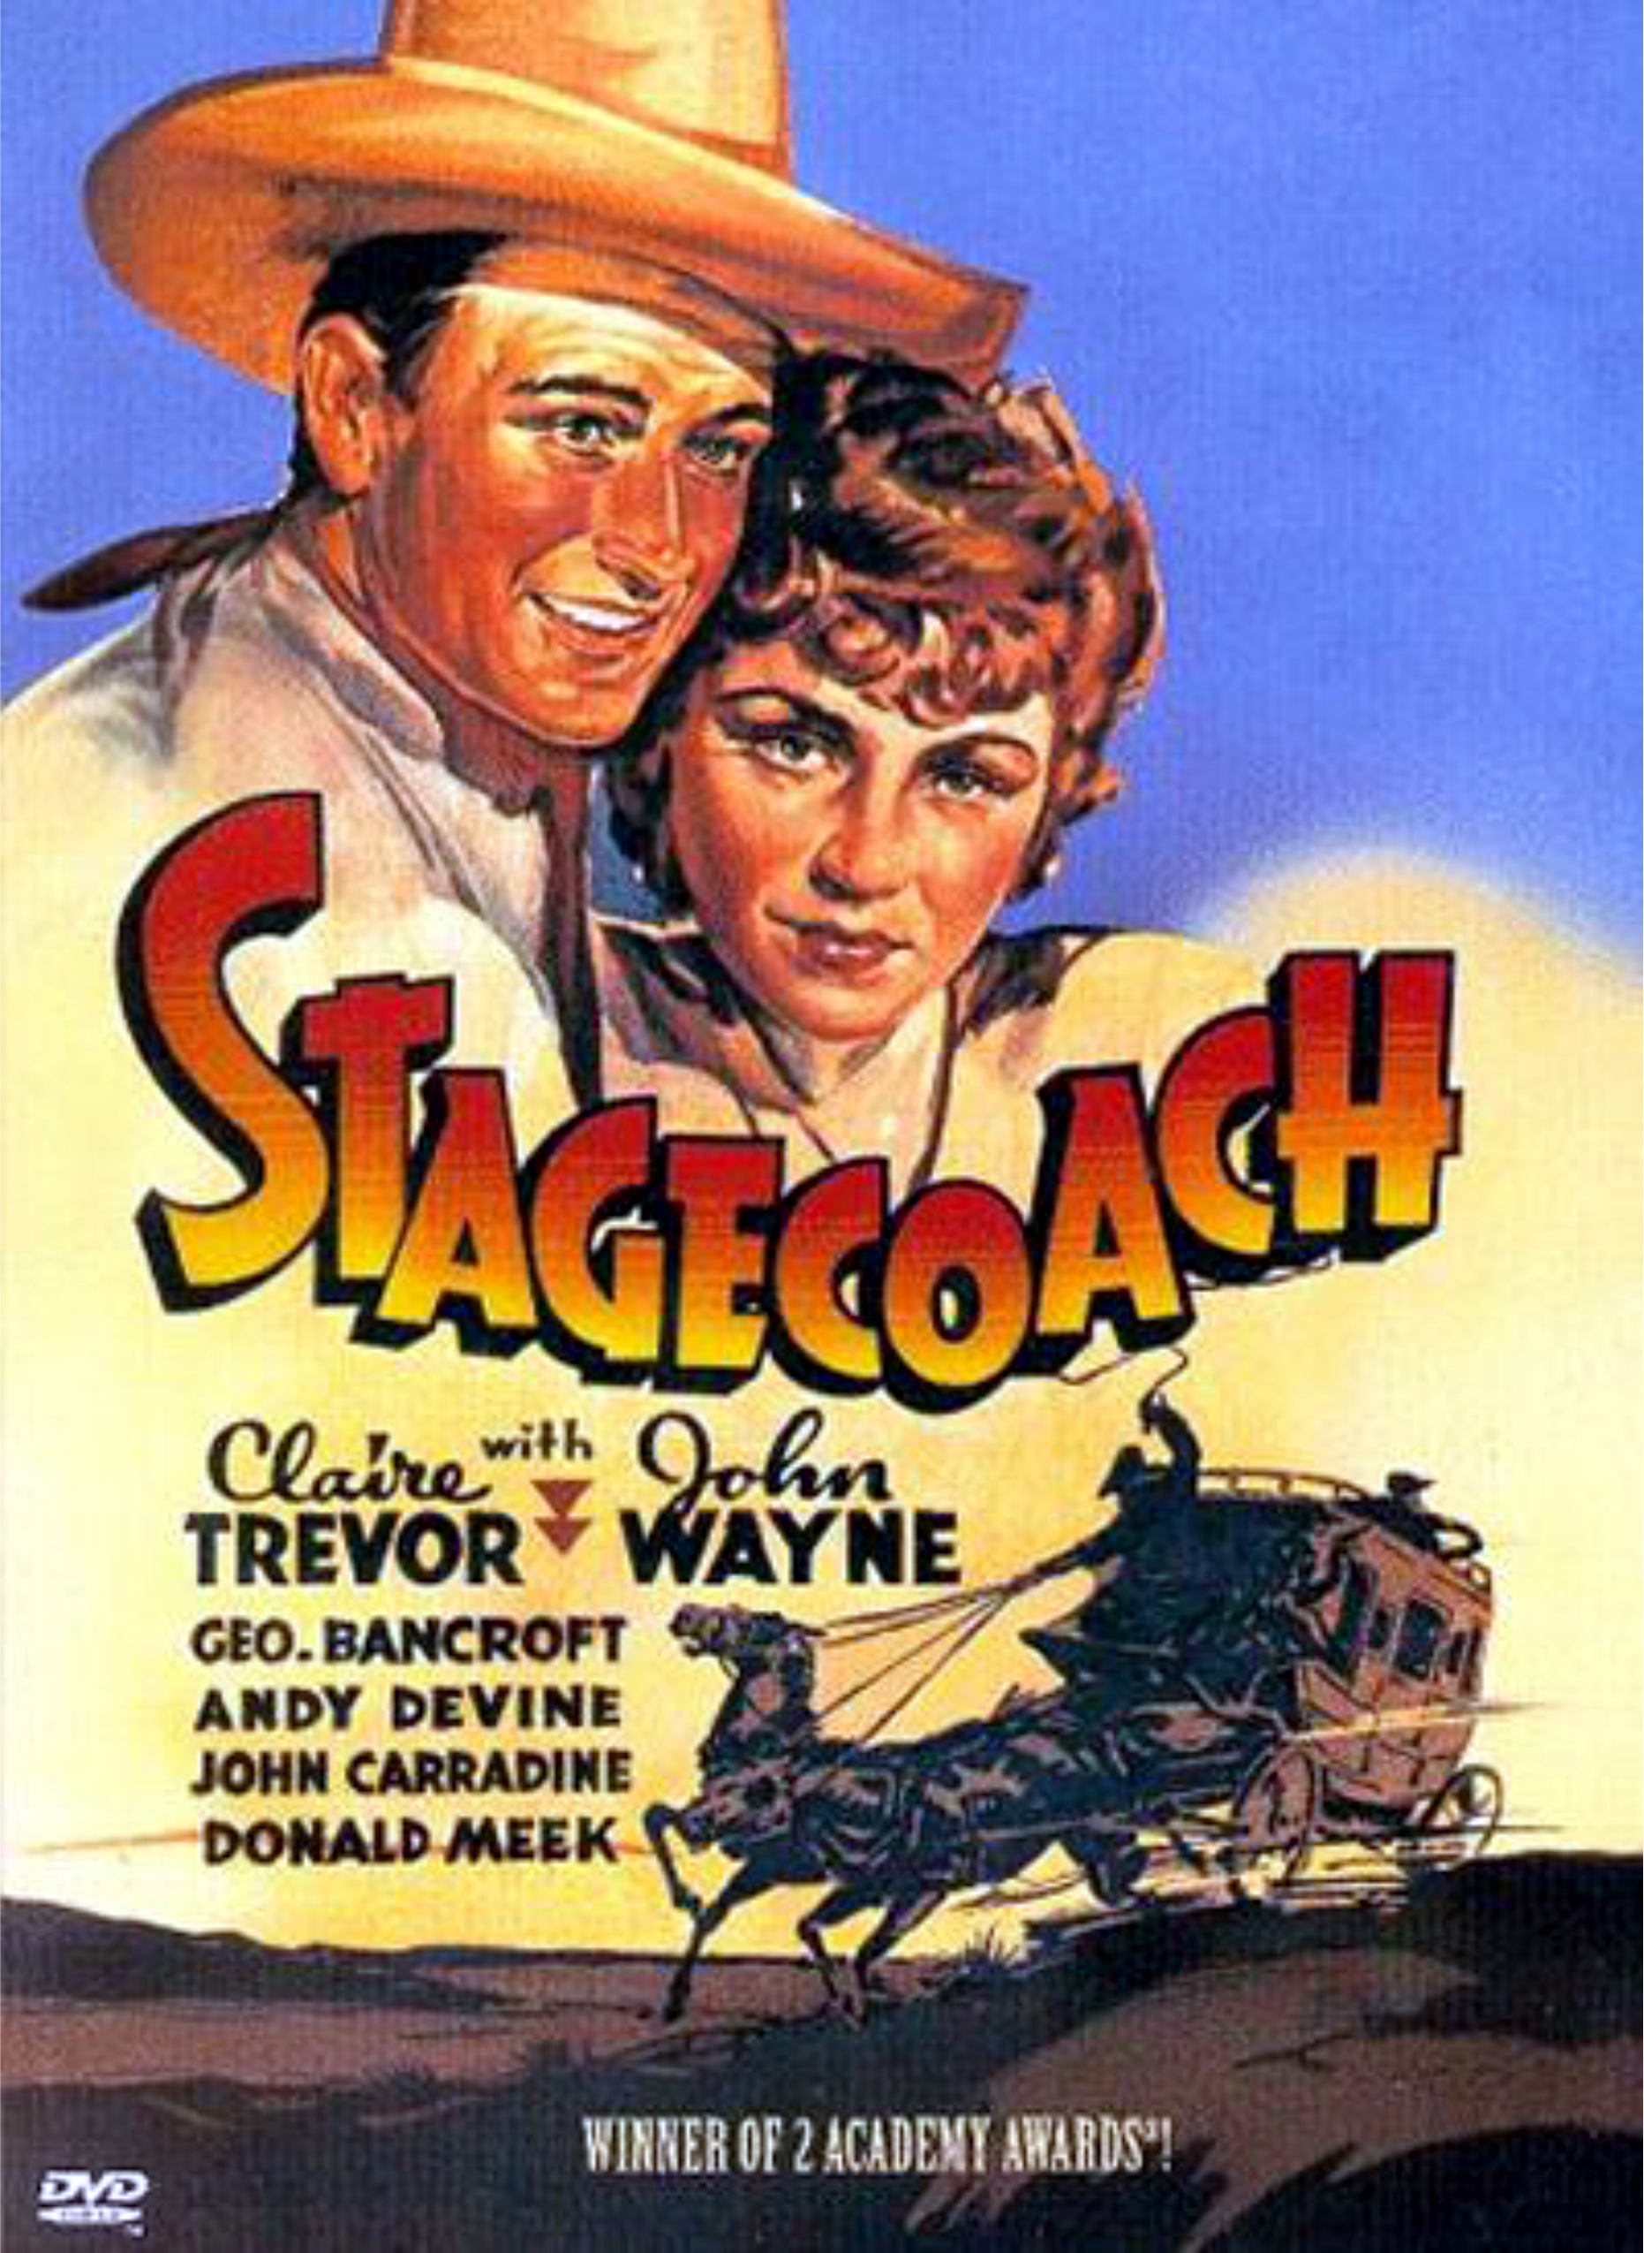
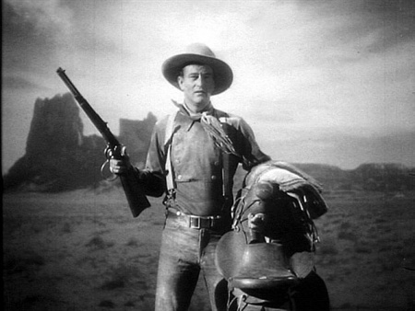
Winchesters in Films
John Wayne as the Ringo Kid in Stagecoach (1939). Directed by John Ford, this was Wayne’s breakthrough role.

Slide 19
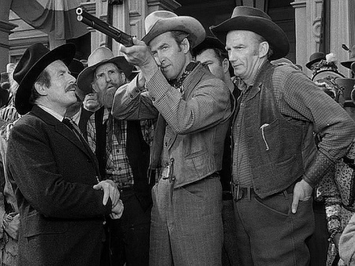
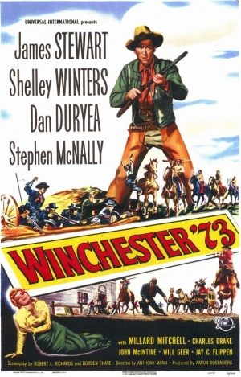
Winchesters in Films
Lin McAdam (Jimmy Stewart) takes aim with the custom rifle he won in Winchester ’73 (1950).

Slide 20
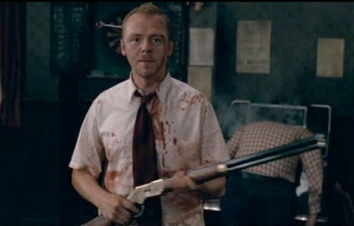
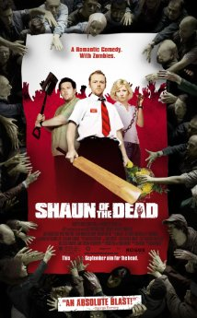
Winchesters in Films
In Shaun of the Dead (2004) Shaun (Simon Peg) makes a last stand against marauding zombies with a Model 1866 found in “The Winchester,” a London pub.

Slide 21
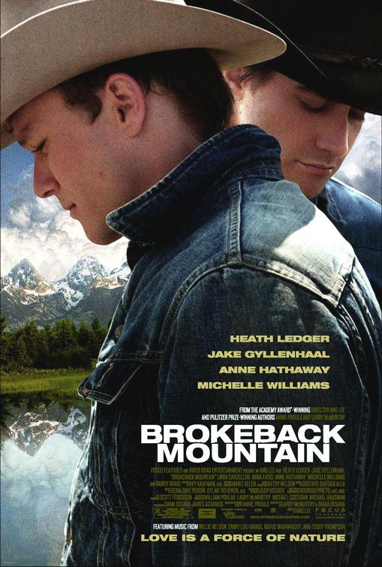
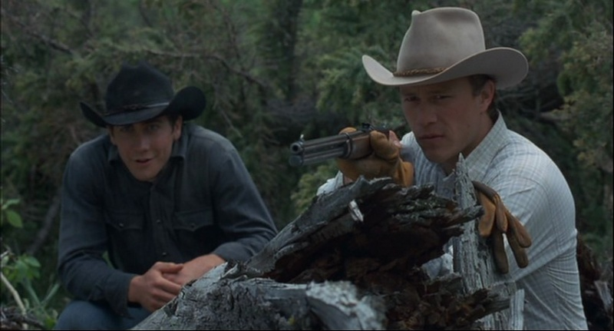
Winchesters in Films
Jake Gyllenhaal as Jack Twist & Heath Ledger as Ennis Del Mar in Brokeback Mountain (2005). Directed by Ang Lee, this gay western won three Academy Awards.

Slide 22
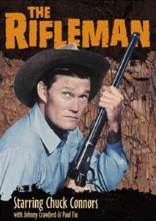
Winchester on Television
Chuck Connors in The Rifleman (ABC, 1958 – 1963)
Rifleman Clip

Slide 23
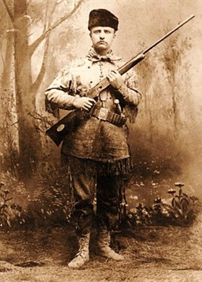
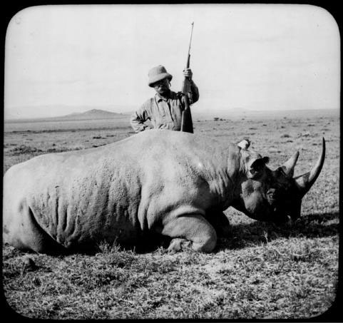
Winchester Brand Communities
President Theodore Roosevelt with Winchesters: as a young man in 1885 (l.) & on safari in 1909 (r.)

Slide 24
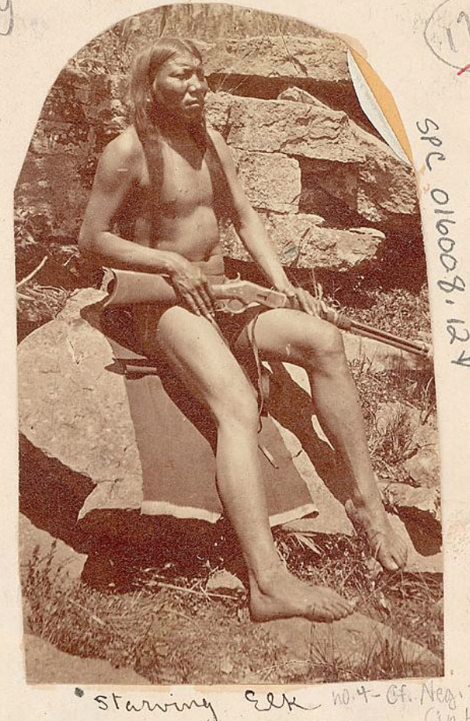
Winchester Brand Communities: Native Americans
Cheyenne Indian with Winchester rifle. Taken near Okmulgee, Oklahoma Territory, May 10, 1875 by John K. Hillers (1843-1925). Source: National Anthropological Archives Smithsonian Institution.

Slide 25
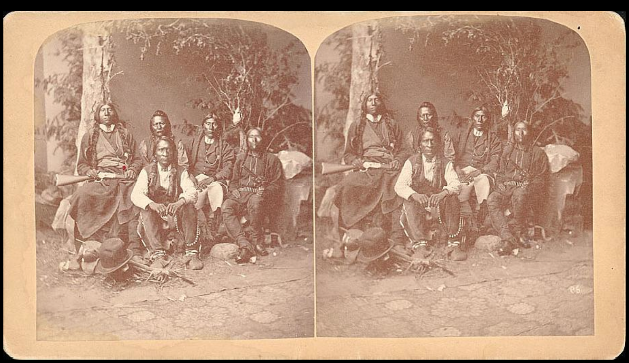
Winchester Brand Communities: Native Americans
Stereograph of Ute Indians visiting “Denver of Little Crow.” Taken in 1885 by Alexander Martin (1841-1929). Source: National Anthropological Archives, Smithsonian Institution.

Slide 26
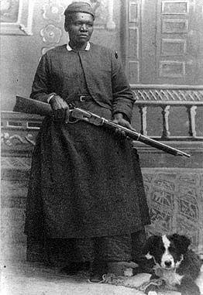
Winchester Brand Communities: African Americans
Mary Fields and her Winchester Model 1876 carbine, circa 1895. Source: http://www.blackcowboys.com/maryfields.htm

Slide 27
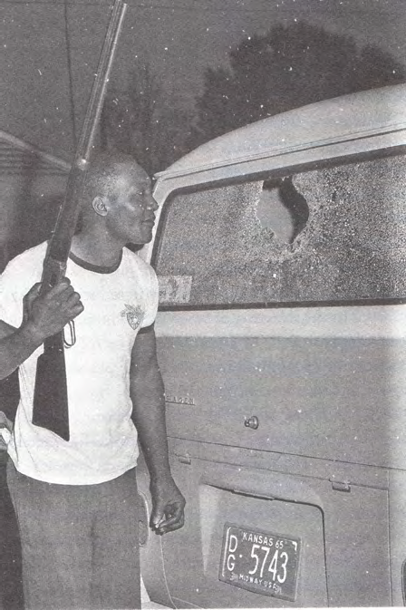
Winchester Brand Communities: African Americans
Robert Hicks & Winchester rifle surveying damage following late night attack in Bogalusa, Louisiana, 1965. He organized a local chapter of “Deacons for Defense,” an armed African-American civil rights group. Source: AP photo from Johnson (2014).

Slide 28
Winchester Arms Collectors Association (WACA)
Founded in 1977.
About 2000 members, mostly older, conservative, white males.
Sponsors a quarterly publication, The Winchester Collector
Hosts gun shows in Cody, Wyoming, the home of the Buffalo Bill Center of the West, a complex of five museums

Slide 29
Winchester Brand Communities: Collectors
Upper half of Winchester Arms Collector Association website. The frame underneath rotates to feature the gun show, Winchester online store, etc. Source: http://winchestercollector.org.

Slide 30
Implications for CBR Research
Consumer brand relationships depend upon cultural context.
Some cultural elements are relatively unchanging, e.g., American support for & ownership of firearms.
Other cultural contexts change over time, e.g., declining interest in big game hunting & display of trophy animals.
Cultural contexts influence the meanings & associations consumers attribute to brands.

Slide 31
Implications for CBR Research
Consumer relationships with heritage brands result from three different historical processes.
CBR intertwined with the company driven history of the brand including the evolution of the product itself, its promotional support, & the events that occurred during its past.
CBR is affected by the history of cultural references to a brand. Cultural references appear largely in popular media & do much to transmit the heritage of the brand over time.
Brand communities, consumption subcultures & consumer tribes also have a history. They take on different forms, e.g. users versus collectors, & stress different brand meanings over time.

Slide 32
Implications for CBR Research
Studies of consumer brand relationships in marketing & consumer research are largely ahistorical & of the moment, aiming to contribute to theory development.
Yet, heritage brands, cultural references, & consumer communities are perpetually in flux because of changing technological, economic, & social conditions.
This raises questions about the validity & reliability of consumer brand relationship theory & research set entirely in the here and now.

Slide 33
Thank You!
Questions?

