Slide 1
The role of in-store actions in building
consumer-brand relationships
Sarah Mussol
Philippe Aurier
Gilles Séré de Lanauze
Montpellier University

Slide 2
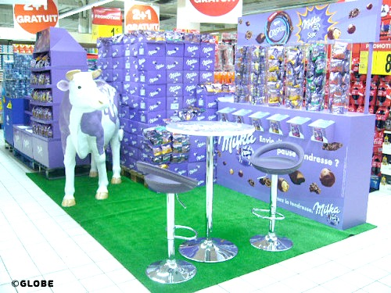
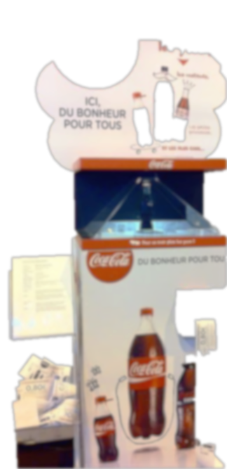
Origin of the
research
Conceptual foundations
Method
Results
Discussion
Hypotheses
Empirical statement
Theoretical statement
Promotions :
Few relational studies
Relationship marketing :
Few studies about in-store marketing
Role of in-store actions in consumer-brand relationships

Slide 3
Origin of the
research
Conceptual foundations
Method
Results
Discussion
Hypotheses
Relationship marketing
Consumer-brand relationship
2 interdependent parts: consumer and brand
Series of unique interactions (Fournier, 1998)
Trust and commitment (Morgan and Hunt, 1994)
Attribution theory
Relationship marketing benefits attributes to the entity controlling their implementation
Feelings of gratitude →reciprocity (Palmatier and al., 2007)
Relational investment
Brand expression: willingness and ability of the brand to develop relationship with its customers
Individualization, reciprocity, long-term perspective (Aurier and Lanauze, 2011)

Slide 4
Origin of the
research
Conceptual foundations
Method
Results
Discussion
Hypotheses
In-store marketing
Shopping experience
Store: point of contact, interactions with staff
Aesthetic, playful value, price efficiency (Habib 2011)
Perceived benefits of in-store actions
Perceived value of the contact with an action as well as its usage (Keller 2008)
Utilitarian: savings, higher product quality, improved shopping convenience
Hedonic : opportunities for value expression, entertainment, exploration (Chandon and al., 2000)
Actions as facilitator media
Congruence between type of actions and benefits
Interactivity (Debos, 2007)

Slide 5
Origin of the
research
Conceptual foundations
Method
Results
Discussion
Hypotheses
Respondents exposed to a relational action perceive higher brand efforts (H1)
Respondents exposed to a relational action are more attached to the brand, identify more to the brand (H2), trust more the brand (H3)
Respondents exposed to a relational action perceive less functional benefits (H4), perceive more relational benefits (H5), perceive more entertainment benefits and more exploration benefits (H6)
Perceived brand expression
Perceived benefits
Relationship quality
Type of action
Exploration
Trust
Entertainment
Commitment
Relational
Functional

Slide 6
Origin of the
research
Conceptual foundations
Method
Results
Conclusion
Hypotheses
Experimental method
Online questionnaire
Ice cream – 4 brands
Exposition to a in-store action
Measure of the main relational constructs: trust, commitment (attachment and identification, brand perceived
812 consumers
203 exposed to price reduction
205 to a tasting
203 to a game
201 to a lottery
Multivariate variance analysis

Slide 7
Origin of the
research
Conceptual foundations
Method
Results
Conclusion
Hypotheses
Stimuli
TRANSACTIONAL ACTION | Price reduction | 20% of price reduction distributed by a machine in store
Behind a Ben & Jerry’s stand, a machine offers you the possibility to play a game that consists in voting for the future ice cream taste of the brand.
RELATIONAL ACTION | Tasting | Ice cream tasting through a machine in store
 | Game | Game through a machine in store
 | Lottery | Lottery through a machine in store
Behind a Ben & Jerry’s stand, a machine offers you the possibility to print a coupon to receive a 20% price reduction during check out.

Slide 8
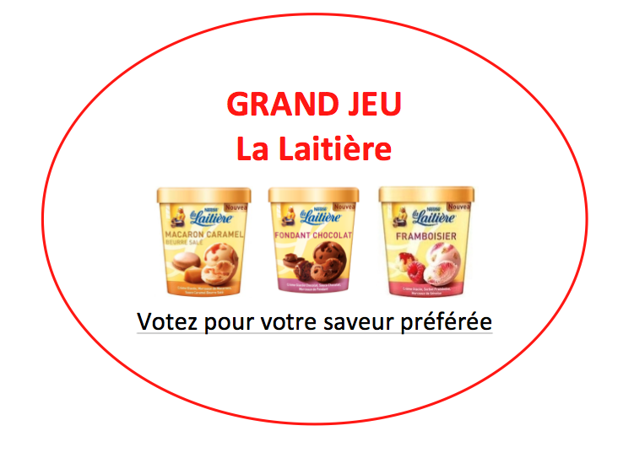
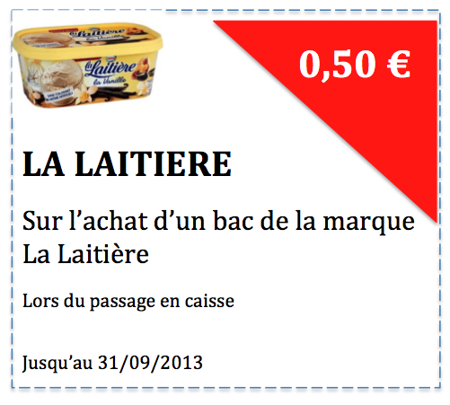
Origin of the
research
Conceptual foundations
Method
Results
Discussion
Hypotheses
Multivariate analysis results
 | Format of action
 | M_{transac} | M_{relat} | p
Functional benefits | 4.17 | 2.73 | **
Relational benefits | 2.44 | 2.87 | **
Entertainment benefits | 3.57 | 4.50 | **
Exploration benefits | 3.85 | 4.66 | **
Brand perceived expression | 3.45 | 3.62 | **
Trust | 4.63 | 4.69 | 0.430
Attachment | 3.03 | 3.18 | 0.171
Identification | 2.15 | 2.34 | *
REDUCTION
DEGUSTATION

Slide 9
Origin of the
research
Conceptual foundations
Method
Results
Discussion
Hypotheses
Main results
H1 validated: Respondents exposed to a relational action perceive higher brand efforts
H2 partially validated: Respondents exposed to a relational action identify more to the brand
H3 not validated
H4,H5,H6 validated: Congruence between type of action and type of benefits
Games and tastings: develop in-store consumer-brand relationships,through commitment
Promotions: functional benefits, no negative effect on trust

Slide 10
Origin of the
research
Conceptual foundations
Method
Results
Discussion
Hypotheses
Contributions
Theoretical
Managerial
Methodological
Brand expression manifested through in-store actions
Creation of brand experience in-store
Measurement scales
Identification to the values of the brand
Type of actions to implement
Validation relational benefits

Slide 11
Origin of the
research
Conceptual foundations
Method
Results
Discussion
Hypotheses
Limits
Perspectives
Online questionnaire
In-store experimental study
Unique category
Non alimentary products
Study of the relationship at instant t
Definition of relational

