Slide 1
Why do consumers hate your brand?
S. Umit Kucuk, PhD
City University of Seattle

Slide 2


Slide 3


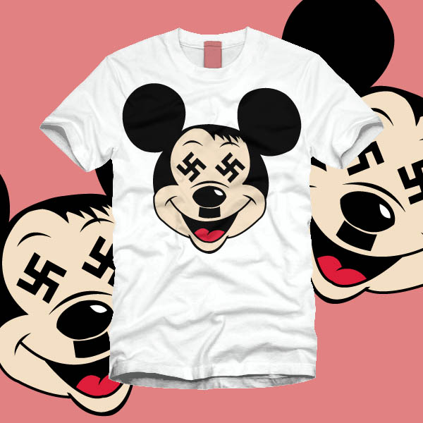

Slide 4
Why Consumer ‘Brand Hate’ (BH) Now?
  High Expectations(Kucuk 2009; Gregoire, Tripp and Legoux 2009)
  Easy to Complain (Wu 1999, Kucuk 2008)
  Consumer Power (Kucuk and Krishnamurthy 2007; Cherrier 2009)

Slide 5
What Triggers Consumer ‘Brand Hate’ (BH)?
    (Kucuk 2009; Krishnamurthy and Kucuk 2009; Kucuk 2015)
Social Level:
    the difference between consumers and companies in terms of a company’s stand on social, ideological, and business issues
(CSR Literature)
Individual Level:
  Service Failures
    (Consumer Complaint Literature)

Slide 6
What Triggers Consumer ‘Brand Hate’ (BH)?
Corporate Social Responsibility (CSR)
  the lack of CSR efforts as an indicator of social level consumer-company conflict—defined as corporate social irresponsibility
  (Sen and Bhattacharya, 2001; Bhattacharya and Sen, 2003; Gurhan-Canli and Batra, 2004; Luo and Bhattacharya, 2006; Sweetin et al 2013).
Consumer Complaint (CC)
  the lack of satisfactory consumer service supports as a leading-indicator of consumer dissatisfaction and complaints
  (Harrison-Walker, 2001; Ward and Ostrom 2006; Sen and Lerman, 2007; Kucuk 2008; Gregoire, Tripp and Legoux, 2009; Zhu and Zhang, 2010; Kucuk, 2010; Tripp and Gregoire, 2011).

Slide 7
Hypothesis
Direct Effects
H₁: Brands with low favorable CSR initiatives can expect to receive more consumer anti-branding activities.
H₃: Consumer complaints can directly lead to consumer anti-branding activities.
Mediated Effects (Interactions)
H₂: Brands with low favorable CSR initiatives can lead to consumer anti-branding through mediating and interacting with consumer complaints.

Slide 9
Data Collection Process:
Business Week’s Top 100 Most Valuable Brand list in both 2005 and 2009 (n=57 only US brands)
CSR Measure: Number of times listed in CRS Magazine Best Corporate Citizen list (btw 2002-2005 and 2006-2009)
CC Measure: Number of Complaints counted in Complaint.com (chronological depth--also used by Harrison-Walker, 2001)
BH Measure: Number of Anti-Branding websites, blogs, social networking sites (Kucuk, 2008; 2010)

Slide 11
Data Analysis
Aiken and West (1991)’s Ŷ = b₀+ b₁X+b₂Z+b₃XZ
E (AB) = b₀ +b₁CSR+b₂CC+b₃ (CC by CSR)
Correlations are partialed out by using the Gram-Schmidt orthogonalizing process to prevent possible multicollineary problems.
As a result of this process, correlations among the independent variables are almost zero (e.g. 1.31E⁻¹⁶; 1.15E⁻¹⁶; etc.). Thus, no multicollinearity problem detected.

Slide 13
Findings
  H₁ is rejected, but there is no evidence to reject the corresponding H₂ and H₃
  In other words, there is no direct link between CSR and Brand Hate. However, CSR effects can partially be observed with mediating effects of consumer complaints (CC) on Brand Hate.
There is direct link between CC and Brand Hate

Slide 14
Conclusion:
This is the first study reveals that there is a negative relationship between CSR and consumer brand hate mediated by consumer dissatisfaction.
In other words, companies with low CSR initiatives and a greater number of consumer complaints will be among “the most hated brands” in the markets.
Conversely, companies with low consumer complaints and high level of CSR initiatives’ brands are the ones likely to be “the most loved brands” in the markets

Slide 15
Managerial Issues

Slide 17
THANK YOU!
Contact:
sukucuk.research@gmail.com

